Slide 1




What are some ‘other summery statistics’ that can be seen in everyday circumstances and how can we analyse them?
Control Charts
What are control charts and how do we use them to assess quality control?

Slide 2

What are some ‘other summery statistics’ that can be seen in everyday circumstances and how can we analyse them?
Vocab | Mathematical Definition
Warning | a statement or event that warns of something or that serves as a cautionary example
Action | the fact or process of doing something, typically to achieve an aim.
Limit | a point or level beyond which something does not or may not extend or pass
Cross-Curricular Link | In 2024 there were over 20 000 jobs in industry which were related to quality assurance such as Site QC Civil Engineer, Quality Assurance officer and Technical Quality Lead
What are control charts and how do we use them to assess quality control?

Slide 3
What are some ‘other summery statistics’ that can be seen in everyday circumstances and how can we analyse them?
The Knowledge Phase
Statistical process control may be used when a large number of similar items are being produced.
Its purpose is to give a signal when the process mean has moved away from the target value or when item-to-item variability has increased.
The most common method of statistical process control is to take samples at regular intervals and to plot the sample mean on a control chart
A Control Chart is a graph used to study how a process changes over time with data plotted in time order. Means and ranges of samples are plotted on a control chart are plotted and the position on the graph determines the next step in the process
UPPER ACTION LIMIT
UPPER WARNING LIMIT
TARGET VALUE
LOWER WARNING LIMIT
LOWER ACTION LIMIT
What are control charts and how do we use them to assess quality control?

Slide 4
What are some ‘other summery statistics’ that can be seen in everyday circumstances and how can we analyse them?
If the sample mean lies between the warning limits | → | no action to be taken
If the sample mean is between a warning and action limit | → | take another sample immediately If new sample mean outside warning limits then take action
If the sample mean is outside of the action limits | → | take action immediately
What are control charts and how do we use them to assess quality control?

Slide 5
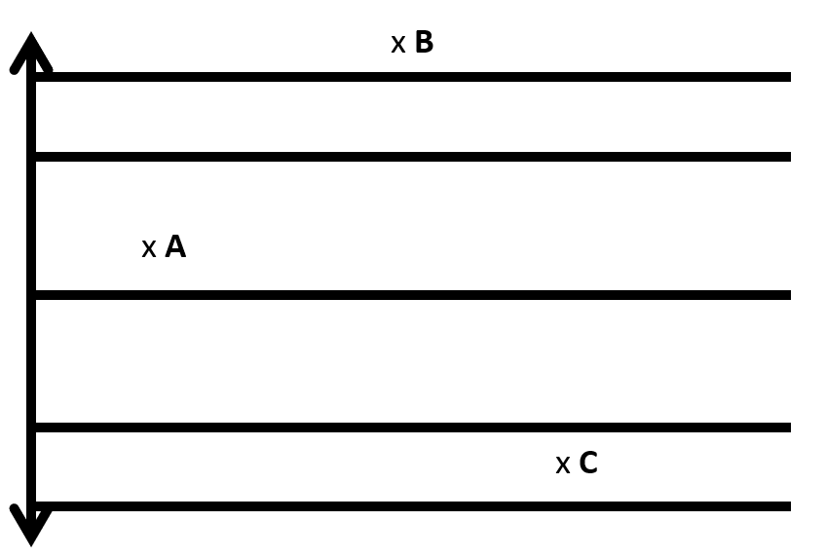
What are some ‘other summery statistics’ that can be seen in everyday circumstances and how can we analyse them?
WE DO
The sample means for A, B and C have been marked on the control chart below
Identify what action (if any) needs to be taken for each sample
What are control charts and how do we use them to assess quality control?

Slide 6
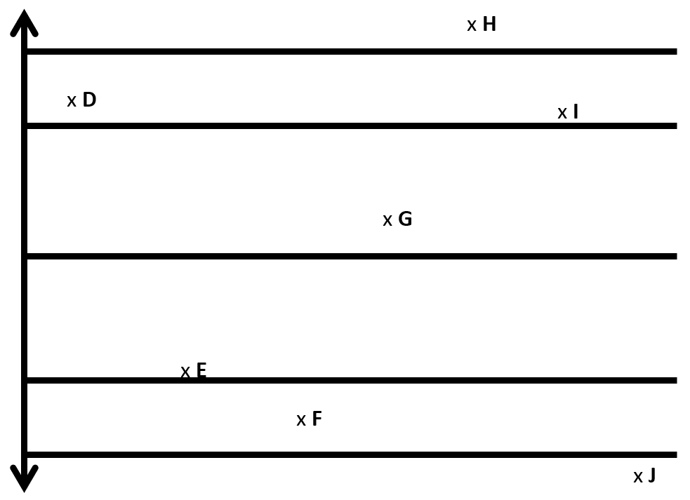
What are some ‘other summery statistics’ that can be seen in everyday circumstances and how can we analyse them?
Skills Check
What are control charts and how do we use them to assess quality control?

Slide 7
What are some ‘other summery statistics’ that can be seen in everyday circumstances and how can we analyse them?
Setting the Limits
The warning and action limits are not drawn at random but calculated using the following formulae:
The warning limits are set at:
μ ± 2σ
95% of the data should lie within the warning limits
The action limits are set at:
μ ± 3σ
99.8% of the data should lie within the warning limits
What are control charts and how do we use them to assess quality control?

Slide 8
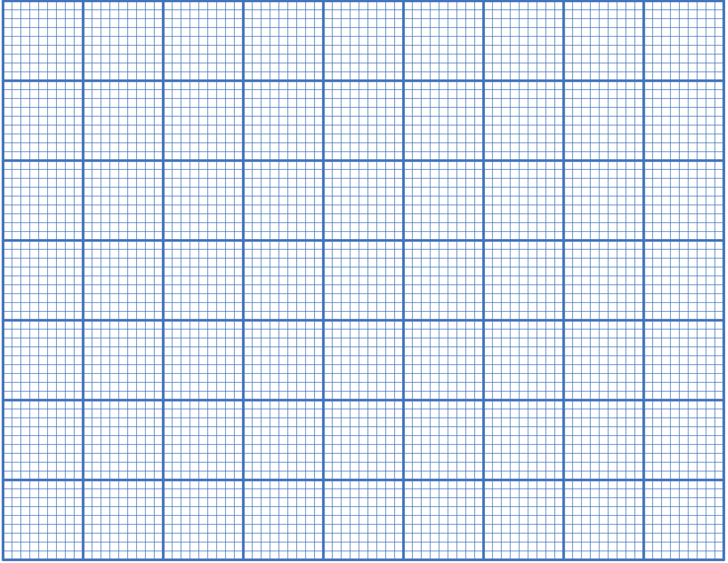
What are some ‘other summery statistics’ that can be seen in everyday circumstances and how can we analyse them?
WE DO
A machine filling packets of breakfast cereal is known to operate with a
standard deviation of 3g. The target is to put 500g of cereal in each
packet. Production is to be controlled by taking four packets at regular
intervals and weighing their contents
(a) Set up control charts for means
(b) What action, if any, would you recommend if the next sample weighed:
(i) 50 497 499 496
(ii) 501 491 492 492
(iii) 502 500 507 505
(iv) 500 502 505 501?
What are control charts and how do we use them to assess quality control?

Slide 9


What are some ‘other summery statistics’ that can be seen in everyday circumstances and how can we analyse them?
Practise Questions
Exam Questions
What are control charts and how do we use them to assess quality control?

Slide 10

What are some ‘other summery statistics’ that can be seen in everyday circumstances and how can we analyse them?
MWB ACTIVITY
What are control charts and how do we use them to assess quality control?

