Slide 1




What are some ‘other summery statistics’ that can be seen in everyday circumstances and how can we analyse them?
Population Averages
How do we calculate population averages and what do they mean?

Slide 2

What are some ‘other summery statistics’ that can be seen in everyday circumstances and how can we analyse them?
Vocab | Mathematical Definition
Crude | Lacking in taste, tact or refinement; vulgar; a crude joke in a natural or unrefined state
Rate | assign a standard or value to (something) according to a particular scale
Real World Application | Crude death rates were regularly reported to the world via news channels and government reports during the COVID-19 pandemic in 2020-2021 The global crude death rate in 2016 was 7.6, and in the United States, the rate was 8 per 1,000. The crude death rate for the world has been on the decline since 1960 when it came in at 17.7.
How do we calculate population averages and what do they mean?

Slide 3
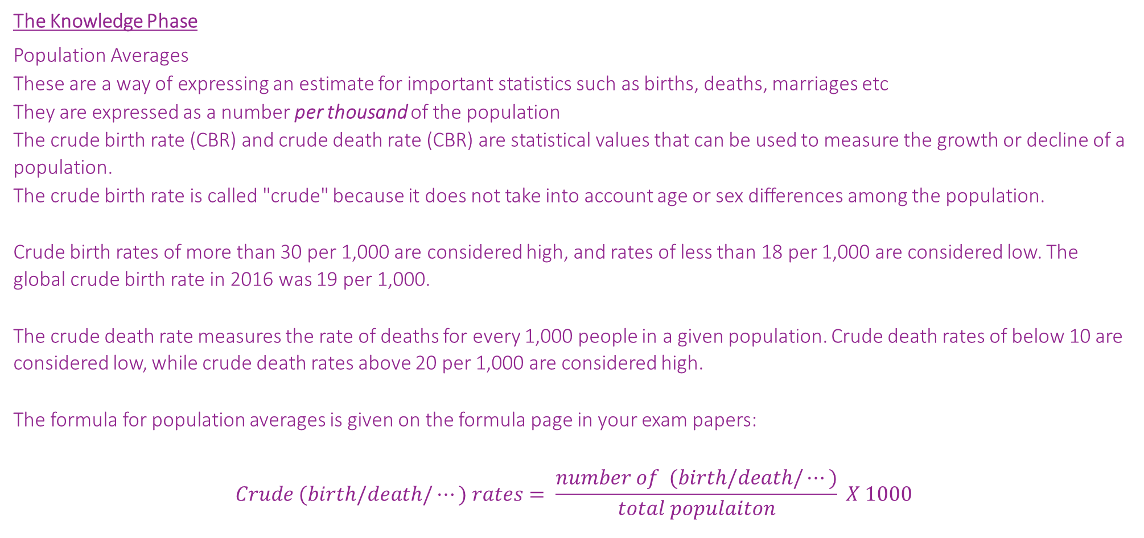
What are some ‘other summery statistics’ that can be seen in everyday circumstances and how can we analyse them?
The Knowledge Phase
Population Averages
These are a way of expressing an estimate for important statistics such as births, deaths, marriages etc
They are expressed as a number per thousand of the population
The crude birth rate (CBR) and crude death rate (CBR) are statistical values that can be used to measure the growth or decline of a population.
The crude birth rate is called "crude" because it does not take into account age or sex differences among the population.
Crude birth rates of more than 30 per 1,000 are considered high, and rates of less than 18 per 1,000 are considered low. The global crude birth rate in 2016 was 19 per 1,000.
The crude death rate measures the rate of deaths for every 1,000 people in a given population. Crude death rates of below 10 are considered low, while crude death rates above 20 per 1,000 are considered high.
The formula for population averages is given on the formula page in your exam papers:
$$Crude (birth/death/…) rates= \frac{number of (birth/death/…)}{total populaiton} X 1000$$
How do we calculate population averages and what do they mean?

Slide 4
What are some ‘other summery statistics’ that can be seen in everyday circumstances and how can we analyse them?
I DO
The incomplete table gives some information about the number of births in the USA, the total population of the USA and the crude birth rate for the USA in 1960 and in 2021.
Calculate the missing values from the table
Year | Births | Population | Crude rate
1960 |  | 179.3 mill | 23.7
2021 | 3659289 | 331.9 mil
WE DO
The population in Beechfield in 2018 was 21,287.
111 babies were born that year and 128 people died.
The population in Oakfield in 2018 was 61,179.
259 babies were born that year and 312 people died.
Calculate and compare the crude death rate for the two towns
How do we calculate population averages and what do they mean?

Slide 5
What are some ‘other summery statistics’ that can be seen in everyday circumstances and how can we analyse them?
YOU DO
There are 384 deaths in the town of Antsville, which has a population of 16 000.
Find the crude death rate.
How do we calculate population averages and what do they mean?

Slide 6


What are some ‘other summery statistics’ that can be seen in everyday circumstances and how can we analyse them?
Practise Questions
Exam Questions
How do we calculate population averages and what do they mean?

Slide 7

What are some ‘other summery statistics’ that can be seen in everyday circumstances and how can we analyse them?
MWB ACTIVITY
How do we calculate population averages and what do they mean?

