Slide 1




What are some ‘other summery statistics’ that can be seen in everyday circumstances and how can we analyse them?
Weighted Index Numbers
How do we calculate weighted index numbers and what do they mean?

Slide 2
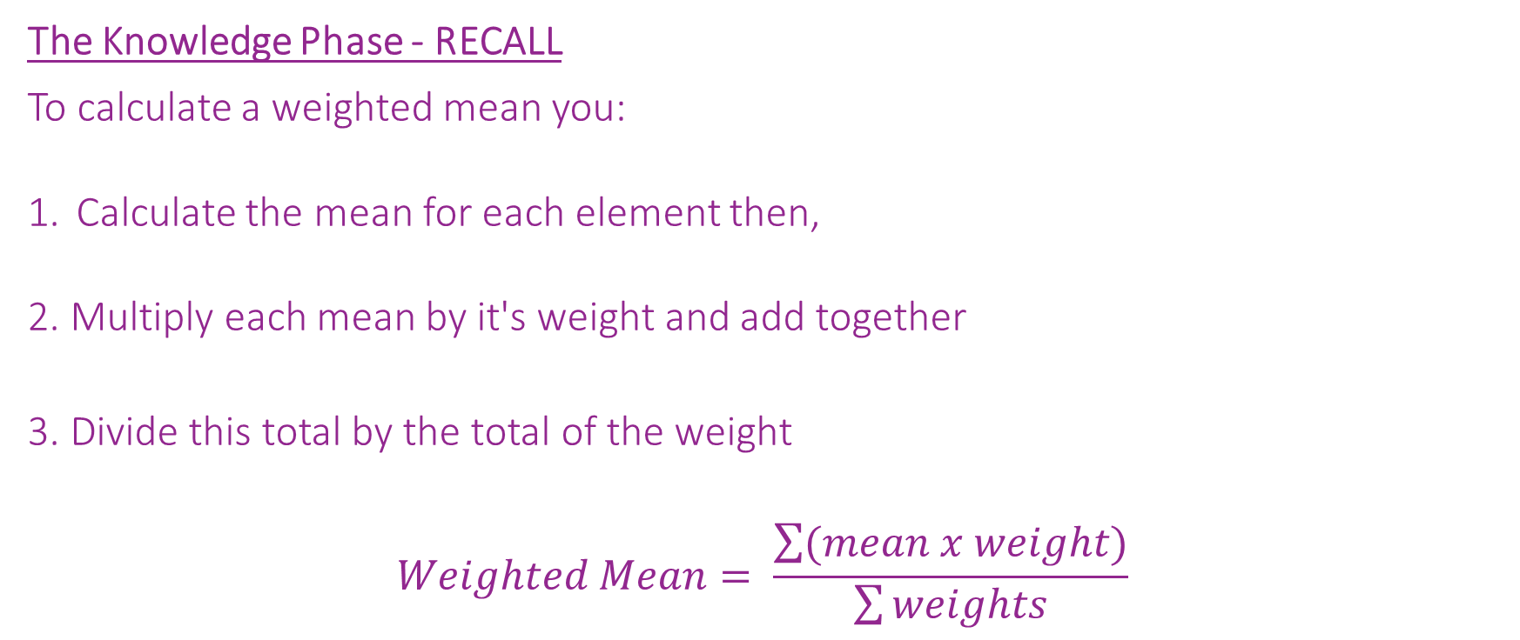
What are some ‘other summery statistics’ that can be seen in everyday circumstances and how can we analyse them?
The Knowledge Phase - RECALL
To calculate a weighted mean you:
Calculate the mean for each element then,
2. Multiply each mean by it's weight and add together
3. Divide this total by the total of the weight
$$Weighted Mean= \frac{\sum{(mean x weight)}}{\sum{weights}}$$
How do we calculate weighted index numbers and what do they mean?

Slide 3
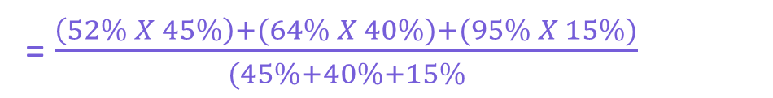
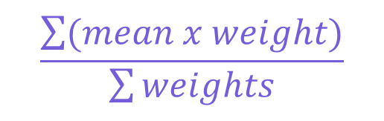
What are some ‘other summery statistics’ that can be seen in everyday circumstances and how can we analyse them?
I DO
The GCSE Statistics exam is marked across 3
different papers
Paper 1 is a written paper worth 45%
Paper 2 is a 2nd written paper worth 40%
Paper 3 is a piece of coursework worth 15%
Mary scored the following marks on each test, what
was her mean score?
Paper 1 Paper 2 Paper 3
52% 64% 95%
$$\frac{\sum{(mean x weight)}}{\sum{weights}}$$
= $\frac{\left(52\% X 45\%\right)+(64\% X 40\%)+(95\% X 15\%)}{(45\%+40\%+15\%}$
= 63.25%
How do we calculate weighted index numbers and what do they mean?

Slide 4
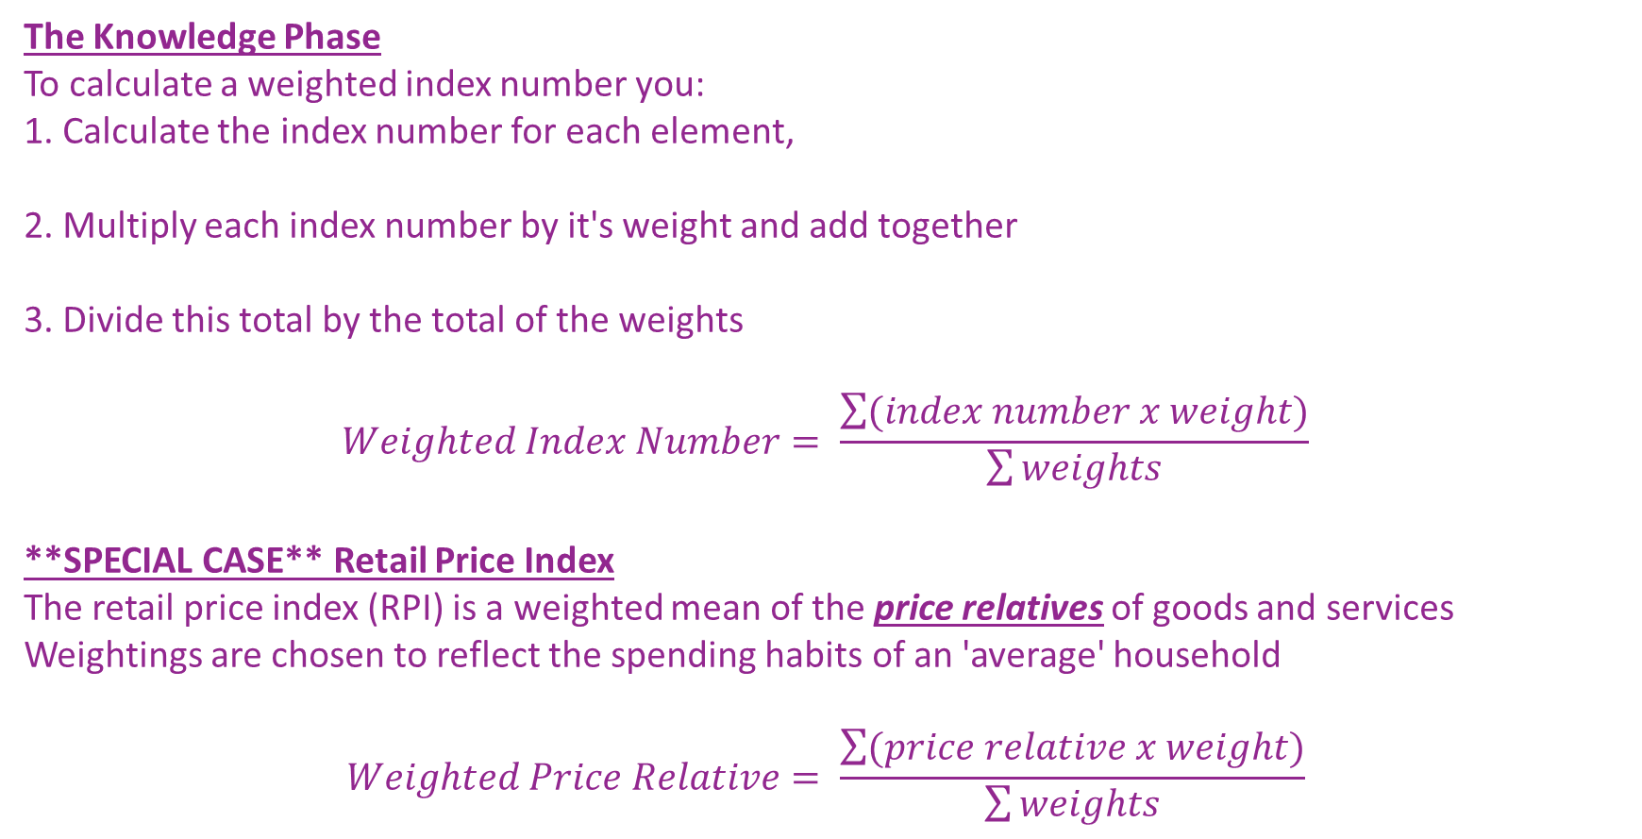
What are some ‘other summery statistics’ that can be seen in everyday circumstances and how can we analyse them?
The Knowledge Phase
To calculate a weighted index number you:
1. Calculate the index number for each element,
2. Multiply each index number by it's weight and add together
3. Divide this total by the total of the weights
$$Weighted Index Number= \frac{\sum{(index number x weight)}}{\sum{weights}}$$
**SPECIAL CASE** Retail Price Index
The retail price index (RPI) is a weighted mean of the price relatives of goods and services
Weightings are chosen to reflect the spending habits of an 'average' household
$$Weighted Price Relative= \frac{\sum{(price relative x weight)}}{\sum{weights}}$$
How do we calculate weighted index numbers and what do they mean?

Slide 5
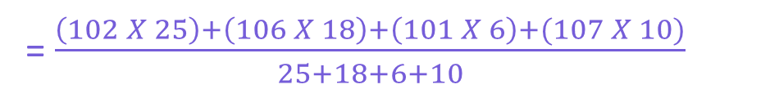
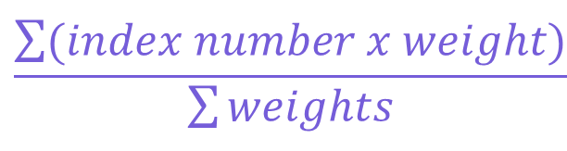
What are some ‘other summery statistics’ that can be seen in everyday circumstances and how can we analyse them?
I DO
This table shows data about some common ingredients and their index numbers for 2013 and 2014
Find the weighted mean index for 2014
$$\frac{\sum{(index number x weight)}}{\sum{weights}}$$
Ingredient | 2013 | 2014 | Weighting w
Flour Butter Milk Sugar | 100 100 100 100 | 102 106 101 107 | 25 18 6 10
= $\frac{\left(102 X 25\right)+\left(106 X 18\right)+\left(101 X 6\right)+(107 X 10)}{25+18+6+10}$
= 104.0
How do we calculate weighted index numbers and what do they mean?

Slide 6
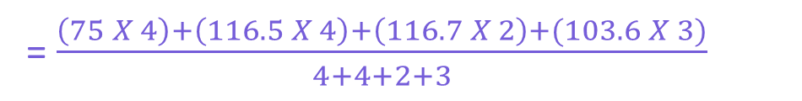
What are some ‘other summery statistics’ that can be seen in everyday circumstances and how can we analyse them?
WE DO
Using 2010 as the base year, calculate the weighted index number for the ingredients in 2020
$$\frac{\sum{(index number x weight)}}{\sum{weights}}$$
Ingredient | 2010 | 2020 | Weighting w
Flour Butter Milk Sugar | 72 79 54 56 | 54 92 63 58 | 4 4 2 3
index
= $\frac{\left(75 X 4\right)+\left(116.5 X 4\right)+\left(116.7 X 2\right)+(103.6 X 3)}{4+4+2+3}$
75
= 100.8
116.5
116.7
103.6
How do we calculate weighted index numbers and what do they mean?

Slide 7
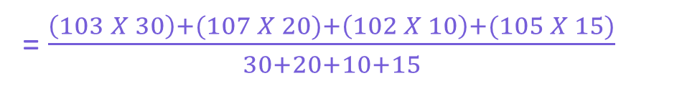
What are some ‘other summery statistics’ that can be seen in everyday circumstances and how can we analyse them?
I DO
This table shows data about some common ingredients and their index numbers for 2018 and 2019
Find the weighted mean index for 2019
$$\frac{\sum{(index number x weight)}}{\sum{weights}}$$
Ingredient | 2018 | 2019 | Weighting w
Flour Butter Milk Sugar | 100 100 100 100 | 103 107 102 105 | 30 20 10 15
= $\frac{\left(103 X 30\right)+(107 X 20)+\left(102 X 10\right)+(105 X 15)}{30+20+10+15}$
= 104.3
How do we calculate weighted index numbers and what do they mean?

Slide 8


What are some ‘other summery statistics’ that can be seen in everyday circumstances and how can we analyse them?
Practise Questions
Exam Questions
How do we calculate weighted index numbers and what do they mean?

Slide 9

What are some ‘other summery statistics’ that can be seen in everyday circumstances and how can we analyse them?
MWB ACTIVITY
How do we calculate weighted index numbers and what do they mean?

