Slide 1




What are some ‘other summery statistics’ that can be seen in everyday circumstances and how can we analyse them?
Chain Base Index Numbers
How do we calculate chain base index numbers and what do they mean?

Slide 2

What are some ‘other summery statistics’ that can be seen in everyday circumstances and how can we analyse them?
Vocab | Mathematical Definition
Annual | occurring once every year
Historical Origins | No clear consensus has emerged on who created the first price index. The earliest reported research in this area came from Welshman Rice Vaughan, who examined price level change in his 1675 book A Discourse of Coin and Coinage. Vaughan wanted to separate the inflationary impact of the influx of precious metals brought by Spain from the New World from the effect due to currency debasement. Vaughan compared labor statutes from his own time to similar statutes dating back to Edward III.
How do we calculate chain base index numbers and what do they mean?

Slide 3
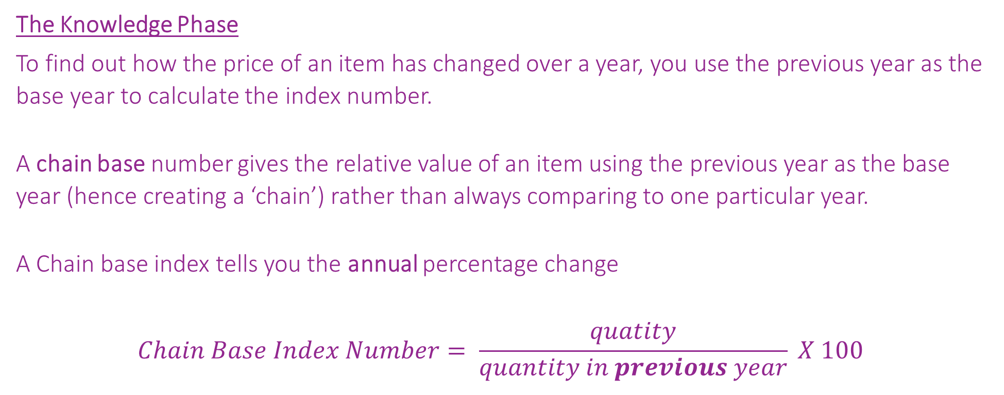
What are some ‘other summery statistics’ that can be seen in everyday circumstances and how can we analyse them?
The Knowledge Phase
To find out how the price of an item has changed over a year, you use the previous year as the base year to calculate the index number.
A chain base number gives the relative value of an item using the previous year as the base year (hence creating a ‘chain’) rather than always comparing to one particular year.
A Chain base index tells you the annual percentage change
$$Chain Base Index Number= \frac{quatity}{quantity in previous year} X 100$$
How do we calculate chain base index numbers and what do they mean?

Slide 4
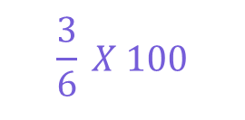
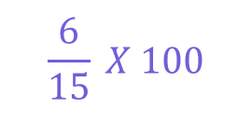
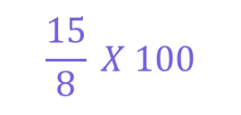
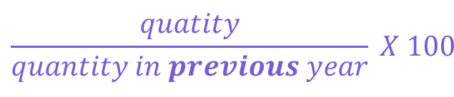
What are some ‘other summery statistics’ that can be seen in everyday circumstances and how can we analyse them?
$$\frac{quatity}{quantity in previous year} X 100$$
I DO
The table below shows the price changes over four years of a child’s toy as it rose and fell in popularity:
a) Find the chain base index number for each year.
b) What do the chain base index numbers show?
Year | 1998 | 1999 | 2000 | 2001
Price (£) | 8 | 15 | 6 | 3
Chain Base Index
50
100
187.5
40
$$\frac{15}{8} X 100$$
$$\frac{6}{15} X 100$$
$$\frac{3}{6} X 100$$
1998 - > 1999 a 87.5% increase in price
1999 - > 2000 a 60% decrease in price
2000 - > 2001 a 50% decrease in price
How do we calculate chain base index numbers and what do they mean?

Slide 5
What are some ‘other summery statistics’ that can be seen in everyday circumstances and how can we analyse them?
$$\frac{quatity}{quantity in previous year} X 100$$
WE DO
The data below shows the price for a bottle of milk over 5 consecutive years
a) Calculate the index numbers for 2011-2015 using 2011 as the base year
b) Calculate the chain base index numbers for 2011-2015
Year | 2011 | 2012 | 2013 | 2014 | 2015
Cost (p) | 25 | 29 | 31 | 35 | 37
Index Number
100
116
124
140
148
Chain Base Index
100
116
106.9
112.9
105.7
How do we calculate chain base index numbers and what do they mean?

Slide 6
What are some ‘other summery statistics’ that can be seen in everyday circumstances and how can we analyse them?
$$\frac{quatity}{quantity in previous year} X 100$$
YOU DO
The table below shoes the price indices for an economy pack of toilet rill at Cheap As Chips Superstore, using 2019 as the base year
a) Rewrite the price indices using chain base index numbers
b) In which year did the price fall?
Year | 2019 | 2020 | 2021 | 2022 | 2023
Price Index | 100 | 102 | 108 | 102 | 106
Chain Base Index | 100
102
105.9
94.4
103.9
How do we calculate chain base index numbers and what do they mean?

Slide 7


What are some ‘other summery statistics’ that can be seen in everyday circumstances and how can we analyse them?
Practise Questions
Exam Questions
How do we calculate chain base index numbers and what do they mean?

Slide 8

What are some ‘other summery statistics’ that can be seen in everyday circumstances and how can we analyse them?
MWB ACTIVITY
How do we calculate chain base index numbers and what do they mean?

