Slide 1




What are some ‘other summery statistics’ that can be seen in everyday circumstances and how can we analyse them?
Index Numbers
How do we calculate index numbers and what do they mean?

Slide 2
What are some ‘other summery statistics’ that can be seen in everyday circumstances and how can we analyse them?
Vocab | Mathematical Definition
Base Year | the first of a series of years in an economic or financial index
Index | a measure of something.
How do we calculate index numbers and what do they mean?

Slide 3
What are some ‘other summery statistics’ that can be seen in everyday circumstances and how can we analyse them?
The Knowledge Phase - RECALL
Percentage multipliers allow us to increase or decrease a number by a given percentage simply by multiplying by the corresponding decimal
It works on the principal that the original amount is 100% = 1
To INCREASE by a percentage we ADD on the percentage
To DECREASE by a percentage we SUBTRACT the percentage
How do we calculate index numbers and what do they mean?

Slide 4
What are some ‘other summery statistics’ that can be seen in everyday circumstances and how can we analyse them?
I DO
What is the decimal multiplier to:
INCREASE by 2%
DECREASE by 54%
WE DO
What is the decimal multiplier to:
INCREASE by 40%
DECREASE by 80%
YOU DO
What is the decimal multiplier to:
INCREASE by 72%
DECREASE by 6%
100% + 2% = 102%
= 1.02
100% - 54% = 46%
= 0.46
100% + 40% = 140%
= 1.4
100% - 80% = 20%
= 0.2
100% + 72% = 172%
= 1.72
100% - 6% = 94%
= 0.94
How do we calculate index numbers and what do they mean?

Slide 5

What are some ‘other summery statistics’ that can be seen in everyday circumstances and how can we analyse them?
MWB ACTIVITY
How do we calculate index numbers and what do they mean?

Slide 6
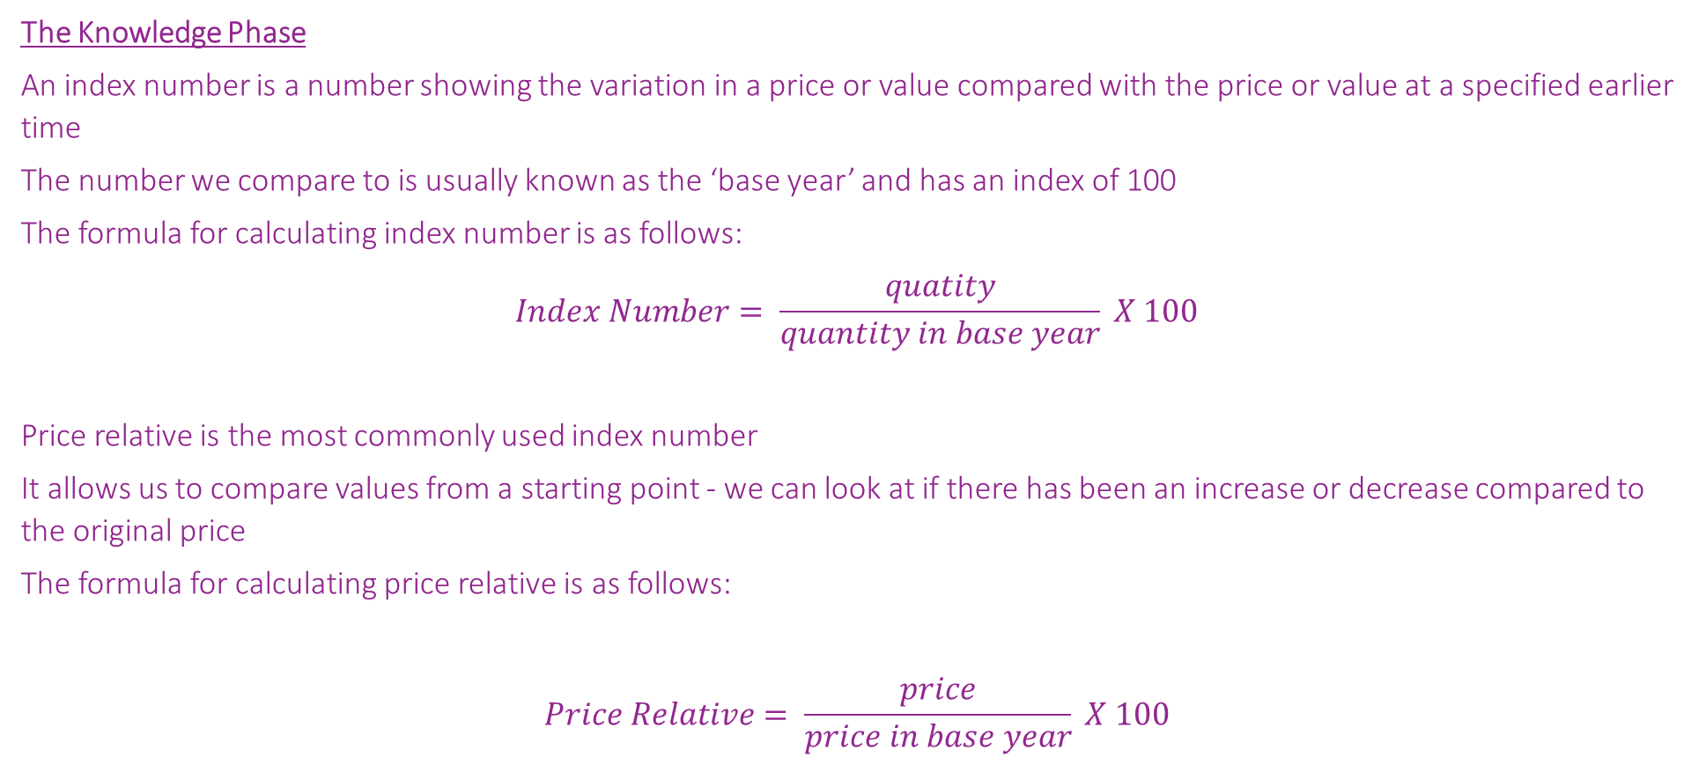
What are some ‘other summery statistics’ that can be seen in everyday circumstances and how can we analyse them?
The Knowledge Phase
An index number is a number showing the variation in a price or value compared with the price or value at a specified earlier time
The number we compare to is usually known as the ‘base year’ and has an index of 100
The formula for calculating index number is as follows:
$$Index Number= \frac{quatity}{quantity in base year} X 100$$
Price relative is the most commonly used index number
It allows us to compare values from a starting point - we can look at if there has been an increase or decrease compared to the original price
The formula for calculating price relative is as follows:
$$Price Relative= \frac{price}{price in base year} X 100$$
How do we calculate index numbers and what do they mean?

Slide 7


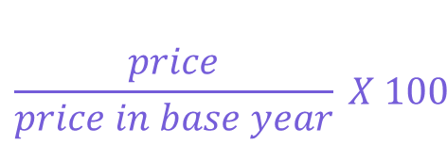
What are some ‘other summery statistics’ that can be seen in everyday circumstances and how can we analyse them?
$$\frac{price}{price in base year} X 100$$
I DO
The table below shows the price, to the nearest pound, of a toy as it rose and fell in popularity
Using 2018 as the base year, find the price relative for 2019 and 2020
2019 = $\frac{15}{8} X 100$
= 187.5
Year | 2018 | 2019 | 2020
Price | 8 | 15 | 6
87.5% increase from 2018 to 2019
2020 = $\frac{6}{8} X 100$
= 70
WE DO
Information about the price and price relative for a particular electronic toy for pre-school children is shown above.
Using the information given:
a) What has been used as the base year?
b) What was the price in 2012?
c) What was the price in 2015?
30% decrease from 2018 to 2020
Year | 2011 | 2012 | 2013 | 2014 | 2015
Cost (p) | 25 |  | 31 | 35
Index | 100 | 116 | 124 | 140 | 148
**Base year has an index of 100
= 2011
Index = 116
=> 16% increase from 2011
25 X 1.16 = 29p
Index = 148
=> 48% increase from 2011
25 X 1.48 = 37p
How do we calculate index numbers and what do they mean?

Slide 8


What are some ‘other summery statistics’ that can be seen in everyday circumstances and how can we analyse them?
Practise Questions
Exam Questions
How do we calculate index numbers and what do they mean?

