Slide 1




What are some ‘other summery statistics’ that can be seen in everyday circumstances and how can we analyse them?
Standardised Scores
How to we calculate standardised scored and what do they mean?

Slide 2
What are some ‘other summery statistics’ that can be seen in everyday circumstances and how can we analyse them?
Vocab | Mathematical Definition
Standardized Score | A score calculated to allow comparisons between scores with different totals, means and standard divisions.
Mean | The total of all the numbers in a data set divided by the number of pieces of data in that set
Standard Deviation | A measure of how spread the data is around the mean
How to we calculate standardised scored and what do they mean?

Slide 3
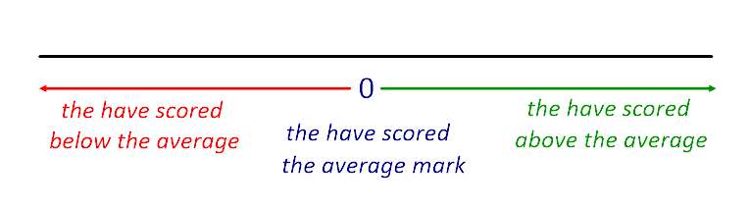
What are some ‘other summery statistics’ that can be seen in everyday circumstances and how can we analyse them?
The Knowledge Phase
A standardised score is A score calculated to allow comparisons between scores with different totals, means and standard divisions.
It compares an individual result to the average
A positive standardised score implies that the score is above the mean (average)
A negative standardised score implies that the score is below the mean (average)
The further away from zero the score is, the further away from the average the score is
How to we calculate standardised scored and what do they mean?

Slide 4
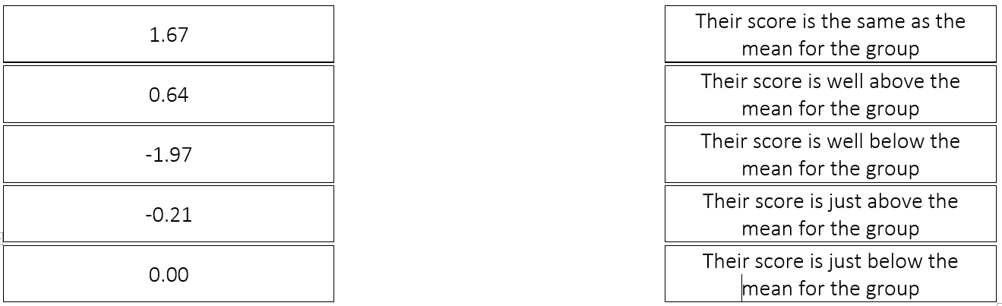
What are some ‘other summery statistics’ that can be seen in everyday circumstances and how can we analyse them?
Skills Check
How to we calculate standardised scored and what do they mean?

Slide 5
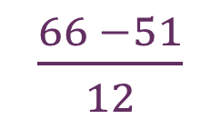
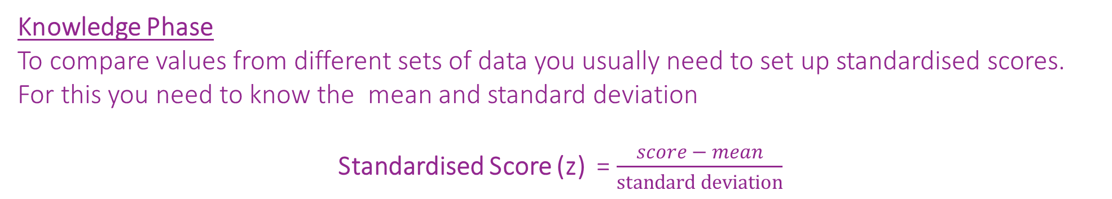
What are some ‘other summery statistics’ that can be seen in everyday circumstances and how can we analyse them?
Knowledge Phase
To compare values from different sets of data you usually need to set up standardised scores.
For this you need to know the mean and standard deviation
Standardised Score (z) = $\frac{score − mean}{standard deviation}$
I DO
If the mean English Score was 51 and the s.d. was 12, work out Jennifer's Standardized Score if she got 66
$\frac{66 −51}{12}$
= 1.25
How to we calculate standardised scored and what do they mean?

Slide 6




What are some ‘other summery statistics’ that can be seen in everyday circumstances and how can we analyse them?
Standardised Score (z) = $\frac{score − mean}{standard deviation}$
WE DO
Fred and Vicki did a test in English and a test in Statistics.
Both tests had a maximum mark of 100.
Their results are given in the table below
(a) Work out Fred and Vicki's standardised scores
(b) Comment on the examination performances of the two students. Who do you think did better overall?
Fred English =
$\frac{36 −50}{12}$
= -1.17
In English Vicki did better than Fred
In Stats, Fred did better than Vicki
Fred did better in Stats than English
Vicki did better in English than Stats
Overall Vicki did better compared to the rest of the class than Fred
Fred Stats =
$\frac{38 −42}{8}$
= 0.5
 | Fred’s Score | Vicki’s Score | Mean Score | Standard Deviation
English | 46 | 55 | 50 | 12
Statistics | 38 | 40 | 42 | 8
Vicki English =
$\frac{55 −50}{12}$
= 0.42
Vicki Stats =
$\frac{40 −42}{8}$
= -0.25
How to we calculate standardised scored and what do they mean?

Slide 7


What are some ‘other summery statistics’ that can be seen in everyday circumstances and how can we analyse them?
Standardised Score (z) = $\frac{score − mean}{standard deviation}$
YOU DO
The table gives the time that Lena took to complete successfully each of two skills tests, test A and test B.
The mean and the standard deviation for each of these tests for all the students who completed the tests are also given.
Using standardised scores, compare Lena's performance in Test A relative to the other students with her performance in Test B relative to the other students. Explain how you reach your conclusion.
Test A =
$\frac{16.3 −14.4}{1.5}$
= 1.27
Leena scored well above the mean in Test A and did better than the average of the class
 |  | All Students
 | Lena | Mean | Standard Deviation
Test A (mins) | 16.3 | 14.4 | 1.5
Test B (mins) | 21.6 | 19.8 | 2.4
Test B =
$\frac{21.6 −19.8}{2.4}$
= 0.75
Although Leena scored better in Test B and still scored above the average of the class, she did not do as well in comparison to the rest of the class as she did in Test A
How to we calculate standardised scored and what do they mean?

Slide 8
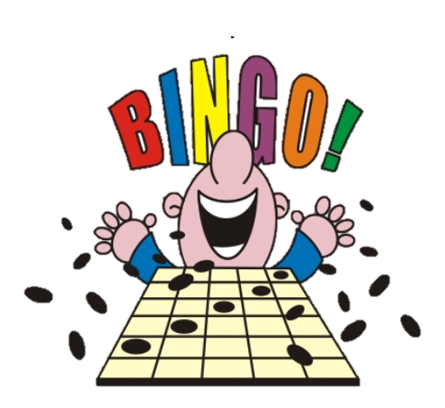
What are some ‘other summery statistics’ that can be seen in everyday circumstances and how can we analyse them?
0 0.1 0.2 0.5 0.7
1 1.5 2 -0.1 -0.2
-0.5 -0.7 -1 -1.5 - 2
Draw a 3 x 3 grid in your
books and choose 9
numbers from those
given to fill it with
How to we calculate standardised scored and what do they mean?

Slide 9
What are some ‘other summery statistics’ that can be seen in everyday circumstances and how can we analyse them?
mean = 25
s.d. = 2
Calculated the standardised score for
score : 24
How to we calculate standardised scored and what do they mean?

Slide 10
What are some ‘other summery statistics’ that can be seen in everyday circumstances and how can we analyse them?
mean = 25
s.d. = 2
Calculated the standardised score for
score : 29
How to we calculate standardised scored and what do they mean?

Slide 11
What are some ‘other summery statistics’ that can be seen in everyday circumstances and how can we analyse them?
mean = 25
s.d. = 2
Calculated the standardised score for
score : 23.6
How to we calculate standardised scored and what do they mean?

Slide 12
What are some ‘other summery statistics’ that can be seen in everyday circumstances and how can we analyse them?
mean = 25
s.d. = 2
Calculated the standardised score for
score : 21
How to we calculate standardised scored and what do they mean?

Slide 13
What are some ‘other summery statistics’ that can be seen in everyday circumstances and how can we analyse them?
mean = 25
s.d. = 2
Calculated the standardised score for
score : 22
How to we calculate standardised scored and what do they mean?

Slide 14
What are some ‘other summery statistics’ that can be seen in everyday circumstances and how can we analyse them?
mean = 25
s.d. = 2
Calculated the standardised score for
score : 26
How to we calculate standardised scored and what do they mean?

Slide 15
What are some ‘other summery statistics’ that can be seen in everyday circumstances and how can we analyse them?
mean = 25
s.d. = 2
Calculated the standardised score for
score : 26.4
How to we calculate standardised scored and what do they mean?

Slide 16
What are some ‘other summery statistics’ that can be seen in everyday circumstances and how can we analyse them?
mean = 25
s.d. = 2
Calculated the standardised score for
score : 23
How to we calculate standardised scored and what do they mean?

Slide 17
What are some ‘other summery statistics’ that can be seen in everyday circumstances and how can we analyse them?
mean = 25
s.d. = 2
Calculated the standardised score for
score : 25
How to we calculate standardised scored and what do they mean?

Slide 18
What are some ‘other summery statistics’ that can be seen in everyday circumstances and how can we analyse them?
mean = 25
s.d. = 2
Calculated the standardised score for
score : 28
How to we calculate standardised scored and what do they mean?

Slide 19
What are some ‘other summery statistics’ that can be seen in everyday circumstances and how can we analyse them?
mean = 25
s.d. = 2
Calculated the standardised score for
score : 25.2
How to we calculate standardised scored and what do they mean?

Slide 20
What are some ‘other summery statistics’ that can be seen in everyday circumstances and how can we analyse them?
mean = 25
s.d. = 2
Calculated the standardised score for
score : 24.6
How to we calculate standardised scored and what do they mean?

Slide 21
What are some ‘other summery statistics’ that can be seen in everyday circumstances and how can we analyse them?
mean = 25
s.d. = 2
Calculated the standardised score for
score : 24.8
How to we calculate standardised scored and what do they mean?

Slide 22
What are some ‘other summery statistics’ that can be seen in everyday circumstances and how can we analyse them?
mean = 25
s.d. = 2
Calculated the standardised score for
score : 25.4
How to we calculate standardised scored and what do they mean?

Slide 23
What are some ‘other summery statistics’ that can be seen in everyday circumstances and how can we analyse them?
mean = 25
s.d. = 2
Calculated the standardised score for
score : 27
How to we calculate standardised scored and what do they mean?

Slide 24
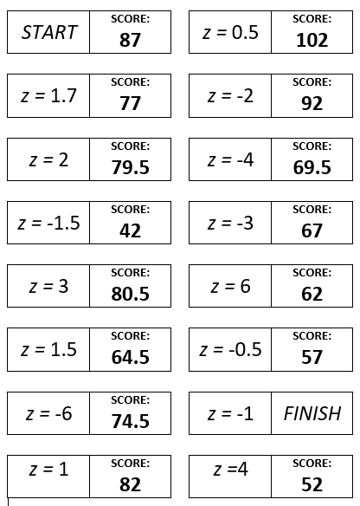
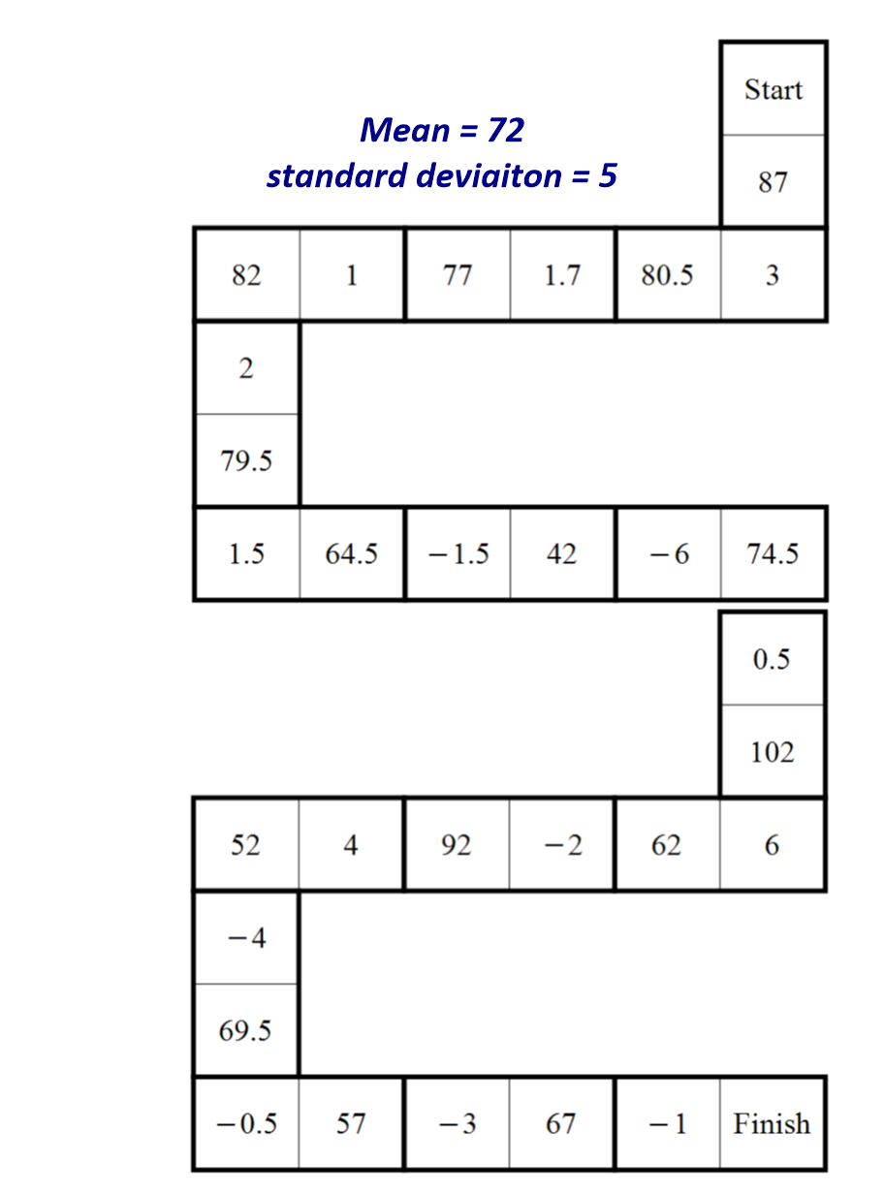
What are some ‘other summery statistics’ that can be seen in everyday circumstances and how can we analyse them?
mean = 72
s.d. = 5
How to we calculate standardised scored and what do they mean?

Slide 25


What are some ‘other summery statistics’ that can be seen in everyday circumstances and how can we analyse them?
Practise Questions
Exam Questions
How to we calculate standardised scored and what do they mean?

Slide 26
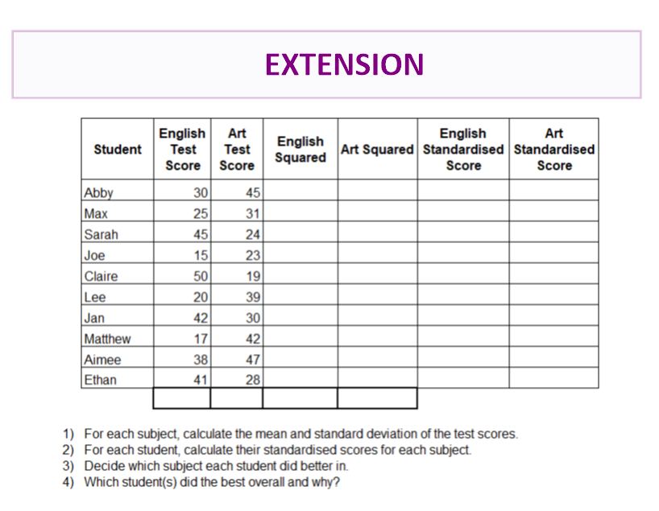
What are some ‘other summery statistics’ that can be seen in everyday circumstances and how can we analyse them?
How to we calculate standardised scored and what do they mean?

Slide 27

What are some ‘other summery statistics’ that can be seen in everyday circumstances and how can we analyse them?
MWB ACTIVITY
How to we calculate standardised scored and what do they mean?

