Slide 1




How do we calculate probabilities for different situations and use them effectively to make accurate predications?
Sample Space Diagrams
How can we draw and use a sample space diagram effectively?

Slide 2
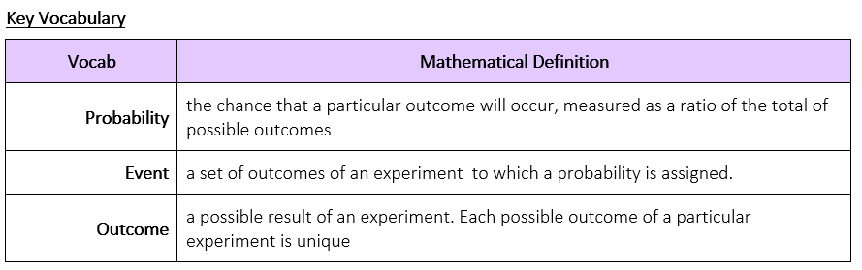
How do we calculate probabilities for different situations and use them effectively to make accurate predications?
How can we draw and use a sample space diagram effectively?

Slide 3
How do we calculate probabilities for different situations and use them effectively to make accurate predications?
Key Knowledge
Sample Space Diagrams are used to display all the outcomes of 2 or more events occurring.
Most commonly they are presented as a two way table and can show outcomes of two events happening simultaneously.
These can be qualitative or quantitative data and should never be mistakenly written as frequencies or probabilities
How can we draw and use a sample space diagram effectively?

Slide 4
How do we calculate probabilities for different situations and use them effectively to make accurate predications?
I DO
A coin is flipped twice
Draw a sample space diagram to show all of the possible outcomes of these events
WE DO
A coin is flipped and a fair dice is rolled
Draw a sample space diagram to show all of the possible outcomes of these two events
 |  | First Flip
 |  | Heads | Tails
Second Flip | Heads
 | Tails
 |  | Dice
 |  | 1 | 2 | 3 | 4 | 5 | 6
Coin | H
 | T
H1
H2
H3
H4
H5
H6
HH
HT
T1
T2
T3
T4
T5
T6
TH
TT
How can we draw and use a sample space diagram effectively?

Slide 5

How do we calculate probabilities for different situations and use them effectively to make accurate predications?
Practise Questions
How can we draw and use a sample space diagram effectively?

Slide 6
How do we calculate probabilities for different situations and use them effectively to make accurate predications?
Key Knowledge
To calculate probabilities from a sample space diagram we simply use the information we have found in the two way table
Remember:
the number of what we want
the total number of everything
How can we draw and use a sample space diagram effectively?

Slide 7
How do we calculate probabilities for different situations and use them effectively to make accurate predications?
WE DO
A fair dice are thrown. Their scores are added.
Fill in the sample space diagram to show all the possibilities.
I DO
A coin is flipped twice
Draw a sample space diagram to show all of the possible outcomes of these events
= 4 / 36
 |  | Dice1
 |  | 1 | 2 | 3 | 4 | 5 | 6
Dice2 | 1
 | 2
 | 3
 | 4
 | 5
 | 6
a) P(sum = 5)
b) P(sum > 7)
c) P(sum ≤ 10)
d) P(sum = even)
 |  | First Flip
 |  | Heads | Tails
Second Flip | Heads
 | Tails
2
3
4
5
6
7
= 15/36
3
4
5
6
7
8
HH
HT
4
5
6
7
8
9
5
6
7
8
9
10
TH
TT
6
7
8
9
10
11
7
8
9
10
11
12
1 / 4
e) P(sum = 6 if one dice is 3)
f) P(sum = 12 if one dice is 1)
P (HH) =
P(one head one tail) =
2 / 4
How can we draw and use a sample space diagram effectively?

Slide 8
How do we calculate probabilities for different situations and use them effectively to make accurate predications?
Practise Questions
How can we draw and use a sample space diagram effectively?

Slide 9

How do we calculate probabilities for different situations and use them effectively to make accurate predications?
MWB ACTIVITY
How can we draw and use a sample space diagram effectively?

