Slide 1
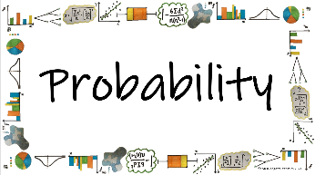



How do we calculate probabilities for different situations and use them effectively to make accurate predications?
Randomised Response
What is randomised response and why do we use it?

Slide 2
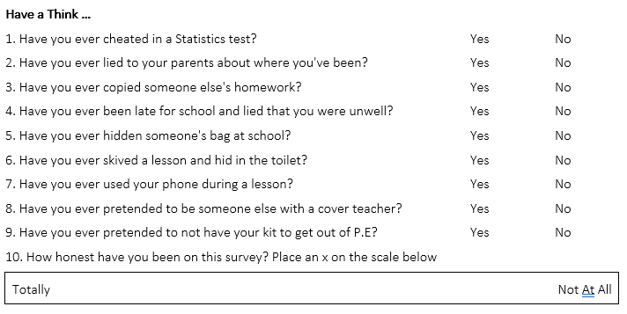
How do we calculate probabilities for different situations and use them effectively to make accurate predications?
Vocab | Mathematical Definition
Randomized response | a research method used in structured survey interview.
What is randomised response and why do we use it?

Slide 3
How do we calculate probabilities for different situations and use them effectively to make accurate predications?
The Knowledge Phase
Warner and Greenberg came up with the random response method to allow respondents to respond to sensitive issues (such as criminal behaviour or sexuality) while maintaining confidentiality.
Their idea was that participants would take part in a probability experiment, then depending on the result the would answer the question a) honestly or b) randomly
Then an estimate of the true proportion of results could be calculated using probability
1. Participants take part in a probability experiment, such as flipping a coin or rolling a dice.
2. Depending on the result, participants answer the question:
a) yes (embarrassing answer)
b) honestly
3. Then we estimate the true proportion of results using theoretical probability eliminating the calculated proportion of participants who will have answered yes through random selection
What is randomised response and why do we use it?

Slide 4
How do we calculate probabilities for different situations and use them effectively to make accurate predications?
I DO
Teachers are asked if they have ever smoked.
Before answering they are asked to flip a coin
If it lands on heads they are asked to answer 'yes'
If it lands on tails they are asked to answer honestly.
Of the 244 teachers asked, 155 said 'yes'
Estimate the proportion of the number of teachers
who have ever smoked
P(heads) = 0.5
Number of teachers we expected to tick yes
through probability = 0.5 x 244 = 122
Number of teachers we expected to answer
honestly = 122
Number of teachers who ticked 'yes'
honestly = 155 - 122 = 33
Proportion of teachers who have ever
smoked = 33/122 = 27%
What is randomised response and why do we use it?

Slide 5
How do we calculate probabilities for different situations and use them effectively to make accurate predications?
WE DO
Taxi Drivers are asked if they have ever run a red light
Before answering they are asked to choose a card
If they choose a heart they are asked to answer 'yes'
If they choose a different card they are asked to
answer honestly.
Of the 1064 taxi drivers asked, 658 said yes
Estimate the proportion of the number of taxi drivers who have ever run a red light
P(hearts) = 0.25
Number of drivers we expected to tick yes
through probability = 0.25 x 1064 = 266
Number of drivers we expected to answer
honestly = 1064 - 266 = 798
Number of drivers who ticked 'yes'
honestly = 658 - 266 = 392
Proportion of drivers who have ever run a
red light = 392/798
What is randomised response and why do we use it?

Slide 6
How do we calculate probabilities for different situations and use them effectively to make accurate predications?
YOU DO
Builders are asked if they have ever finished early on
a Friday without telling their boss
Before answering they are asked to roll a dice
If it lands on 1 they are asked to answer 'yes'
If it lands on 2-6 they are asked to answer honestly.
Of the 523 builders asked, 39 answered no
Estimate the proportion of the number of builders
who have ever finished early on a Friday without
telling their boss.
P(1) = 1/6
Number of builders we expected to tick yes
through probability = 1/6 x 523 = 87
Number of builders we expected to answer
honestly = 523 - 87 = 436
Number of builders who ticked 'yes'
honestly = 436 - (484-87) =397
Proportion of builders who have finished
early on Friday = 397/436 = 91%
What is randomised response and why do we use it?

Slide 7

How do we calculate probabilities for different situations and use them effectively to make accurate predications?
Practice Questions
Exam Practice
What is randomised response and why do we use it?

