Slide 1
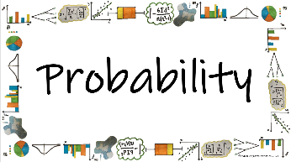



How do we calculate probabilities for different situations and use them effectively to make accurate predications?
Theoretical Probability
How is theoretical probability calculated?

Slide 2
How do we calculate probabilities for different situations and use them effectively to make accurate predications?
Vocab | Mathematical Definition
Probability | the chance that a particular outcome will occur, measured as a ratio of the total of possible outcomes
Theoretical | based on or calculated through theory rather than experience or practice
How is theoretical probability calculated?

Slide 3
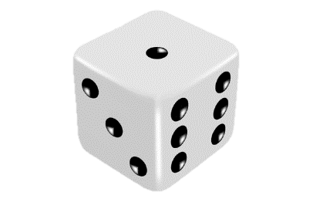

How do we calculate probabilities for different situations and use them effectively to make accurate predications?
The Knowledge Phase
A dice has 6 sides with possible outcomes: 1, 2, 3, 4, 5, 6
A deck of cards has 52 cards (no jokers)
26 are red and 26 are black
There a 4 suits, 13 cards in each: hearts, diamonds, clubs, spades
The cards in each suit are: 2, 3, 4, 5, 6, 7, 8, 9, 10, J, Q, K, A
J, Q, K are all ‘face cards’
How is theoretical probability calculated?

Slide 4
How do we calculate probabilities for different situations and use them effectively to make accurate predications?
The Knowledge Phase
Theoretical Probability
Theoretical Probability refers to the calculated probability that would be expected if everything worked IN THEORY and there was no other possible factor that could cause a change to the outcomes
A theoretical probability can be calculated by dividing the number of successful events by the total number of events. This can then be left as a fraction, or converted into a decimal/percentage to 3.s.f.
We find probabilities by writing:
the number of what we want
the total number of everything
How is theoretical probability calculated?

Slide 5




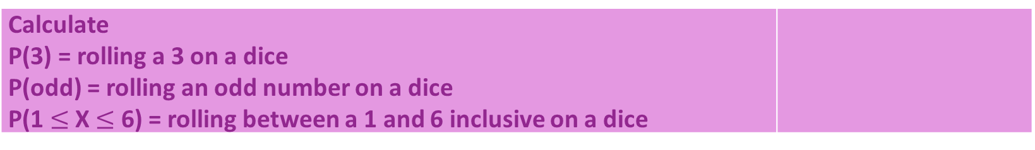


How do we calculate probabilities for different situations and use them effectively to make accurate predications?
the number of what we want
the total number of everything
I DO
Calculate: P(girl) = choosing a girl from the class P(year 11) = probability of choosing a year 11 students from this class P(15) = Probability of choosing a 15 year old from this class
WE DO
$$\frac{1}{6}$$
Calculate P(3) = rolling a 3 on a dice P(odd) = rolling an odd number on a dice P(1 $≤$ X $≤$ 6) = rolling between a 1 and 6 inclusive on a dice
$$\frac{3}{6}$$
$$\frac{6}{6}$$
YOU DO
Calculate: P(black) = probability of choosing a black card from a deck of cards P(diamond) = probability of choosing a diamond from a deck of cards P(3 hearts) = probability of choosing a 3 of hearts from a deck of cards
$$\frac{26}{52}$$
$$\frac{13}{52}$$
$$\frac{1}{52}$$
How is theoretical probability calculated?

Slide 6


How do we calculate probabilities for different situations and use them effectively to make accurate predications?
What is the probability of choosing a black counter?
MWB ACTIVITY
$$\frac{4}{9}$$
How is theoretical probability calculated?

Slide 7

How do we calculate probabilities for different situations and use them effectively to make accurate predications?
What is the probability of choosing a white counter?
MWB ACTIVITY
$$\frac{3}{9}$$
How is theoretical probability calculated?

Slide 8

How do we calculate probabilities for different situations and use them effectively to make accurate predications?
What is the probability of choosing a purple counter?
MWB ACTIVITY
$$\frac{2}{9}$$
How is theoretical probability calculated?

Slide 9

How do we calculate probabilities for different situations and use them effectively to make accurate predications?
What is the probability of choosing a black counter?
MWB ACTIVITY
$$\frac{7}{10}$$
How is theoretical probability calculated?

Slide 10

How do we calculate probabilities for different situations and use them effectively to make accurate predications?
What is the probability of choosing a white counter?
MWB ACTIVITY
$$\frac{2}{10}$$
How is theoretical probability calculated?

Slide 11

How do we calculate probabilities for different situations and use them effectively to make accurate predications?
What is the probability of choosing a purple counter?
MWB ACTIVITY
$$\frac{1}{10}$$
How is theoretical probability calculated?

Slide 12

How do we calculate probabilities for different situations and use them effectively to make accurate predications?
What is the probability of choosing a black or white counter?
MWB ACTIVITY
$$\frac{8}{11}$$
How is theoretical probability calculated?

Slide 13

How do we calculate probabilities for different situations and use them effectively to make accurate predications?
What is the probability of choosing a black or purple counter?
MWB ACTIVITY
$$\frac{5}{11}$$
How is theoretical probability calculated?

Slide 14

How do we calculate probabilities for different situations and use them effectively to make accurate predications?
What is the probability of choosing a white or purple counter?
MWB ACTIVITY
$$\frac{9}{11}$$
How is theoretical probability calculated?

Slide 15

How do we calculate probabilities for different situations and use them effectively to make accurate predications?
Practice Questions
How is theoretical probability calculated?

Slide 16
How do we calculate probabilities for different situations and use them effectively to make accurate predications?
Key Knowledge
The Complement
The complement of an event is all the possible the outcomes that do not happen in this event.
Sometimes this can be simply ‘the event does not happen’ and other times we need to me more specific about what is included in this complementary event.
This is denoted with a ‘ i.e. If A is the event A, then A’ is the event not A
We know that the sum of the probabilities of all possible outcomes should be 1. Hence;
P(A’) = 1 – P(A)
As all probabilities should equal 1 hence to find the probability of something NOT happening we can simply do 1 - P(A)
How is theoretical probability calculated?

Slide 17
How do we calculate probabilities for different situations and use them effectively to make accurate predications?
I DO
Not reading exactly 31 pages of your book
What is the complementary event to ‘Reading exactly 31 pages of your book’?
WE DO
If the probability of being chosen to go up on stage at a magic show is 0.19, calculate the probability of the complement of this event
P(chosen) = 0.19
P(chosen ‘) = 0.81
YOU DO
Rani and Kul are having an extension built to the side of their house. The roofer has said he will turn up this week but cannot guarantee which day it will be. The table below shows the probability of him turning up each day. Calculate the probability that he turns up at the weekend.
P(week) = 0.98
P(not week) = 0.02
Day | Mon | Tues | Weds | Thurs | Fri
P(X = x) | 0.06 | 0.14 | 0.12 | 0.45 | 0.21
How is theoretical probability calculated?

Slide 18
How do we calculate probabilities for different situations and use them effectively to make accurate predications?
P(A) = 0.56
What is P(A’)?
MWB ACTIVITY
0.44
How is theoretical probability calculated?

Slide 19
How do we calculate probabilities for different situations and use them effectively to make accurate predications?
P(B) = 0.22
What is P(B’)?
MWB ACTIVITY
0.78
How is theoretical probability calculated?

Slide 20
How do we calculate probabilities for different situations and use them effectively to make accurate predications?
P(C) = 0.37
What is P(C’)?
MWB ACTIVITY
0.63
How is theoretical probability calculated?

Slide 21
How do we calculate probabilities for different situations and use them effectively to make accurate predications?
P(D’) = 0.95
What is P(D)?
MWB ACTIVITY
0.05
How is theoretical probability calculated?

Slide 22
How do we calculate probabilities for different situations and use them effectively to make accurate predications?
P(E’) = 0.58
What is P(E)?
MWB ACTIVITY
0.42
How is theoretical probability calculated?

Slide 23

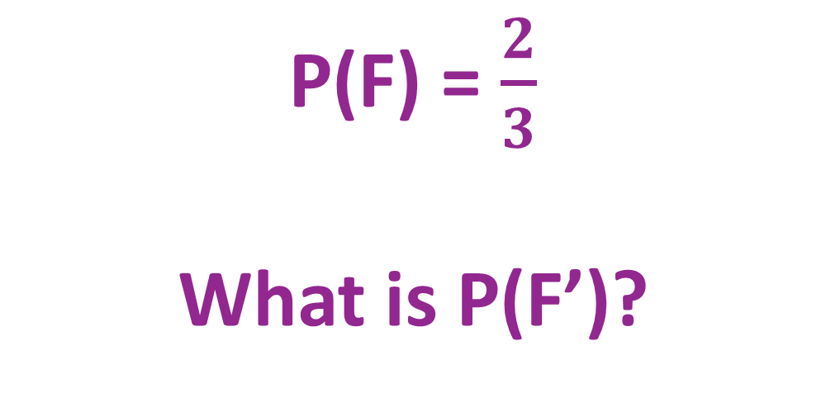
How do we calculate probabilities for different situations and use them effectively to make accurate predications?
P(F) = $\frac{2}{3}$
What is P(F’)?
MWB ACTIVITY
$$\frac{1}{3}$$
How is theoretical probability calculated?

Slide 24

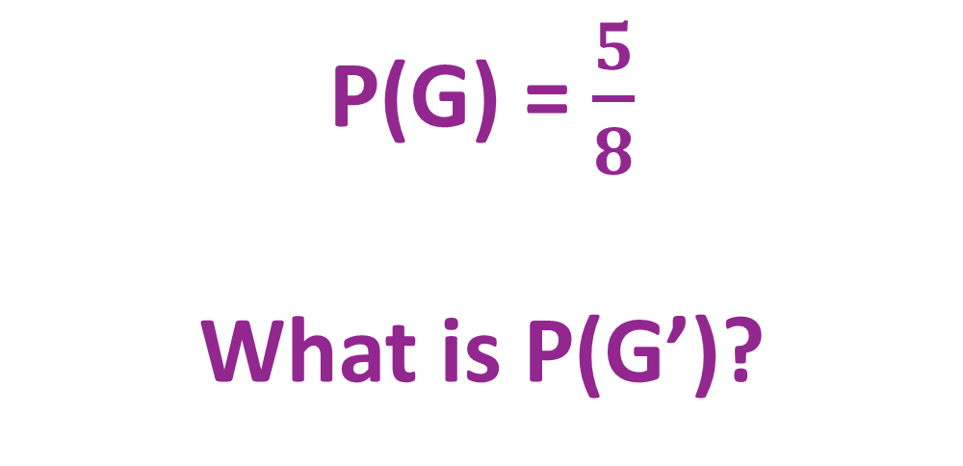
How do we calculate probabilities for different situations and use them effectively to make accurate predications?
P(G) = $\frac{5}{8}$
What is P(G’)?
MWB ACTIVITY
$$\frac{3}{8}$$
How is theoretical probability calculated?

Slide 25

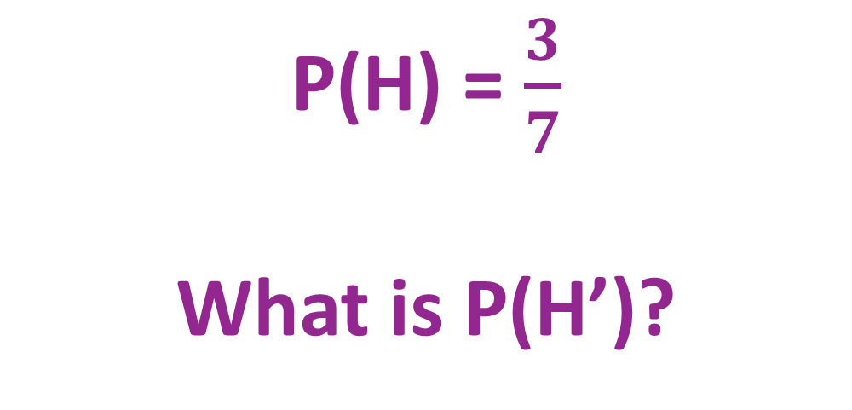
How do we calculate probabilities for different situations and use them effectively to make accurate predications?
P(H) = $\frac{3}{7}$
What is P(H’)?
MWB ACTIVITY
$$\frac{4}{7}$$
How is theoretical probability calculated?

Slide 26

How do we calculate probabilities for different situations and use them effectively to make accurate predications?
P(X) =1
What is P(X’)?
MWB ACTIVITY
$$0$$
How is theoretical probability calculated?

Slide 27

How do we calculate probabilities for different situations and use them effectively to make accurate predications?
P(Y) = 0
What is P(Y’)?
MWB ACTIVITY
$$1$$
How is theoretical probability calculated?

Slide 28
How do we calculate probabilities for different situations and use them effectively to make accurate predications?
Practice Questions
Exam Practice
How is theoretical probability calculated?

