Slide 1




How do we calculate probabilities for different situations and use them effectively to make accurate predications?
Tree Diagrams (2)
How can we draw and use a Tree diagram effectively for repeated events?

Slide 2
How do we calculate probabilities for different situations and use them effectively to make accurate predications?
Vocab | Mathematical Definition
Outcomes | a possible result of an experiment. Each possible outcome of a particular experiment is unique
Key Knowledge
Repeated Events
Repeated events are when the same this is tested more than once
This can occur with or without replacement and it is important to identify this from the question
We know that for any tree diagram each pair (or set) of branches must total 1
For two or more repeated events with replacement, every pair (or set) of branches must be the same
How can we draw and use a Tree diagram effectively for repeated events?

Slide 3
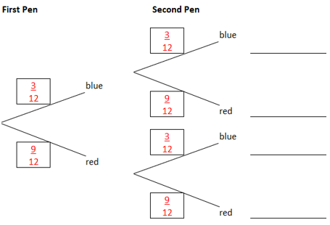








How do we calculate probabilities for different situations and use them effectively to make accurate predications?
I DO
a) What is the probability that Emma choose 2 blue pens?
b) What is the probability that Emma chooses only 1 blue pen?
c) What is the probability that Emma chooses at least 1 blue pen?
d) What is the probability that Emma chooses no blue pens?
P(bb) = $\frac{3}{12}$ X $\frac{3}{12}$ = $\frac{9}{144}$
P(br) = $\frac{3}{12}$ X $\frac{9}{12}$ = $\frac{27}{144}$
P(rb) = $\frac{9}{12}$ X $\frac{3}{12}$ = $\frac{27}{144}$
P(rr) = $\frac{9}{12}$ X $\frac{9}{12}$ = $\frac{81}{144}$
P(bb) = $\frac{9}{144}$
P(br) or P(rb) = $\frac{27}{144}$ + $\frac{27}{144}$ = $\frac{54}{144}$
P(br) or P(rb) or P(bb) = $\frac{27}{144}$ + $\frac{27}{144}$ + $\frac{9}{144}$ = $\frac{63}{144}$
P(rr) = $\frac{81}{144}$
How can we draw and use a Tree diagram effectively for repeated events?

Slide 4
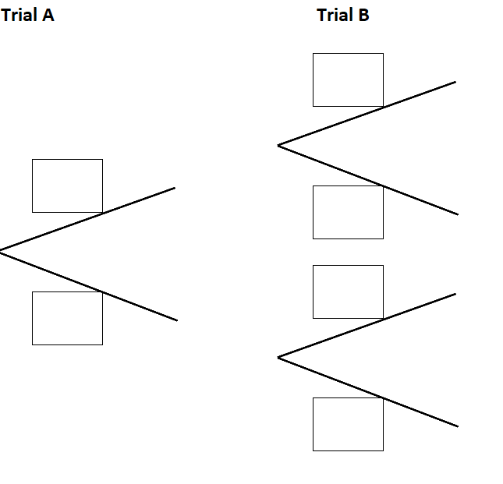
How do we calculate probabilities for different situations and use them effectively to make accurate predications?
WE DO
I flip a coin twice
Draw a tree diagram to show the probabilities of all possible outcomes
Flip 1
Flip 2
0.5
H
P(HH) = 0.5 X 0.5 = 0.25
0.5
H
0.5
T
P(HT) = 0.5 X 0.5 = 0.25
0.5
H
P(TH) = 0.5 X 0.5 = 0.25
0.5
T
0.5
T
P(TT) = 0.5 X 0.5 = 0.25
How can we draw and use a Tree diagram effectively for repeated events?

Slide 5
How do we calculate probabilities for different situations and use them effectively to make accurate predications?
YOU DO
Products made in the Greenway factory either start in machine A, B or C. Machine A is the oldest and can make less products per hour than B and C in turn. In an hour, machine A can produce 17 items, machine B can produce 26 items and the newest machine C can produce 31 per hour.
Each hour, the floor manager selects 2 items at random to check for quality assurance.
a) Draw a tree diagram showing the probabilities of the possible outcomes for this sample.
b) Calculate the probability that both items were made by the same machine.
c) Calculate the probability that both items were made by different machines.
How can we draw and use a Tree diagram effectively for repeated events?

Slide 6

How do we calculate probabilities for different situations and use them effectively to make accurate predications?
Practice Questions
How can we draw and use a Tree diagram effectively for repeated events?

