Slide 1
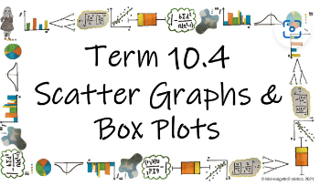



How do we use box plots and scatter graphs to represent and compare large data sets?
Interpolation and Extrapolation
What is the difference between interpolation and extrapolation?

Slide 2
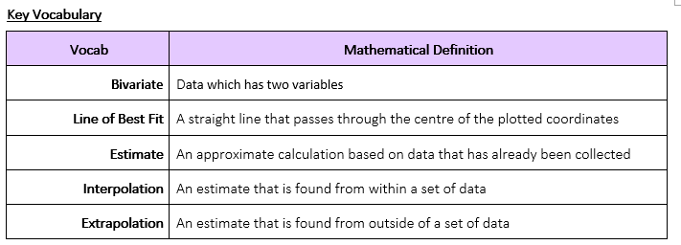
How do we use box plots and scatter graphs to represent and compare large data sets?
What is the difference between interpolation and extrapolation?

Slide 3
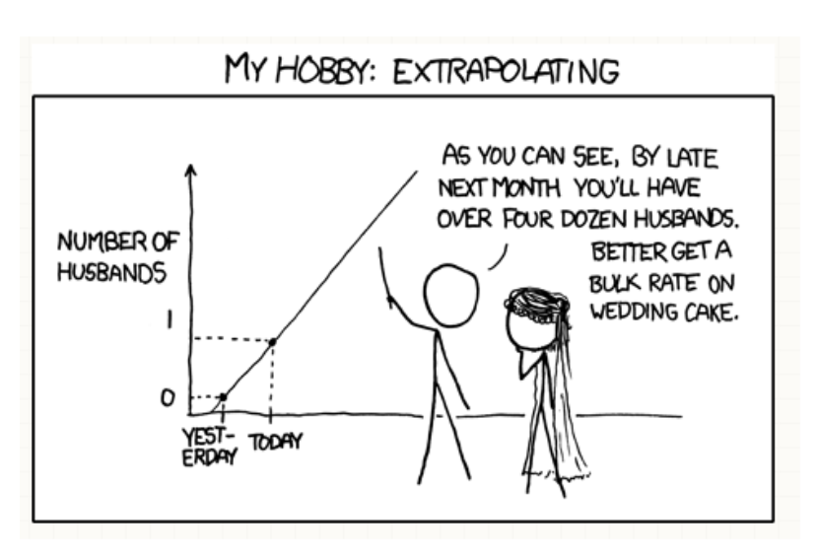
How do we use box plots and scatter graphs to represent and compare large data sets?
The Knowledge Phase
Interpolation and extrapolation are the names given to a way of estimating or predicting using pre-existing data values.
This can be done from:
Within a data set
A scatter graph
A time Series graph
Interpolation is when an estimate is found from within the data you already have. i.e. there will be explanatory variables either side of the value you are using to create the estimate Interpolation can be estimated from a data set(see separate notes on interpolation)
Extrapolation is when the estimate (or prediction) is found from outside of the data set i.e. the will be explanatory variables either above or below the value you are using to create the estimate but not both.
Which one should I use?
Interpolation is the most accurate of the two estimates as it has variables either side to assist with the prediction.
Extrapolation can be unreliable as we have no data to base what may happen at the lower or upper end.
Particularly with time series graphs, we can follow the trend and variation of the data to make a prediction but you never know what may happen in the future which may change the outcome.
What is the difference between interpolation and extrapolation?

Slide 4
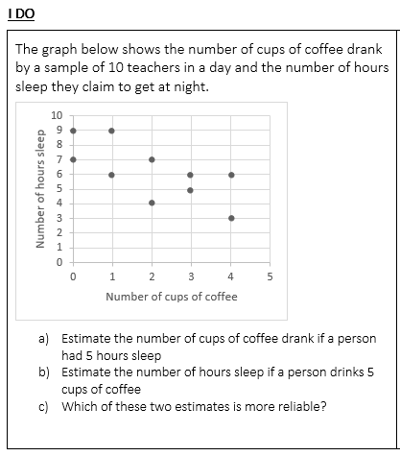
How do we use box plots and scatter graphs to represent and compare large data sets?
Plot a line of best fit by eye
a) 3 cups of coffee
*interpolation
b) 2 hours sleep
*extrapolation
c) Answer a) as this is estimated from within the sample of data
What is the difference between interpolation and extrapolation?

Slide 5
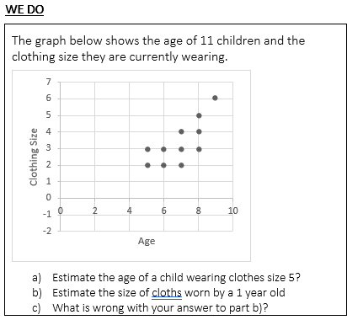
How do we use box plots and scatter graphs to represent and compare large data sets?
Plot a line of best fit by eye
a) 8 years old
*interpolation
b) size -3
*extrapolation
c) It is a negative size (non-existent) due to extrapolation
What is the difference between interpolation and extrapolation?

Slide 6
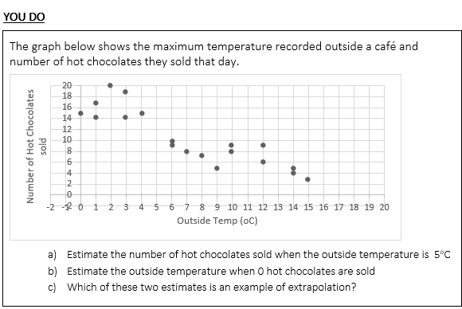
How do we use box plots and scatter graphs to represent and compare large data sets?
Plot a line of best fit by eye
a) 13 hot chocolates
*interpolation
b) 14.5 degressd
*interpolation
c) b: 0 hot chocolates was less than any in the sample
What is the difference between interpolation and extrapolation?

Slide 7

How do we use box plots and scatter graphs to represent and compare large data sets?
Practise Questions
What is the difference between interpolation and extrapolation?

