Slide 1
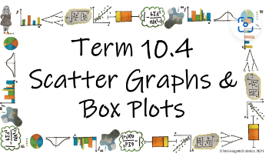



How do we use box plots and scatter graphs to represent and compare large data sets?
Plotting Scatter Graphs
How do I plot a scatter graph?

Slide 2
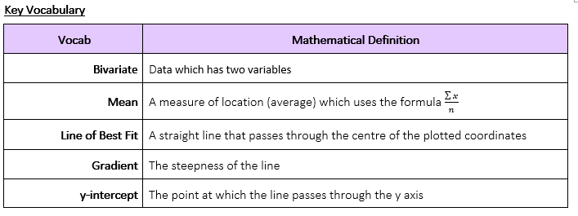
How do we use box plots and scatter graphs to represent and compare large data sets?
How do I plot a scatter graph?

Slide 3

How do we use box plots and scatter graphs to represent and compare large data sets?
The Knowledge Phase
A scatter graph is a statistical diagram used to display Bivariate Data
They allow you to plot two pieces of data simultaneously using a small cross and when lots of data is presented together on a scatter graph we can look for a relationship (Called a correlations) between the two variables
When plotting a scatter graph you need to use a table of values. Whichever variable is on the top row/the left row should be put on the x axis and plot the data as pairs of coordinates.
How do I plot a scatter graph?

Slide 4
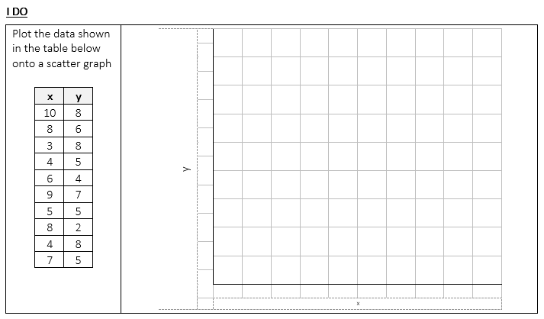
How do we use box plots and scatter graphs to represent and compare large data sets?
8
X
X
X
7
X
6
X
5
X
X
X
4
X
3
2
X
1
0
1
2
3
4
5
6
7
8
9
10
How do I plot a scatter graph?

Slide 5
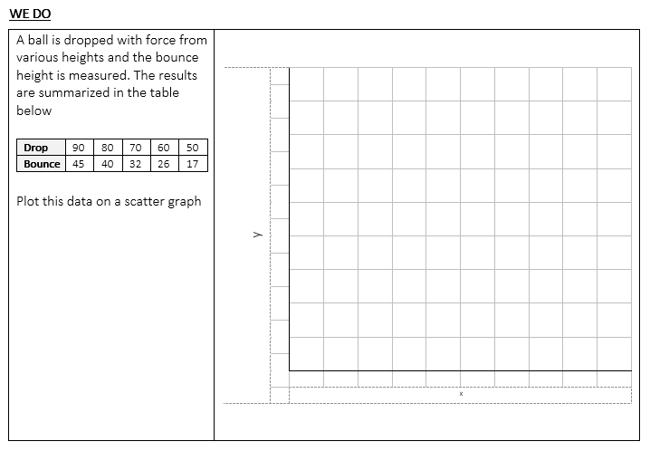
How do we use box plots and scatter graphs to represent and compare large data sets?
X
40
X
X
30
X
20
X
10
0
10
20
30
40
50
60
70
80
90
How do I plot a scatter graph?

Slide 6
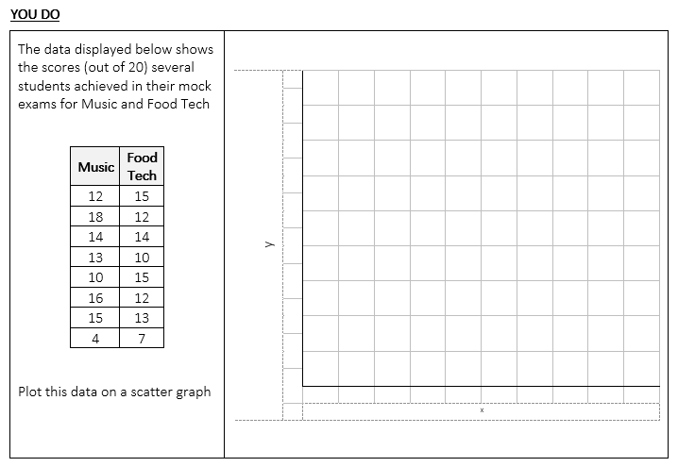
How do we use box plots and scatter graphs to represent and compare large data sets?
16
X
X
X
14
X
X
12
X
10
X
8
X
6
4
2
0
2
4
6
8
10
12
14
16
18
How do I plot a scatter graph?

Slide 7

How do we use box plots and scatter graphs to represent and compare large data sets?
Practise Questions
How do I plot a scatter graph?

Slide 8
How do we use box plots and scatter graphs to represent and compare large data sets?
The Knowledge Phase
You can draw a line of best fit on a scatter diagram if the graph shows there is a correlation (see next lesson)
The line of best fit will pass through the mean of both sets of data
When drawing the line of best fit it must be a straight line which follows the trend of the points
It is unlikely that the line will pass through every point. You must try and draw the line so that is passes through or as close to as many points as possible and any points that it does not pass through should be equally shared either side of the line
How do I plot a scatter graph?

Slide 9
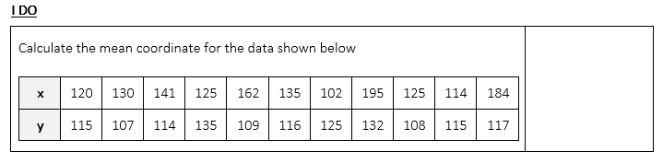
How do we use box plots and scatter graphs to represent and compare large data sets?
139
118
(139,118)
How do I plot a scatter graph?

Slide 10
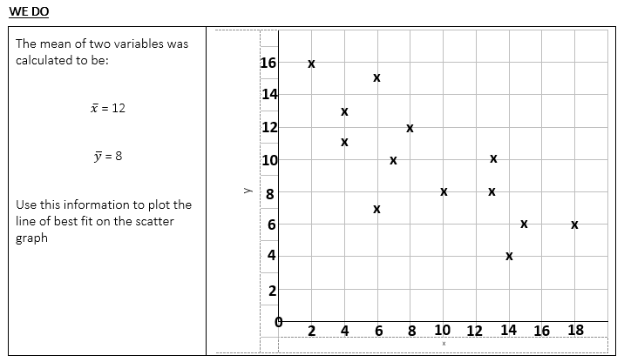
How do we use box plots and scatter graphs to represent and compare large data sets?
X
How do I plot a scatter graph?

Slide 11
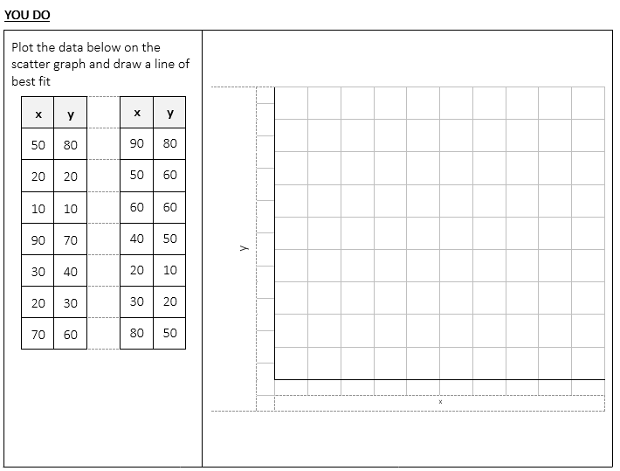
How do we use box plots and scatter graphs to represent and compare large data sets?
80
X
X
70
X
60
X
X
X
50
X
X
X
40
X
30
X
20
X
X
10
X
X
( 47 , 46 )
0
10
20
30
40
50
60
70
80
90
How do I plot a scatter graph?

Slide 12
How do we use box plots and scatter graphs to represent and compare large data sets?
Practise Questions
How do I plot a scatter graph?

Slide 13
How do we use box plots and scatter graphs to represent and compare large data sets?
The Knowledge Phase
The equation of the line of best fit
y = m x + c
Where the value of ‘m’ represents the value of the gradient : the coefficient of x
Where the value of ‘c’ represents the value of the y-intercept : the constant
How do I plot a scatter graph?

Slide 14
How do we use box plots and scatter graphs to represent and compare large data sets?
I DO
State the value of the gradient and y-intercept for the following line of best fit:
y = 3x + 9
WE DO
State the value of the gradient and y-intercept for the following line of best fit:
2y = 8x – 7
YOU DO
State the value of the gradient and y-intercept for the following line of best fit:
y = 5 – 4.2x
GRADIENT:
+3
INTERCEPT:
+9
GRADIENT:
+4
y = 4x – 3.5
INTERCEPT:
-3.5
GRADIENT:
-4.2
INTERCEPT:
+5
How do I plot a scatter graph?

Slide 15

How do we use box plots and scatter graphs to represent and compare large data sets?
What is the gradient?
y = 4x + 74
MWB ACTIVITY
A: +4
B: -4
C: 4x
D: 74
How do I plot a scatter graph?

Slide 16
How do we use box plots and scatter graphs to represent and compare large data sets?
What is the gradient?
y = 23 + 16.3x
MWB ACTIVITY
A: +23
B: +16.3
C: 16.3x
D: 23 +16.3x
How do I plot a scatter graph?

Slide 17
How do we use box plots and scatter graphs to represent and compare large data sets?
What is the y-intercept?
y = 0.7x - 5
MWB ACTIVITY
A: +0.7
B: 0.7x
C: 5
D: -5
How do I plot a scatter graph?

Slide 18
How do we use box plots and scatter graphs to represent and compare large data sets?
What is the gradient?
y = 55.2 – 7x
MWB ACTIVITY
A: 55.2
B: +7
C: -7
D: -7x
How do I plot a scatter graph?

Slide 19
How do we use box plots and scatter graphs to represent and compare large data sets?
What is the y-intercept?
-9 – 3.6x = y
MWB ACTIVITY
A: -9
B: +9
C: -3.6
D: -3.6x
How do I plot a scatter graph?

Slide 20
How do we use box plots and scatter graphs to represent and compare large data sets?
What is the gradient?
y – 13 = 2.6x
MWB ACTIVITY
+2.6
How do I plot a scatter graph?

Slide 21
How do we use box plots and scatter graphs to represent and compare large data sets?
What is the gradient?
13.9x = y + 7
MWB ACTIVITY
+13.9
How do I plot a scatter graph?

Slide 22
How do we use box plots and scatter graphs to represent and compare large data sets?
What is the gradient?
2y = 5.4x + 13
MWB ACTIVITY
+2.7
How do I plot a scatter graph?

Slide 23
How do we use box plots and scatter graphs to represent and compare large data sets?
What is the gradient?
15 – 30x = 5y
MWB ACTIVITY
-6
How do I plot a scatter graph?

Slide 24
How do we use box plots and scatter graphs to represent and compare large data sets?
Practise Questions
How do I plot a scatter graph?

Slide 25
How do we use box plots and scatter graphs to represent and compare large data sets?
The Knowledge Phase
The Gradient
To find the gradient you need to:
pick 2 points on your line of best fit
join them with a triangle
divide the number down by the number across
The y-intercept
The y - intercept is the point at which the line passes the y axis
How do I plot a scatter graph?

Slide 26
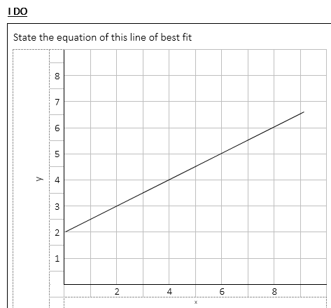
How do we use box plots and scatter graphs to represent and compare large data sets?
intercept: +2
gradient: 2 ÷ 4 = 0.5
x
y = 0.5x + 2
2
x
4
How do I plot a scatter graph?

Slide 27
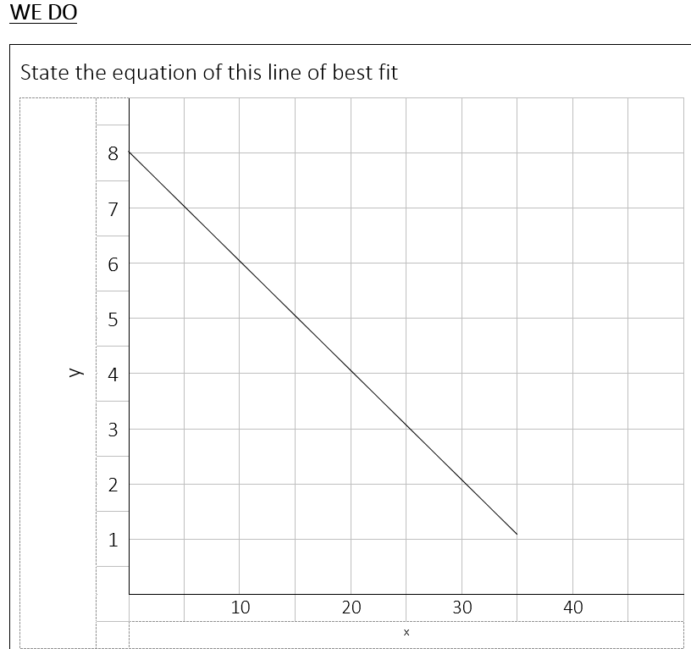
How do we use box plots and scatter graphs to represent and compare large data sets?
intercept: +2
gradient: 2 ÷ 10 = 0.2
NEGATIVE GRADIENT
x
2
y = - 0.2x + 8
x
10
How do I plot a scatter graph?

Slide 28
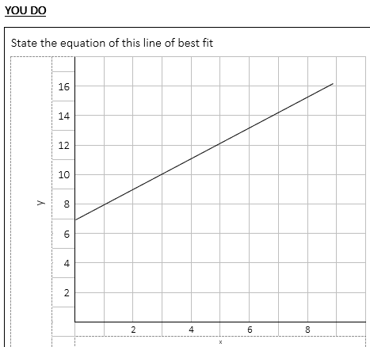
How do we use box plots and scatter graphs to represent and compare large data sets?
intercept: +7
gradient: 4 ÷ 4 = 1
x
4
y = x + 7
x
4
How do I plot a scatter graph?

Slide 29
How do we use box plots and scatter graphs to represent and compare large data sets?
Practise Questions
How do I plot a scatter graph?

Slide 30
How do we use box plots and scatter graphs to represent and compare large data sets?
The Knowledge Phase
Gradient in context
The gradient tells us the 'steepness' of the line
It is calculated: for every one we count across, how many to we count up?
It tells us the increase (or decrease) in y for each change by one in x
y-intercept in context
The y-intercept tells us the point at which the line crosses the y axis
It tells us the value of x when y = 0
How do I plot a scatter graph?

Slide 31
How do we use box plots and scatter graphs to represent and compare large data sets?
I DO
For a scatter graph showing the relationship between the temperature and the bike hires the equations of
the line of best fit is: y = 3x + 42
Explain the value of the gradient in context Explain the value of the y-intercept in context
WE DO
Contestants on a daytime quiz shows are asked to answer questions in 60 seconds. The amount of money they win at the end of the show is also recorded and a scatter graph is used to determine if the two variables are related.
The equation of the line of best for the scatter graph is calculated to be y = 1.47x + 3618
Explain the value of the gradient in context Explain the value of the y-intercept in context
YOU DO
A scatter graph is plotted to show the correlation between the number of faults found in a component made by hand and the number of years experience the employee who made it has in the field. Where the number of years experience is the explanatory variable (x).
An equation for line of best fit is found as follows: y = 9.6 – 3.14x
Explain the value of the gradient in context Explain the value of the y-intercept in context
+3: For every increase of 1 degree in temperature, the average number of bikes hired increase by 3
+42: when the temperature is 0 degrees, the average number of bikes hired is 42
+1.47: For every extra question they answer correctly, they win an average of an extra £1.47
+3618: if they answer 0 question correctly they win an average of £3618
-3.14: For every extra fault that is found it is expected that the employees will have 3.14 years less experience
+9.6: when there are no faults found, the average number of years experience is 9.6

Slide 32
How do we use box plots and scatter graphs to represent and compare large data sets?
Practise Questions
How do I plot a scatter graph?

