Slide 1
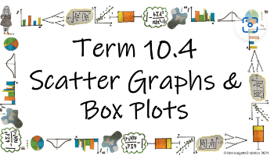



How do we use box plots and scatter graphs to represent and compare large data sets?
Skew
How is skew described and calculated?

Slide 2
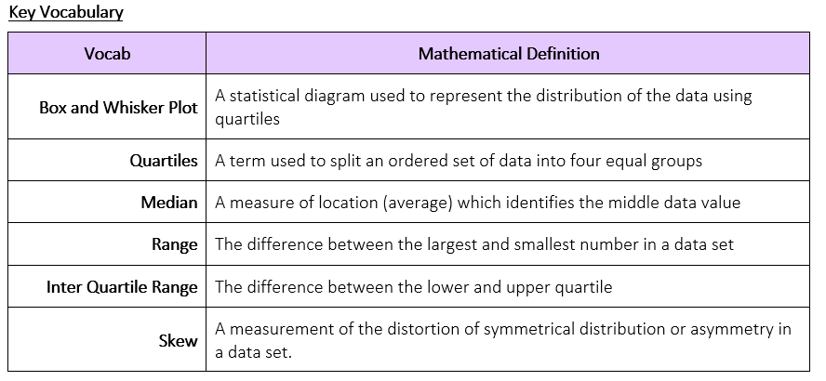
How do we use box plots and scatter graphs to represent and compare large data sets?
How is skew described and calculated?

Slide 3
How do we use box plots and scatter graphs to represent and compare large data sets?
The Knowledge Phase
Negative Skew
The median is closer to the upper quartile than the upper quartile
This means that although the range of the data is wide, the average
of the data is towards the lower end of the scale
Positive Skew
The median is closer to the lower quartile than the lower quartile
This means that although the range of the data is wide, the average
of the data is towards the upper end of the scale
Neither of these distributions are better than the other, it just helps us describe the distribution of the data and compare them
Symmetrical Skew
Should the median be equidistant from both the lower and upper
quartiles, then the skew is said to be ‘symmetrical’
How is skew described and calculated?

Slide 4

How do we use box plots and scatter graphs to represent and compare large data sets?
MWB ACTIVITY
POSITIVE
SYMMETRICAL
NEGATIVE
How is skew described and calculated?

Slide 5
How do we use box plots and scatter graphs to represent and compare large data sets?
MWB ACTIVITY
POSITIVE
SYMMETRICAL
NEGATIVE
How is skew described and calculated?

Slide 6
How do we use box plots and scatter graphs to represent and compare large data sets?
MWB ACTIVITY
POSITIVE
SYMMETRICAL
NEGATIVE
How is skew described and calculated?

Slide 7
How do we use box plots and scatter graphs to represent and compare large data sets?
MWB ACTIVITY
POSITIVE
SYMMETRICAL
NEGATIVE
How is skew described and calculated?

Slide 8
How do we use box plots and scatter graphs to represent and compare large data sets?
MWB ACTIVITY
POSITIVE
SYMMETRICAL
NEGATIVE
How is skew described and calculated?

Slide 9
How do we use box plots and scatter graphs to represent and compare large data sets?
MWB ACTIVITY
POSITIVE
SYMMETRICAL
NEGATIVE
How is skew described and calculated?

Slide 10
How do we use box plots and scatter graphs to represent and compare large data sets?
MWB ACTIVITY
POSITIVE
SYMMETRICAL
NEGATIVE
How is skew described and calculated?

Slide 11
How do we use box plots and scatter graphs to represent and compare large data sets?
MWB ACTIVITY
POSITIVE
SYMMETRICAL
NEGATIVE
How is skew described and calculated?

Slide 12
How do we use box plots and scatter graphs to represent and compare large data sets?
MWB ACTIVITY
POSITIVE
SYMMETRICAL
NEGATIVE
How is skew described and calculated?

Slide 13
How do we use box plots and scatter graphs to represent and compare large data sets?
MWB ACTIVITY
POSITIVE
SYMMETRICAL
NEGATIVE
How is skew described and calculated?

Slide 14
How do we use box plots and scatter graphs to represent and compare large data sets?
MWB ACTIVITY
POSITIVE
SYMMETRICAL
NEGATIVE
How is skew described and calculated?

Slide 15
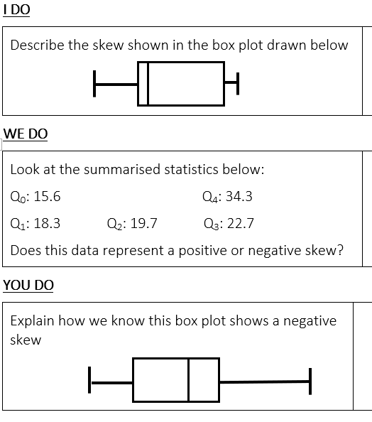
How do we use box plots and scatter graphs to represent and compare large data sets?
Positive Skew
Q₂ – Q₁ = 1.4
Q₃ – Q₂ = 3.0
Positive Skew
The median is closer to the upper quartile than the lower quartile
How is skew described and calculated?

Slide 16


How do we use box plots and scatter graphs to represent and compare large data sets?
Practise Questions
Exam Questions
How is skew described and calculated?

Slide 17
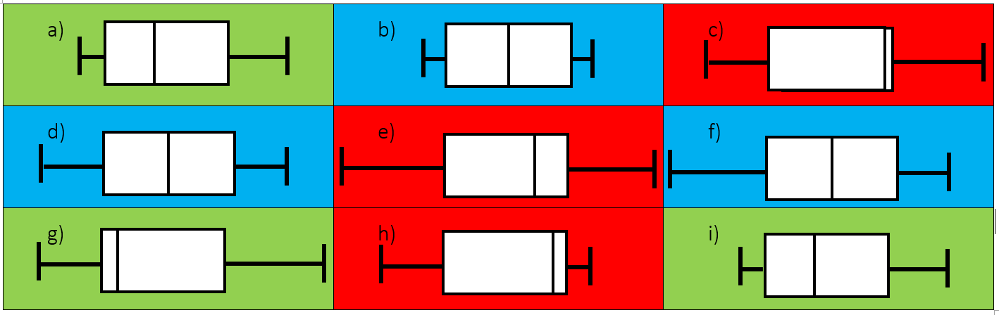
How do we use box plots and scatter graphs to represent and compare large data sets?
Q2 a) positive b) positive c) negative d) symmetrical
How is skew described and calculated?

Slide 18
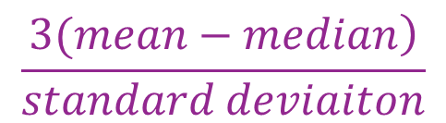
How do we use box plots and scatter graphs to represent and compare large data sets?
The Knowledge Phase
Skew can be identified from a statistical diagram such as a box plot but it can also be calculated with a numerical value
The formula for calculating skew is given as:
N.B we will know if the skew is positive or negative just from the mean and median values
$$\frac{\left.3(mean−median\right)}{standard deviaiton}$$
*This formula is given on the formula page in the front of your exam paper
How is skew described and calculated?

Slide 19
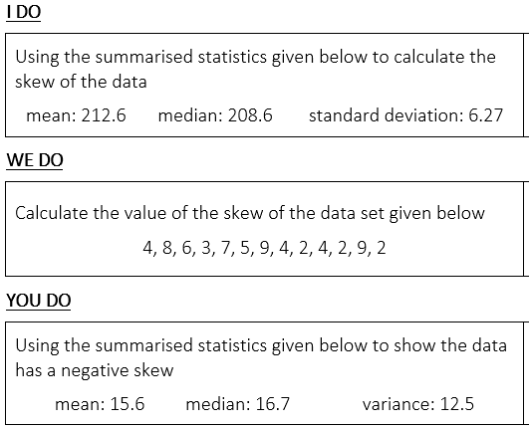
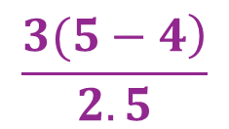
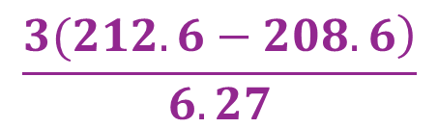
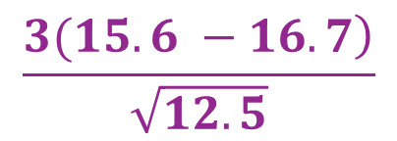
How do we use box plots and scatter graphs to represent and compare large data sets?
$$\frac{\left.3(212.6−208.6\right)}{6.27}$$
= 1.91
mean = 5
median = 4
$$\frac{\left.3(5−4\right)}{2.5}$$
= 1.2
sd = 2.5
$$\frac{\left.3(15.6 −16.7\right)}{\sqrt{12.5}}$$
= -0.93
How is skew described and calculated?

Slide 20
How do we use box plots and scatter graphs to represent and compare large data sets?
Practise Questions
Exam Questions
How is skew described and calculated?

