Slide 1




How do we use box plots and scatter graphs to represent and compare large data sets?
SRCC
How do I calculate and interpret the value of the SRCC?

Slide 2
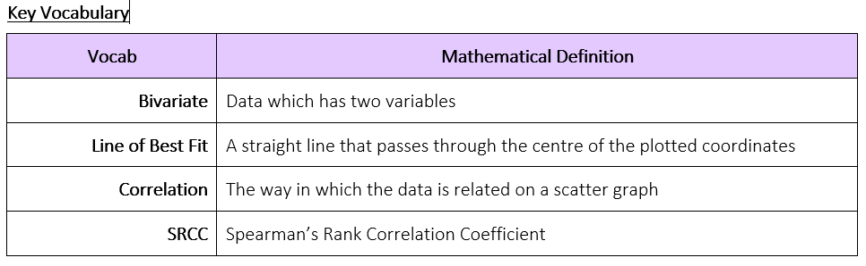
How do we use box plots and scatter graphs to represent and compare large data sets?
How do I calculate and interpret the value of the SRCC?

Slide 3
How do we use box plots and scatter graphs to represent and compare large data sets?
The Knowledge Phase
Spearman’s Rank Correlation Coefficient or SRCC is a special case of the PMCC which is a value given to the correlation between the ranks of two variables.
It can be used when the data is qualitative (as when we rank the data, we make it quantitative) It can be used for non-linear data (the pairs of data are on different scales and therefore unfair to compare)
SPEARMAN’S – it is named after Charles Spearman
RANK – it required you to rank the data
CORRELATION – it is a measure of the relationship between two variables
COEFFICIENT – it is a numerical value It is calculated using a statistical formula given on the formula page of the exam paper
Where d is the differences between the ranks
Where n is the total number of pairs of data
How do I calculate and interpret the value of the SRCC?

Slide 4
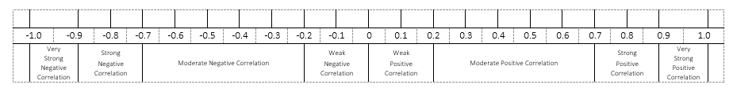
How do we use box plots and scatter graphs to represent and compare large data sets?
Just like the PMCC, the SRCC is a value between – 1 and + 1 (where 0 indicates no correlation)
A negative value implies a negative correlation
A positive value implies a positive correlation
The closer the value is to zero, the weaker the correlation is
The main difference between the calculation on the SRCC compared to the PMCC is that the data must first be RANKED
How do I calculate and interpret the value of the SRCC?

Slide 5
How do we use box plots and scatter graphs to represent and compare large data sets?
Ranking
Always rank from smallest to largest (unless otherwise stated)
If two or more values are equal they MUST share the median rank
The final rank should be equal to n
How do I calculate and interpret the value of the SRCC?

Slide 6
NB Never change the order of the numbers
How do we use box plots and scatter graphs to represent and compare large data sets?
I DO
Rank these data sets each from smallest to largest
147 164 123 125 195 171 112
I DO
Rank these data sets each from smallest to largest
45 61 23 35 23 94 35
WE DO
Rank these data sets each from smallest to largest
11 6 3 6 4 6 5 11 9 15
YOU DO
Rank these data sets each from smallest to largest
4 2 6 4 5 7 9
4
5
2
3
7
6
1
1
3
2
4
5
6
1.5
3.5
1.5
7
3.5
8
4
5
6
9
8.5
5
1
5
2
5
3
8.5
7
10
2
3
2.5
1
5
2.5
4
6
7
How do I calculate and interpret the value of the SRCC?

Slide 7

How do we use box plots and scatter graphs to represent and compare large data sets?
Practise Questions
How do I calculate and interpret the value of the SRCC?

Slide 8
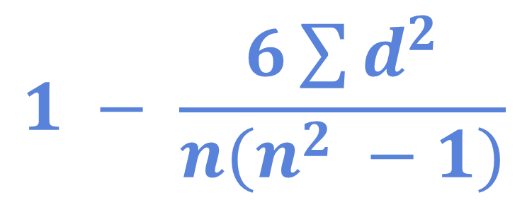
How do we use box plots and scatter graphs to represent and compare large data sets?
The Knowledge Phase
1. Rank both sets of data separately
2. Work out the difference between each pair of ranks [d]
3. Square each of these differences [d²]
4. Add all of these d² values together [Σd²]
5. Multiply this answer by 6 [6Σd²]
6. Count the number of pairs of data [n]
7. Multiply this by the number of pairs of data ^{squared} - 1 [n(n² - 1)]
8. Substitute point 5 and point 7 into the formula
$$1 − \frac{6\sum{d^{2}}}{n(n^{2} −1)}$$
How do I calculate and interpret the value of the SRCC?

Slide 9
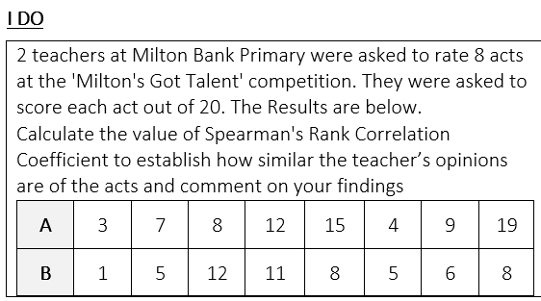
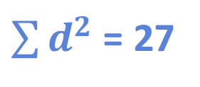
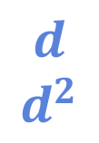



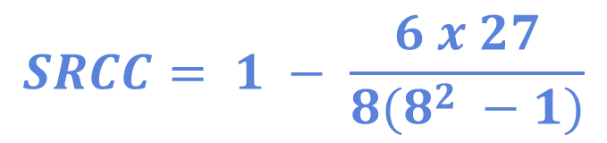

How do we use box plots and scatter graphs to represent and compare large data sets?
$$1 − \frac{6\sum{d^{2}}}{n(n^{2} −1)}$$
$\sum{d^{2}}$ = 27
$$n=8$$
$$SRCC= 1 − \frac{6 x 27}{8(8^{2} −1)}$$
Rank A
Rank B
1
3
4
6
7
2
5
8
1
2.5
8
7
5.5
2.5
4
5.5
$$d$$
$$d^{2}$$
0.5
4
$$SRCC=0.679$$
0
1
1.5
0.5
1
2.5
0
0.25
16
1
2.25
0.25
1
6.25
$$moderate positive$$
$$correlation$$
How do I calculate and interpret the value of the SRCC?

Slide 10
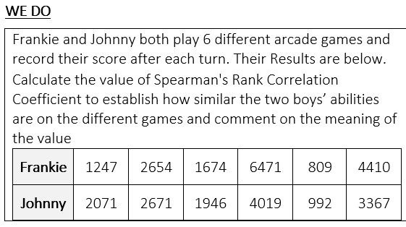
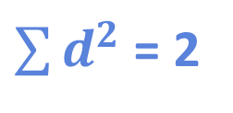

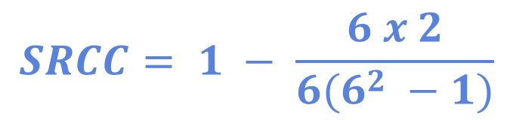
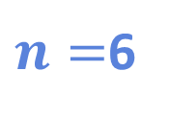
How do we use box plots and scatter graphs to represent and compare large data sets?
$$1 − \frac{6\sum{d^{2}}}{n(n^{2} −1)}$$
$\sum{d^{2}}$ = 2
$n=$6
$$SRCC= 1 − \frac{6 x 2}{6(6^{2} −1)}$$
Rank A
Rank B
2
4
3
6
1
5
3
4
2
6
1
5
$$d$$
$$d^{2}$$
$$SRCC=0.943$$
1
0
1
0
0
0
1
0
1
0
0
0
Very strong positive correlation
How do I calculate and interpret the value of the SRCC?

Slide 11
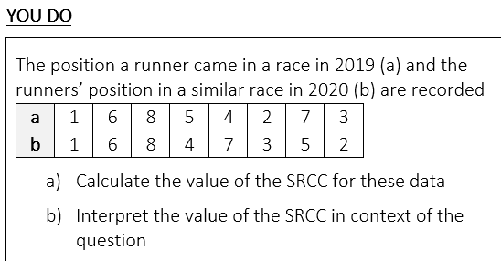
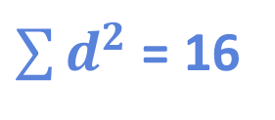



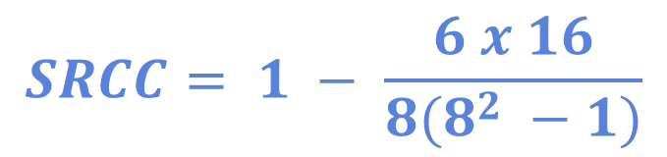
How do we use box plots and scatter graphs to represent and compare large data sets?
$$1 − \frac{6\sum{d^{2}}}{n(n^{2} −1)}$$
$\sum{d^{2}}$ = 16
$$n=8$$
$$SRCC= 1 − \frac{6 x 16}{8(8^{2} −1)}$$
$$d$$
$$d^{2}$$
0
0
0
1
3
1
2
1
0
0
0
1
9
1
4
1
$$SRCC=0.810$$
$$strong positive$$
$$correlation$$
How do I calculate and interpret the value of the SRCC?

Slide 12

How do we use box plots and scatter graphs to represent and compare large data sets?
Rank the clubs from best to worst IN YOU OPINION
Calculate the SRCC between your opinion and others in the class
Who do you most agree with?
Who do you most disagree with?
How do I calculate and interpret the value of the SRCC?

Slide 13

How do we use box plots and scatter graphs to represent and compare large data sets?
Rank the princesses from least to most independent IN YOUR OPINION
Calculate the SRCC between your opinion and others in the class
Who do you most agree with?
Who do you most disagree with?
How do I calculate and interpret the value of the SRCC?

Slide 14
How do we use box plots and scatter graphs to represent and compare large data sets?
Practise Questions
How do I calculate and interpret the value of the SRCC?

