Slide 1




How do we use box plots and scatter graphs to represent and compare large data sets?
PMCC
What does PMCC stand for and what does the value of the PMCC imply about the data?

Slide 2
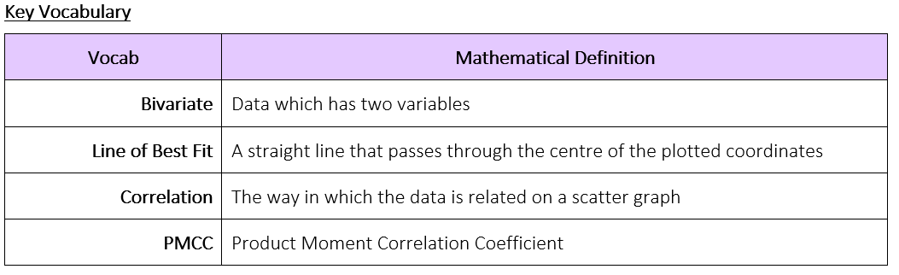
How do we use box plots and scatter graphs to represent and compare large data sets?
What does PMCC stand for and what does the value of the PMCC imply about the data?

Slide 3
How do we use box plots and scatter graphs to represent and compare large data sets?
The Knowledge Phase
Product Moment Correlation Coefficient or PMCC is a value given to a correlation between two variables.
The PMCC is a measure of the strength of a linear association between two variables and is denoted by r.
Basically, if you were to draw a line of best fit through the data of two variables, the PMCC, r, indicates how far away all these data points are to this line of best fit
Product Moment Correlation should be used if:
the variables are either interval or ratio measurements (i.e. numerical values which are not already ranked),
each variable is approximately normally distributed
there is a linear relationship between the two variables.
What does PMCC stand for and what does the value of the PMCC imply about the data?

Slide 4
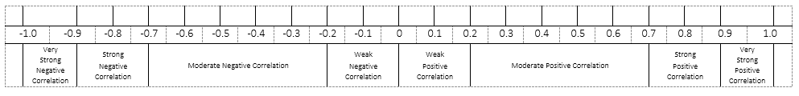
How do we use box plots and scatter graphs to represent and compare large data sets?
The PMCC is a value between – 1 and + 1 (where 0 indicates no correlation)
A negative value implies a negative correlation
A positive value implies a positive correlation
The closer the value is to zero, the weaker the correlation is
What does PMCC stand for and what does the value of the PMCC imply about the data?

Slide 5
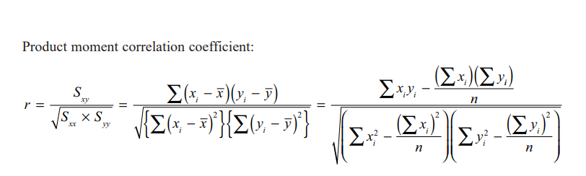
How do we use box plots and scatter graphs to represent and compare large data sets?
What does PMCC stand for and what does the value of the PMCC imply about the data?

Slide 6
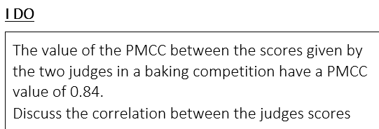
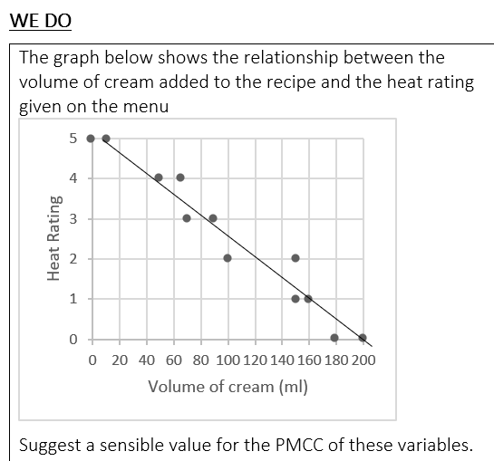
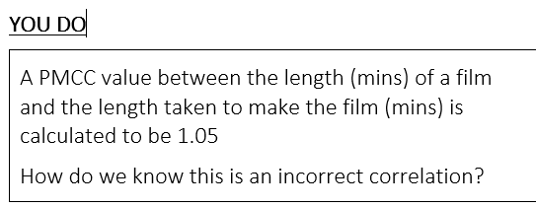
How do we use box plots and scatter graphs to represent and compare large data sets?
0.84 => Strong Positive Correlation
The two judges score very similarly for the baking competition
Negative Correlation (Strong)
PMCC ≈ -0.82
PMCC must be between -1 and +1
What does PMCC stand for and what does the value of the PMCC imply about the data?

Slide 7

How do we use box plots and scatter graphs to represent and compare large data sets?
Practise Questions
What does PMCC stand for and what does the value of the PMCC imply about the data?

