Slide 1
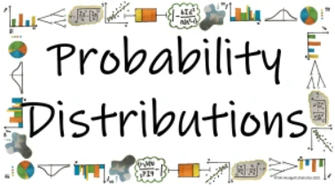



How can the different probability distributions be used to calculate probabilities is specific circumstances?
The Normal Distribution
What are the properties of a normal distribution?

Slide 2
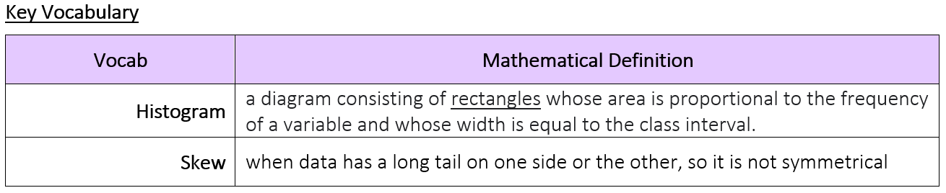
How can the different probability distributions be used to calculate probabilities is specific circumstances?
What are the properties of a normal distribution?

Slide 3
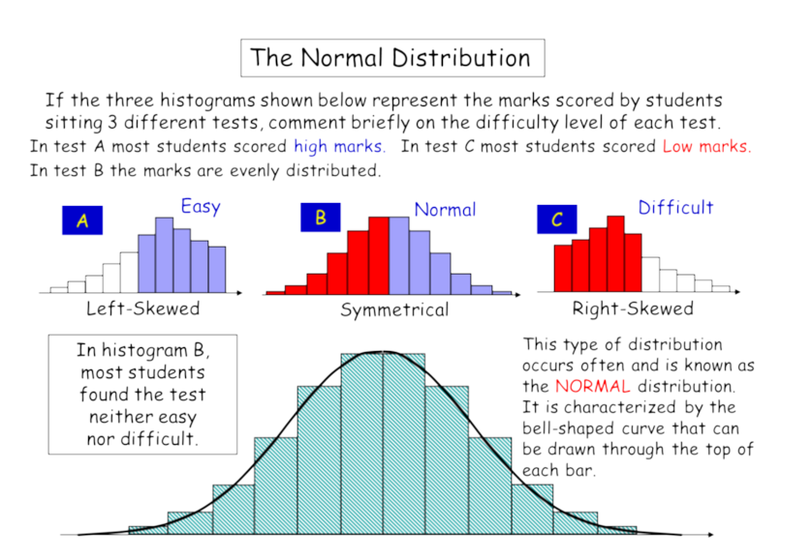
How can the different probability distributions be used to calculate probabilities is specific circumstances?
The Knowledge Phase
Last year we looked at histograms. A histogram is a bar chart for continuous data where the frequency is represented by the area of the bar rather than its height.
When a histogram is drawn we can see how the data is distributed across the scale and get a feel for what the data shows.
If the histogram peaks towards the end of the graph we would say that this is has a negative skew. This suggests that the majority of the data is found to the right of the graph
If the histogram peaks towards the beginning of the graph we would say that this is has a positive skew. This suggests that the majority of the data is found to the left of the graph
If the histogram peaks in the centre of the graph we would say that this is has a symmetrical skew. This suggests that the data is quite evenly shared out between the lower and upper end of the graph
This type of distribution is common and is called the normal distribution
What are the properties of a normal distribution?

Slide 4
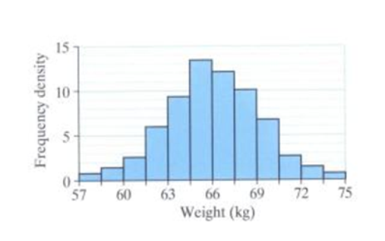
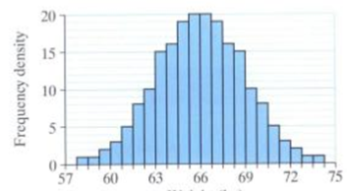
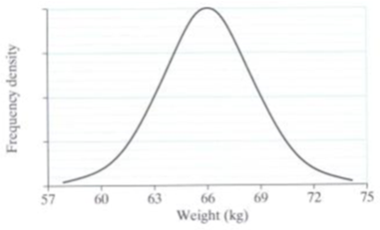
How can the different probability distributions be used to calculate probabilities is specific circumstances?
A histogram for the weights of 100 boys might
look like this
If the number of boys doubles and the class
intervals halved it would look like this
If we kept repeating this process the bars would
become more and more smoothed out and we
would eventually get a bell shaped curve.
Variables which have these qualities are said to be normally distributed
What are the properties of a normal distribution?

Slide 5

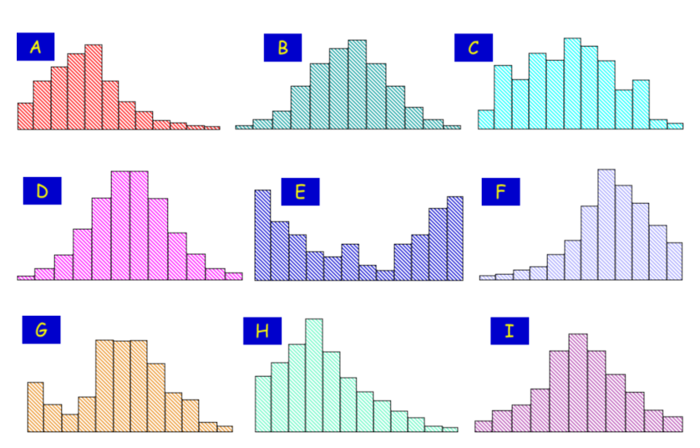
How can the different probability distributions be used to calculate probabilities is specific circumstances?
MWB ACTIVITY
Positive
Skew
What are the properties of a normal distribution?

Slide 6
How can the different probability distributions be used to calculate probabilities is specific circumstances?
MWB ACTIVITY
Symmetrical
Skew
NORMAL
What are the properties of a normal distribution?

Slide 7
How can the different probability distributions be used to calculate probabilities is specific circumstances?
MWB ACTIVITY
No
Skew
What are the properties of a normal distribution?

Slide 8
How can the different probability distributions be used to calculate probabilities is specific circumstances?
MWB ACTIVITY
Symmetrical
Skew
NORMAL
What are the properties of a normal distribution?

Slide 9
How can the different probability distributions be used to calculate probabilities is specific circumstances?
MWB ACTIVITY
No
Skew
What are the properties of a normal distribution?

Slide 10
How can the different probability distributions be used to calculate probabilities is specific circumstances?
MWB ACTIVITY
Negative
Skew
What are the properties of a normal distribution?

Slide 11
How can the different probability distributions be used to calculate probabilities is specific circumstances?
MWB ACTIVITY
No
Skew
What are the properties of a normal distribution?

Slide 12
How can the different probability distributions be used to calculate probabilities is specific circumstances?
MWB ACTIVITY
Positive
Skew
What are the properties of a normal distribution?

Slide 13
How can the different probability distributions be used to calculate probabilities is specific circumstances?
MWB ACTIVITY
Symmetrical
Skew
NORMAL
What are the properties of a normal distribution?

Slide 14
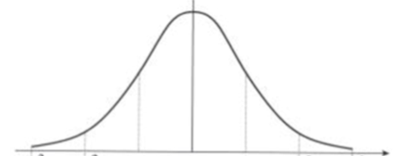
How can the different probability distributions be used to calculate probabilities is specific circumstances?
The Knowledge Phase
the distribution is
symmetrical about the mean
the mean, median and mode are all equal
68% of observations lie within one standard deviation of the mean
95% of observations lie within two standard deviations of the mean
99.8% of observations lie
within three standard deviations of the mean
NB The wider the curve the shorter it will be as they should both have the same area underneath them
What are the properties of a normal distribution?

Slide 15
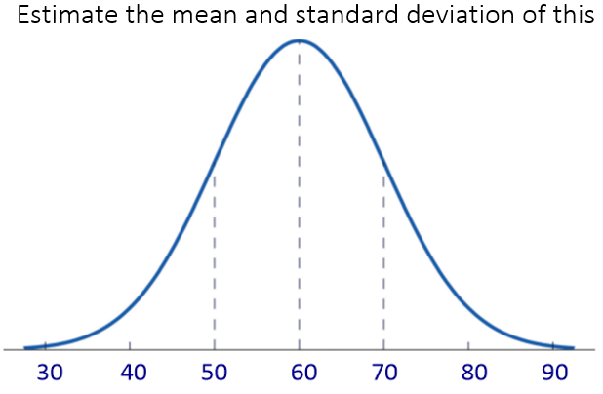
How can the different probability distributions be used to calculate probabilities is specific circumstances?
I DO
What are the properties of a normal distribution?

Slide 16
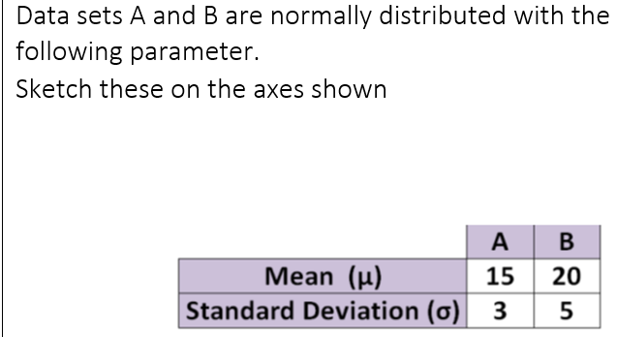
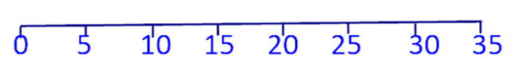
How can the different probability distributions be used to calculate probabilities is specific circumstances?
WE DO
What are the properties of a normal distribution?

Slide 17

How can the different probability distributions be used to calculate probabilities is specific circumstances?
Practise Questions
What are the properties of a normal distribution?

Slide 18
How can the different probability distributions be used to calculate probabilities is specific circumstances?
I DO
A Normal Distribution is used to represent the results of a test out of 30 for students in 11B
The mean score is known to be 20 with a standard deviation of 3
a) Between which two scores are 68% of the marks between?
b) Between which two scores are 95% of the marks between?
c) Between which two scores are 99.8% of the marks between?
What are the properties of a normal distribution?

Slide 19
How can the different probability distributions be used to calculate probabilities is specific circumstances?
I DO
A Normal Distribution is used to represent the weights of 3000 chocolate bars with a standard deviation of 3g and a mean of 120g.
a) How many bars would you expect to weigh between 117g and 123g?
b) How many bars would you expect to weigh between 114g and 126g?
c) How many bars would you expect to weigh less than 114g?
What are the properties of a normal distribution?

Slide 20

How can the different probability distributions be used to calculate probabilities is specific circumstances?
Practise Questions
Exam Questions
What are the properties of a normal distribution?

