Slide 1
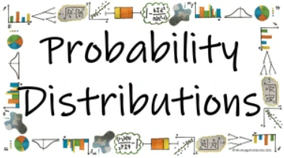



How can the different probability distributions be used to calculate probabilities is specific circumstances?
The Uniform Distribution
What does the Uniform Distribution look like and how can we use it to predict values?

Slide 2
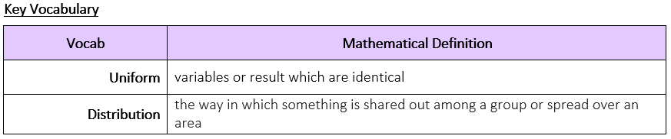
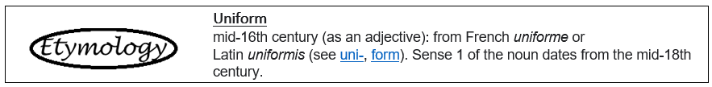
How can the different probability distributions be used to calculate probabilities is specific circumstances?
What does the Uniform Distribution look like and how can we use it to predict values?

Slide 3
How can the different probability distributions be used to calculate probabilities is specific circumstances?
The Knowledge Phase
The Discrete Uniform Distribution occurs when the probability of each outcome is equally likely
Examples of this include:
Rolling a fair dice
Flipping a fair coin
Choosing a card from a fair deck
If the distribution has outcomes of 1, 2, 3, ..., n then the probability of each value occurring is 1/n
N.B if the distribution has outcomes which does not start at 1 we must take this into consideration when calculation the probability.
What does the Uniform Distribution look like and how can we use it to predict values?

Slide 4
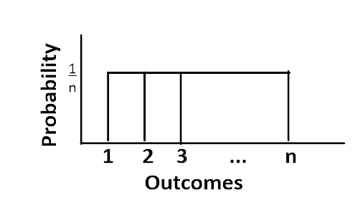

How can the different probability distributions be used to calculate probabilities is specific circumstances?
The Discrete Uniform Distribution is also known as the RECTANGULAR distribution
as it looks like a rectangle
when drawn
Historical Origins | According to James Landau's entry to Jeff Miller's Earliest Known Uses of Some of the Words of Mathematics: "Uniform distribution appears in 1937 in Introduction to Mathematical Probability by J. V. Uspensky.
What does the Uniform Distribution look like and how can we use it to predict values?

Slide 5

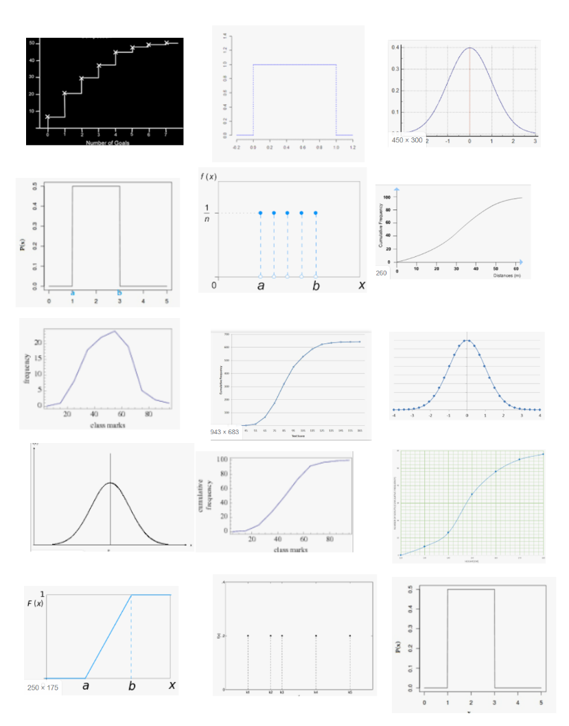
How can the different probability distributions be used to calculate probabilities is specific circumstances?
MWB ACTIVITY
Not Uniform
What does the Uniform Distribution look like and how can we use it to predict values?

Slide 6
How can the different probability distributions be used to calculate probabilities is specific circumstances?
MWB ACTIVITY
Uniform
What does the Uniform Distribution look like and how can we use it to predict values?

Slide 7
How can the different probability distributions be used to calculate probabilities is specific circumstances?
MWB ACTIVITY
Not
Uniform
What does the Uniform Distribution look like and how can we use it to predict values?

Slide 8
How can the different probability distributions be used to calculate probabilities is specific circumstances?
MWB ACTIVITY
Not
Uniform
What does the Uniform Distribution look like and how can we use it to predict values?

Slide 9
How can the different probability distributions be used to calculate probabilities is specific circumstances?
MWB ACTIVITY
Uniform
What does the Uniform Distribution look like and how can we use it to predict values?

Slide 10
How can the different probability distributions be used to calculate probabilities is specific circumstances?
MWB ACTIVITY
Uniform
What does the Uniform Distribution look like and how can we use it to predict values?

Slide 11
How can the different probability distributions be used to calculate probabilities is specific circumstances?
MWB ACTIVITY
Not
Uniform
What does the Uniform Distribution look like and how can we use it to predict values?

Slide 12
How can the different probability distributions be used to calculate probabilities is specific circumstances?
MWB ACTIVITY
Not
Uniform
What does the Uniform Distribution look like and how can we use it to predict values?

Slide 13
How can the different probability distributions be used to calculate probabilities is specific circumstances?
MWB ACTIVITY
Not
Uniform
What does the Uniform Distribution look like and how can we use it to predict values?

Slide 14
How can the different probability distributions be used to calculate probabilities is specific circumstances?
MWB ACTIVITY
Not
Uniform
What does the Uniform Distribution look like and how can we use it to predict values?

Slide 15
How can the different probability distributions be used to calculate probabilities is specific circumstances?
MWB ACTIVITY
Not
Uniform
What does the Uniform Distribution look like and how can we use it to predict values?

Slide 16
How can the different probability distributions be used to calculate probabilities is specific circumstances?
MWB ACTIVITY
Not
Uniform
What does the Uniform Distribution look like and how can we use it to predict values?

Slide 17
How can the different probability distributions be used to calculate probabilities is specific circumstances?
MWB ACTIVITY
Not
Uniform
What does the Uniform Distribution look like and how can we use it to predict values?

Slide 18
How can the different probability distributions be used to calculate probabilities is specific circumstances?
MWB ACTIVITY
Uniform
What does the Uniform Distribution look like and how can we use it to predict values?

Slide 19
How can the different probability distributions be used to calculate probabilities is specific circumstances?
MWB ACTIVITY
Uniform
What does the Uniform Distribution look like and how can we use it to predict values?

Slide 20
How can the different probability distributions be used to calculate probabilities is specific circumstances?
The Knowledge Phase
We can calculate averages from a Uniform distribution. We know that to calculate the mean of any set of data we add all of the values together and divide by the total number of values.
When calculating the weighted mean we use a similar process but must take into consideration the weight of each piece of data.
For a discrete uniform distribution, when the data is evenly spaced and of equal weight we know that the mean and median will be the same value.
With the uniform distribution, because the probability (weight) of each value is the same we can calculate these values using a shortcut:
adding the first and last values
dividing by 2
What does the Uniform Distribution look like and how can we use it to predict values?

Slide 21
How can the different probability distributions be used to calculate probabilities is specific circumstances?
I DO
When you roll a fair dice, each of the six faces
is equally likely to occur.
Draw a probability diagram to show this
What does the Uniform Distribution look like and how can we use it to predict values?

Slide 22
How can the different probability distributions be used to calculate probabilities is specific circumstances?
WE DO
When you roll a fair dice, each of the six faces is equally likely to occur.
Calculate the mean and median score from the dice
What does the Uniform Distribution look like and how can we use it to predict values?

Slide 23
How can the different probability distributions be used to calculate probabilities is specific circumstances?
YOU DO
Random numbers from 0 to 9 are created using a calculator.
Draw a diagram to illustrate the probability distribution
(a) what is the probability of each value?
(b) what is the expected mean value?
What does the Uniform Distribution look like and how can we use it to predict values?

Slide 24


How can the different probability distributions be used to calculate probabilities is specific circumstances?
Practise Questions
Exam Questions
What does the Uniform Distribution look like and how can we use it to predict values?

