Slide 1
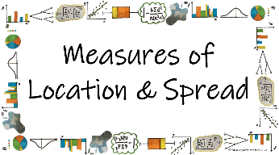



How can we use different statistical calculations to describe sets of data?
The Geometric Mean
What is the geometric mean and how do we calculate it?

Slide 2
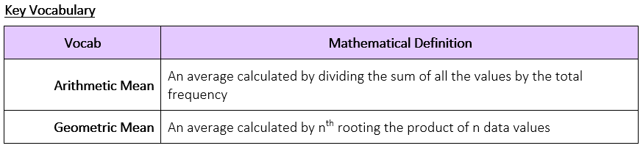
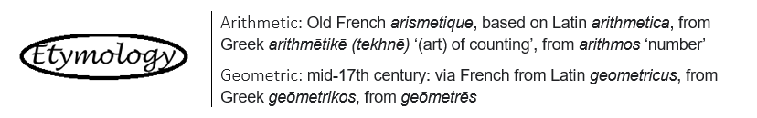
How can we use different statistical calculations to describe sets of data?
What is the geometric mean and how do we calculate it?

Slide 3
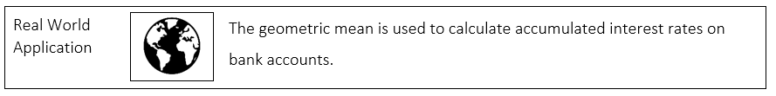
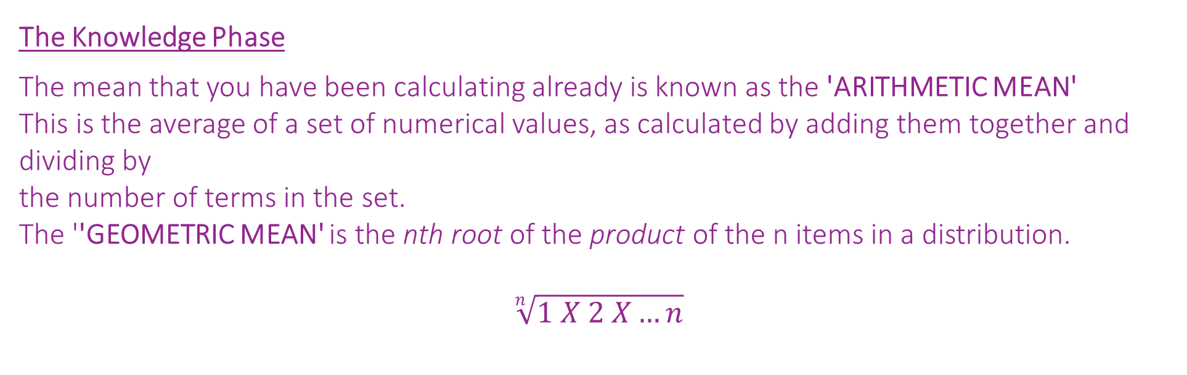
How can we use different statistical calculations to describe sets of data?
The Knowledge Phase
The mean that you have been calculating already is known as the 'ARITHMETIC MEAN'
This is the average of a set of numerical values, as calculated by adding them together and dividing by
the number of terms in the set.
The ''GEOMETRIC MEAN' is the nth root of the product of the n items in a distribution.
$$\sqrt[n]{1 X 2 X…n}$$
What is the geometric mean and how do we calculate it?

Slide 4
How can we use different statistical calculations to describe sets of data?
I DO
Find the arithmetic and geometric mean of
5 and 7
WE DO
Find the arithmetic and geometric mean of
2, 5, 7 and 4
YOU DO
Find the arithmetic and geometric mean of
3, 4 and 6
What is the geometric mean and how do we calculate it?

Slide 5


How can we use different statistical calculations to describe sets of data?
Practise Questions
Exam Questions
What is the geometric mean and how do we calculate it?

Slide 6

How can we use different statistical calculations to describe sets of data?
MWB ACTIVITY
What is the geometric mean and how do we calculate it?

