Slide 1
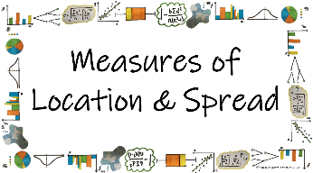



How can we use different statistical calculations to describe sets of data?
Linear Scaling
How can we use scaling to simplify calculating the mean?

Slide 2
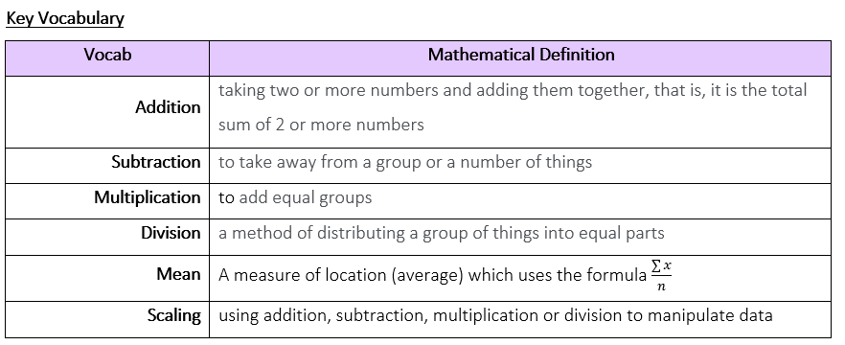
How can we use different statistical calculations to describe sets of data?
How can we use scaling to simplify calculating the mean?

Slide 3
How can we use different statistical calculations to describe sets of data?
The Knowledge Phase
When data involves large or awkward numbers you can sometimes make the numbers easier by scaling.
This means you make fewer errors in your calculations
It also allows us to calculate the mean more quickly if we know that the data has been manipulated in some way without having to work out from scratch again.
How can we use scaling to simplify calculating the mean?

Slide 4
How can we use different statistical calculations to describe sets of data?
We can, therefore, add or subtract the same constant from each value so the numbers you use to calculate the mean with are simpler.
We then subtract or add back the constant to the mean
We can also multiply or divide by the same constant for each value so the numbers you use to calculate the mean with are simpler.
We then divide or multiply back the constant to the mean
How can we use scaling to simplify calculating the mean?

Slide 5
How can we use different statistical calculations to describe sets of data?
I DO
50 90 60 40 50 80 70 40 50 60 30 50
Find the mean of this set of number by using an appropriate scaling method
How can we use scaling to simplify calculating the mean?

Slide 6
How can we use different statistical calculations to describe sets of data?
WE DO
A set of data was scaled by multiplying by 2 then adding 5
The mean of this scaled data is 14.6
What is the mean of the original set of data?
How can we use scaling to simplify calculating the mean?

Slide 7
How can we use different statistical calculations to describe sets of data?
YOU DO
The exchange rate in Paraguay was recorded over a
week and these were the results:
5018, 5006, 5007, 5020, 5009, 5012, 5017
Subtract 5000 from each of the numbers above and calculate the mean of the data set
Scale the mean back up to find the true mean of the data set
How can we use scaling to simplify calculating the mean?

Slide 8


How can we use different statistical calculations to describe sets of data?
Practise Questions
Exam Questions
How can we use scaling to simplify calculating the mean?

Slide 9

How can we use different statistical calculations to describe sets of data?
MWB ACTIVITY
How can we use scaling to simplify calculating the mean?

