Slide 1
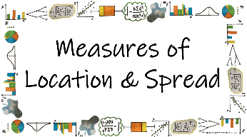



How can we use different statistical calculations to describe sets of data?
The best average to use
How do we know the best average to use?

Slide 2
How can we use different statistical calculations to describe sets of data?
The Knowledge Phase
Sometimes it is possible to calculate all three averages, other times we can only do one or two of them. In any case, it is unlikely that all 3 averages will give the same value so we need to decide which is the best to use in each scenario.
How do we know the best average to use?

Slide 3
How can we use different statistical calculations to describe sets of data?
Start by looking at the advantages and disadvantages of all three averages:
 | Advantages | Disadvantages
Mode
Median
Mean
Can be used for qualitative data
There may be no mode (useless)
Always a data value from the data set
There may be more than one mode which contradict each other
Only ever one median (and there is always one)
Does not take into account every data value
Can only be used for quantitative data
Ignores extreme values (outliers)
May not be a data value form the data set
Only ever one mean (and there is always one)
Can be affected by extreme values (outliers)
Can only be used for quantitative data
Takes into account every data value
May not be a data value form the data set
How do we know the best average to use?

Slide 4
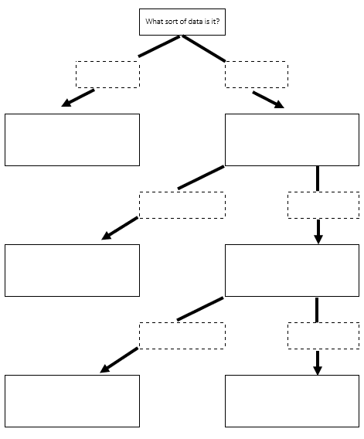
How can we use different statistical calculations to describe sets of data?
This flow chart is a guide for how to find the best average to use.
This does not mean that other averages can’t be calculated it just helps you find the most appropriate one.
Qualitative
Quantitative
Mode is the only measure of average here
How many numbers are there is the data set?
ODD
EVEN
The Median will defiantly give us a number from the data
Are there any extreme values?
YES
NO
The Median will ignore outliers
The Mean is the best average to use but may not be a value form the set
How do we know the best average to use?

Slide 5
How can we use different statistical calculations to describe sets of data?
I DO
The salaries of seven people who work for a small company are:
£12 000 £18 000 £120 000 £28 000
£32 000 £22 000 £30 000
Work out the average salary for the company
WE DO
In April, Gav made the following sales of cars
Juke Micra Juke Qashqai Juke Leaf
Leaf Leaf Juke Qashqai Leaf
What is the best average to use to describe Gav’s sales?
YOU DO
Lucy runs the charity events at her local church and records the amount raised at each event over the last 12 months as follows
£267 £341 £209 £312 £286 £326
£226 £275 £316 £339 £265 £219
Calculate the average amount raised by Lucy’s events each month
Quantitative
Odd number of values and outliers
= £28 000
Median
Qualitative
= Juke and Leaf
Mode
Quantitative
Even number of values and no outliers
= £281.75
Mean
How do we know the best average to use?

Slide 6


How can we use different statistical calculations to describe sets of data?
Practise Questions
Exam Questions
How do we know the best average to use?

Slide 7

How can we use different statistical calculations to describe sets of data?
MWB ACTIVITY
How do we know the best average to use?

