Slide 1
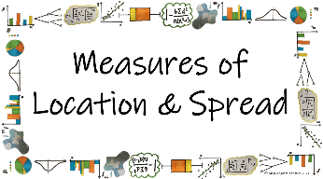



How can we use different statistical calculations to describe sets of data?
Mean, Median and Mode
(grouped frequency table)
What are the measures of location and how do we find them for data presented in a grouped frequency table?

Slide 2
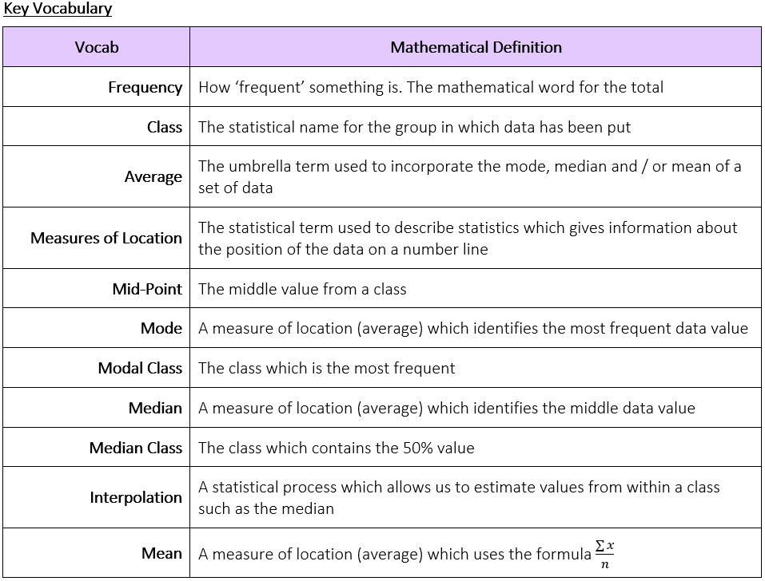
How can we use different statistical calculations to describe sets of data?
What are the measures of location and how do we find them for data presented in a grouped frequency table?

Slide 3
How can we use different statistical calculations to describe sets of data?
The Knowledge Phase
MODAL CLASS
The mode cannot be found in a grouped frequency table as we do not know the value of each piece of data. Instead we can identify the modal class
The modal class is the class is the group with the highest frequency
There can be more than one modal class and these must be listed, separated with commas
There can be no mode.
N.B. This be must written as 'none' and not '0' as 0 can be the mode for a set of data
What are the measures of location and how do we find them for data presented in a grouped frequency table?

Slide 4
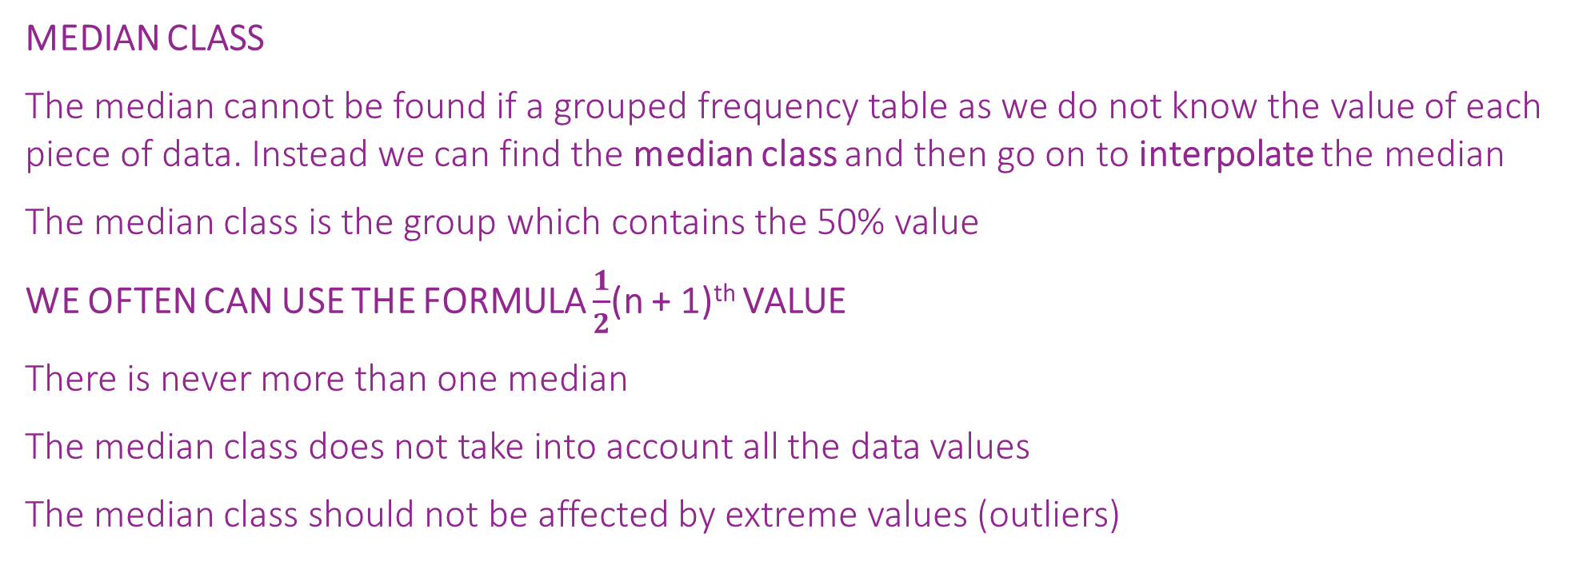
How can we use different statistical calculations to describe sets of data?
MEDIAN CLASS
The median cannot be found if a grouped frequency table as we do not know the value of each piece of data. Instead we can find the median class and then go on to interpolate the median
The median class is the group which contains the 50% value
WE OFTEN CAN USE THE FORMULA $\frac{1}{2}$(n + 1)^{th} VALUE
There is never more than one median
The median class does not take into account all the data values
The median class should not be affected by extreme values (outliers)
What are the measures of location and how do we find them for data presented in a grouped frequency table?

Slide 5
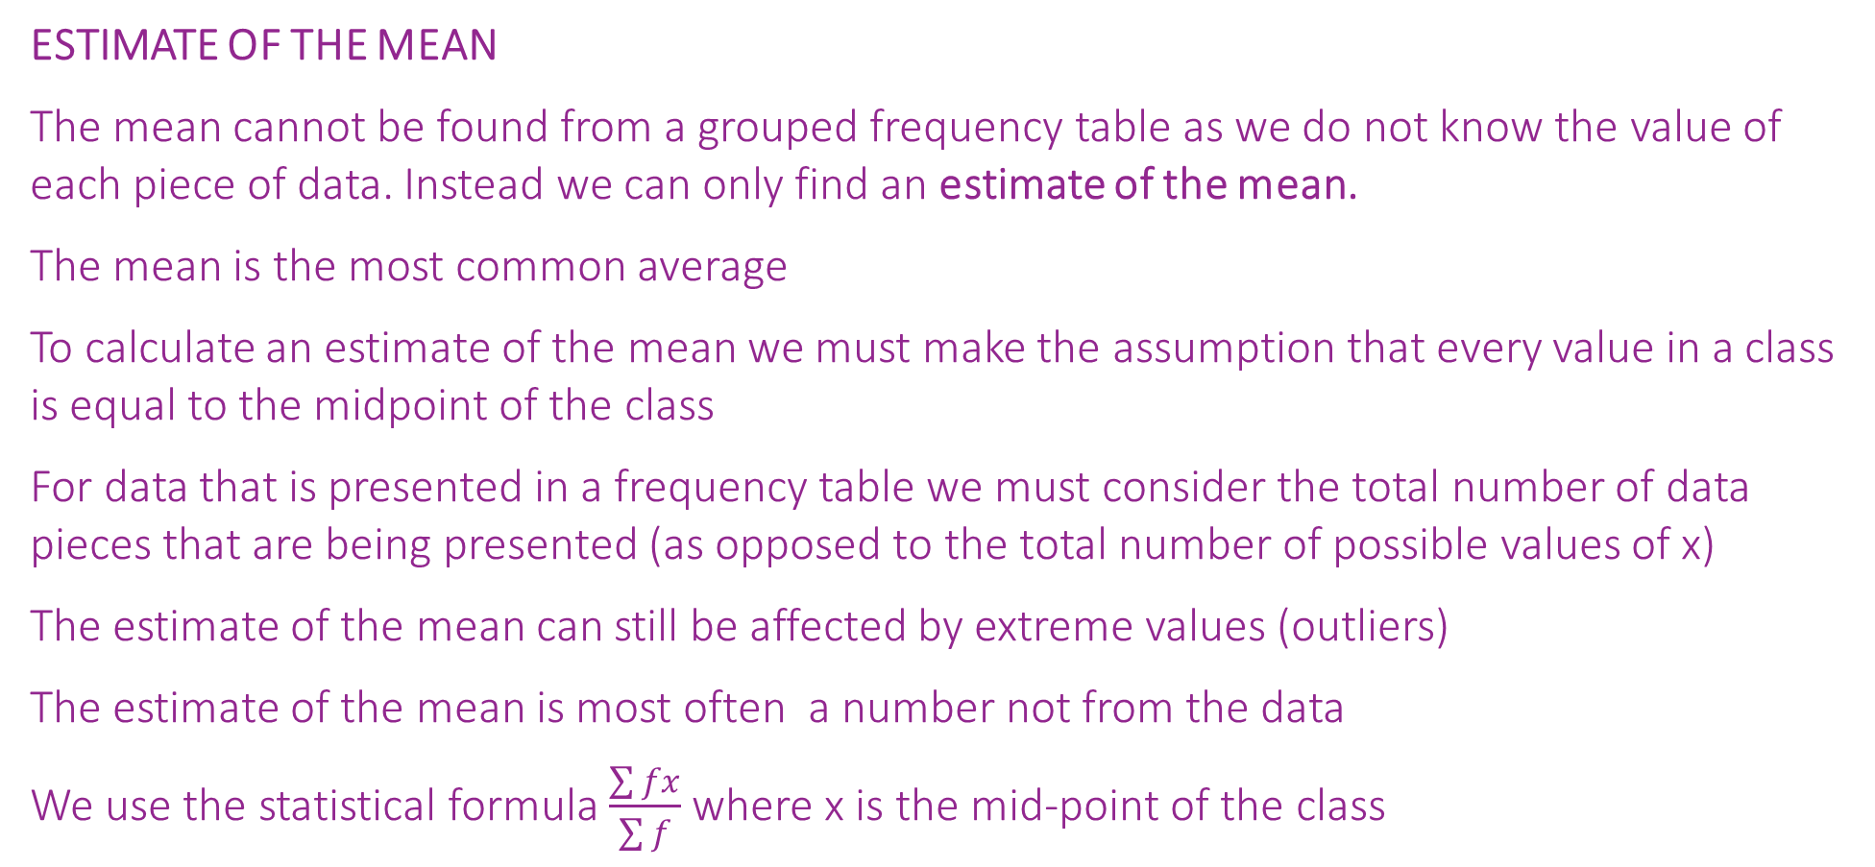
How can we use different statistical calculations to describe sets of data?
ESTIMATE OF THE MEAN
The mean cannot be found from a grouped frequency table as we do not know the value of each piece of data. Instead we can only find an estimate of the mean.
The mean is the most common average
To calculate an estimate of the mean we must make the assumption that every value in a class is equal to the midpoint of the class
For data that is presented in a frequency table we must consider the total number of data pieces that are being presented (as opposed to the total number of possible values of x)
The estimate of the mean can still be affected by extreme values (outliers)
The estimate of the mean is most often a number not from the data
We use the statistical formula $\frac{\sum{fx}}{\sum{f}}$ where x is the mid-point of the class
What are the measures of location and how do we find them for data presented in a grouped frequency table?

Slide 6
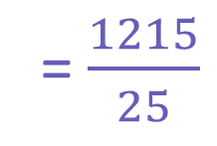
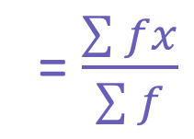
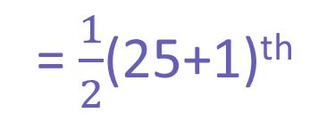
How can we use different statistical calculations to describe sets of data?
I DO
State the modal class
Find the median class
Calculate an estimate for the mean
Modal Class: 50 ≤ x < 60
MEDIAN
= $\frac{1}{2}$(25+1)^{th}
= 13th value
Mass (m) kg | Frequency
30 ≤ x < 40 | 7
40 ≤ x < 50 | 6
50 ≤ x < 60 | 8
60 ≤ x < 70 | 4
= 40 ≤ x < 50
CF
MP X f
MP
35
7
245
= $\frac{\sum{fx}}{\sum{f}}$
MEAN
45
13
270
55
21
440
= $\frac{1215}{25}$
= 48.6
65
25
260
What are the measures of location and how do we find them for data presented in a grouped frequency table?

Slide 7
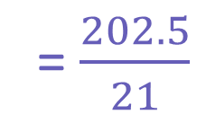
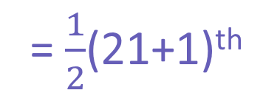
How can we use different statistical calculations to describe sets of data?
WE DO
State the modal class
Find the median class
Calculate an estimate for the mean
Modal Class: 0 ≤ x < 5
MEDIAN
= $\frac{1}{2}$(21+1)^{th}
= 11th value
Height (x) m | Frequency
0 ≤ x < 5 | 8
5 ≤ x < 10 | 2
10 ≤ x < 15 | 5
15 ≤ x < 20 | 6
= 10 ≤ x < 15
CF
MP X f
MP
2.5
8
20
= $\frac{\sum{fx}}{\sum{f}}$
MEAN
10
15
7.5
15
62.5
= $\frac{202.5}{21}$
12.5
= 9.64
21
105
17.5
What are the measures of location and how do we find them for data presented in a grouped frequency table?

Slide 8
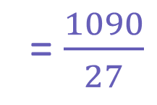
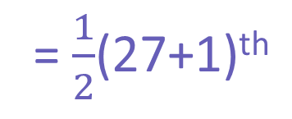
How can we use different statistical calculations to describe sets of data?
YOU DO
State the modal class
Find the median class
Calculate an estimate for the mean
Modal Class: 40 ≤ x < 60
MEDIAN
= $\frac{1}{2}$(27+1)^{th}
= 14th value
Time (x) secs | Frequency
0 ≤ x < 20 | 7
20 ≤ x < 40 | 5
40 ≤ x < 60 | 9
60 ≤ x < 80 | 6
= 40 ≤ x < 60
CF
MP X f
MP
10
7
70
= $\frac{\sum{fx}}{\sum{f}}$
MEAN
12
150
30
21
450
= $\frac{1090}{27}$
50
= 40.4
27
420
70
What are the measures of location and how do we find them for data presented in a grouped frequency table?

Slide 9


How can we use different statistical calculations to describe sets of data?
Practise Questions
Exam Questions
What are the measures of location and how do we find them for data presented in a grouped frequency table?

Slide 10

How can we use different statistical calculations to describe sets of data?
MWB ACTIVITY
What are the measures of location and how do we find them for data presented in a grouped frequency table?

