Slide 1
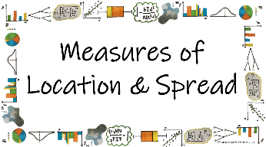



How can we use different statistical calculations to describe sets of data?
Mean, Median and Mode
(frequency table)
What are the measures of location and how do we find them for data presented in a frequency table?

Slide 2

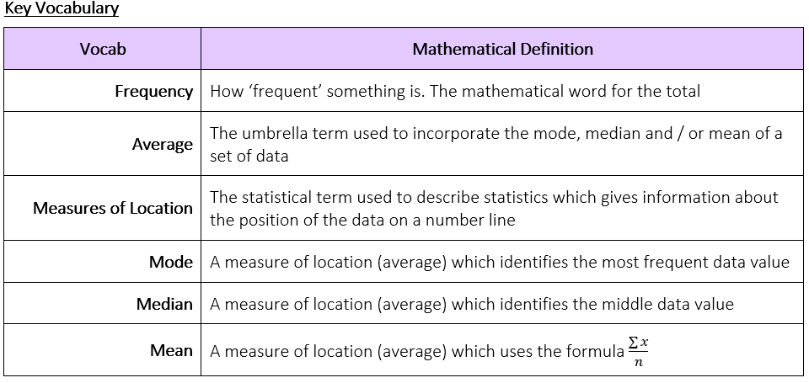
How can we use different statistical calculations to describe sets of data?
What are the measures of location and how do we find them for data presented in a frequency table?

Slide 3
How can we use different statistical calculations to describe sets of data?
The Knowledge Phase
FREQUENCY TABLES
Frequency tables are used to display large volumes of data where data pieces are repeated.
They can be used to represent qualitative or discrete data.
It is important to ensure that you understand the data that is represented in the table before you try to calculate statistics from the data.
What are the measures of location and how do we find them for data presented in a frequency table?

Slide 4
How can we use different statistical calculations to describe sets of data?
I Do
Age | Number of Players
18 | 5
19 | 5
20 | 9
21 | 4
X
= 90
X
= 95
X
= 180
X
= 84
a) Write the data represented in this frequency table as a list of ages
b) How many players were there altogether?
c) What was the total of the ages of all the players?
23
449
What are the measures of location and how do we find them for data presented in a frequency table?

Slide 5
How can we use different statistical calculations to describe sets of data?
We Do
Number of people in each car | Number of Cars
1 | 41
2 | 54
3 | 32
4 | 20
5 | 3
a) How many cars were seen in total?
b) How many cars had more than 3 people in them?
c) How many people were seen altogether?
What are the measures of location and how do we find them for data presented in a frequency table?

Slide 6
How can we use different statistical calculations to describe sets of data?
You Do
Score | Number of Students
6 | 13
7 | 9
8 | 5
9 | 3
10 | 1
a) How many students took the test?
b) How many students scored 9 or 10?
c) What was the total of the scores for all students?
What are the measures of location and how do we find them for data presented in a frequency table?

Slide 7

How can we use different statistical calculations to describe sets of data?
Nº of Pets | Number of Scouts
0 | 8
1 | 12
2 | 6
3 | 2
4+ | 3
MWB ACTIVITY
How many Scouts were asked about their number of pets?
31
What are the measures of location and how do we find them for data presented in a frequency table?

Slide 8
How can we use different statistical calculations to describe sets of data?
Make of Car | Number of Students
Skoda | 8
Nissan | 4
Audi | 6
BMW | 1
Ford | 3
VW | 2
Volvo | 1
Other | 5
MWB ACTIVITY
How many Students were asked about their make of car?
30
What are the measures of location and how do we find them for data presented in a frequency table?

Slide 9
How can we use different statistical calculations to describe sets of data?
Number of GCSEs | Year 11s
1 | 1
2 | 2
3 | 1
4 | 5
5 | 9
6 | 12
7+ | 64
MWB ACTIVITY
How many Year 11s gained at least 1 GCSE?
94
What are the measures of location and how do we find them for data presented in a frequency table?

Slide 10
How can we use different statistical calculations to describe sets of data?
Left turns taken | Taxi Drivers
0 | 1
1 | 8
2 | 15
3 | 20
4 | 22
5 | 16
6 | 9
7+ | 0
MWB ACTIVITY
How many Taxi Drivers took 3 left turns?
20
What are the measures of location and how do we find them for data presented in a frequency table?

Slide 11
How can we use different statistical calculations to describe sets of data?
Nº of Pets | Number of Scouts
0 | 8
1 | 12
2 | 6
3 | 2
4+ | 3
MWB ACTIVITY
How many Scouts owned a pet?
27
What are the measures of location and how do we find them for data presented in a frequency table?

Slide 12
How can we use different statistical calculations to describe sets of data?
Number of GCSEs | Year 11s
1 | 1
2 | 2
3 | 1
4 | 5
5 | 9
6 | 12
7+ | 64
MWB ACTIVITY
How many Year 11s gained at least 7 GCSEs?
64
What are the measures of location and how do we find them for data presented in a frequency table?

Slide 13
How can we use different statistical calculations to describe sets of data?
Left turns taken | Taxi Drivers
0 | 1
1 | 8
2 | 15
3 | 20
4 | 22
5 | 16
6 | 9
7+ | 0
MWB ACTIVITY
How many left turns were taken altogether?
320
What are the measures of location and how do we find them for data presented in a frequency table?

Slide 14
How can we use different statistical calculations to describe sets of data?
Nº of Pets | Number of Scouts
0 | 8
1 | 12
2 | 6
3 | 2
4 | 3
5+ | 0
MWB ACTIVITY
How many pets were owned altogether?
42
What are the measures of location and how do we find them for data presented in a frequency table?

Slide 15
How can we use different statistical calculations to describe sets of data?
Number of GCSEs | Year 11s
1 | 1
2 | 2
3 | 1
4 | 5
5 | 9
6 | 12
7 | 24
8 | 18
9 | 16
10 | 13
11 | 1
MWB ACTIVITY
How many GCSEs were gained altogether?
742
What are the measures of location and how do we find them for data presented in a frequency table?

Slide 16


How can we use different statistical calculations to describe sets of data?
Practise Questions
Exam Questions
What are the measures of location and how do we find them for data presented in a frequency table?

Slide 17
How can we use different statistical calculations to describe sets of data?
The Knowledge Phase
MODE
The mode is the most common value, for data presented in a frequency table, this will be the value with the highest frequency
There can be more than one mode and these must be listed, separated with commas (E.g. 4, 5)
There can be no mode.
N.B. This be must written as 'none' and not '0' as 0 can be the mode for a set of data
The mode must be a value from the data
The mode is the only measure of location which can be found from qualitative (non-numerical) data
What are the measures of location and how do we find them for data presented in a frequency table?

Slide 18
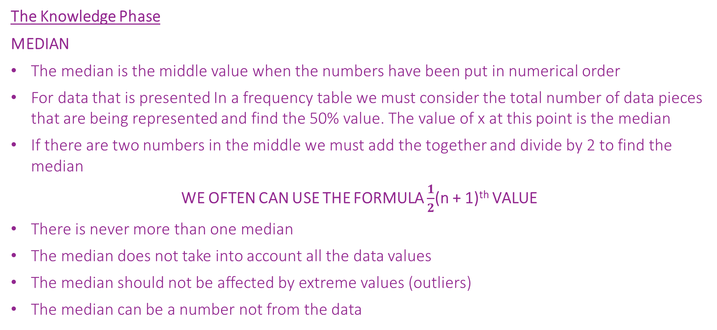
How can we use different statistical calculations to describe sets of data?
The Knowledge Phase
MEDIAN
The median is the middle value when the numbers have been put in numerical order
For data that is presented In a frequency table we must consider the total number of data pieces that are being represented and find the 50% value. The value of x at this point is the median
If there are two numbers in the middle we must add the together and divide by 2 to find the median
WE OFTEN CAN USE THE FORMULA $\frac{1}{2}$(n + 1)^{th} VALUE
There is never more than one median
The median does not take into account all the data values
The median should not be affected by extreme values (outliers)
The median can be a number not from the data
What are the measures of location and how do we find them for data presented in a frequency table?

Slide 19
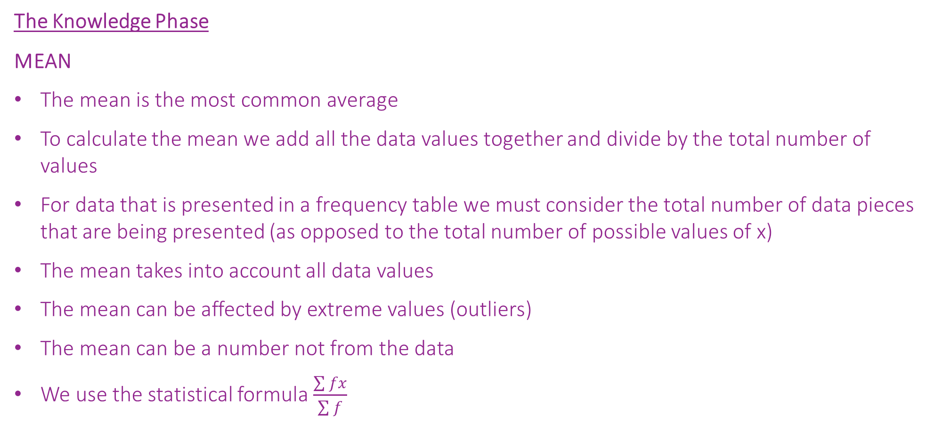
How can we use different statistical calculations to describe sets of data?
The Knowledge Phase
MEAN
The mean is the most common average
To calculate the mean we add all the data values together and divide by the total number of values
For data that is presented in a frequency table we must consider the total number of data pieces that are being presented (as opposed to the total number of possible values of x)
The mean takes into account all data values
The mean can be affected by extreme values (outliers)
The mean can be a number not from the data
We use the statistical formula $\frac{\sum{fx}}{\sum{f}}$
What are the measures of location and how do we find them for data presented in a frequency table?

Slide 20
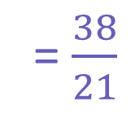
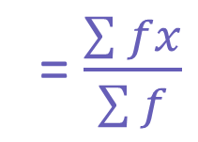
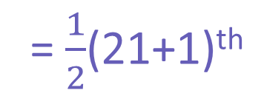
How can we use different statistical calculations to describe sets of data?
I DO
Robbie played twenty football matches for his school team
The number of goals scored in each game are shown in the table
Calculate the mode, median and mean number of goals scored in each game
MODE
= 2
MEDIAN
= $\frac{1}{2}$(21+1)^{th}
Number of goals | Number of matches
0 | 3
1 | 5
2 | 9
3 | 1
4 | 3
CF
FX
= 11th value
3
0
8
5
= 2
17
18
MEAN
= $\frac{\sum{fx}}{\sum{f}}$
18
3
21
12
= $\frac{38}{21}$
= 1.81
What are the measures of location and how do we find them for data presented in a frequency table?

Slide 21
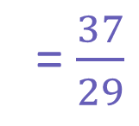
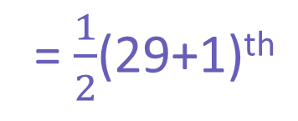
How can we use different statistical calculations to describe sets of data?
We DO
Students were asked how many pets they owned
The results are shown in the table
Calculate the mode, median and mean number of pets the students had
MODE
= 1
MEDIAN
= $\frac{1}{2}$(29+1)^{th}
Number of Pets | Number of Students
0 | 6
1 | 13
2 | 7
3 | 2
4 | 1
CF
FX
= 15th value
6
0
= 1
19
13
MEAN
= $\frac{\sum{fx}}{\sum{f}}$
26
14
28
6
= $\frac{37}{29}$
= 1.28
29
4
What are the measures of location and how do we find them for data presented in a frequency table?

Slide 22
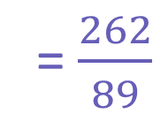
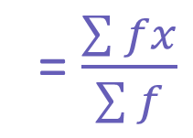
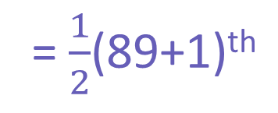
How can we use different statistical calculations to describe sets of data?
You DO
A school records the number of merits pupils received during the Spring term.
The information for year 7s is shown in the table below
Calculate the mode, median and mean number of merits achieved by year 7s in the Spring term
MODE
= 3
Number of merits | Number of Year 7’s
0 | 7
1 | 9
2 | 17
3 | 21
4 | 19
5 | 16
6 | 0
CF
FX
= $\frac{1}{2}$(89+1)^{th}
MEDIAN
7
0
16
9
= 45th value
33
34
= 3
54
63
= $\frac{\sum{fx}}{\sum{f}}$
MEAN
73
76
89
80
= $\frac{262}{89}$
= 2.94
89
0
What are the measures of location and how do we find them for data presented in a frequency table?

Slide 23
How can we use different statistical calculations to describe sets of data?
Practise Questions
Exam Questions
What are the measures of location and how do we find them for data presented in a frequency table?

