Slide 1
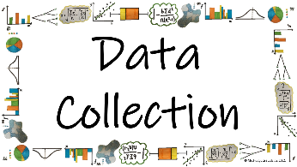



What is Data and how do we collect it?
Sampling
How do we identify a sample, sample units and sample frame?

Slide 2
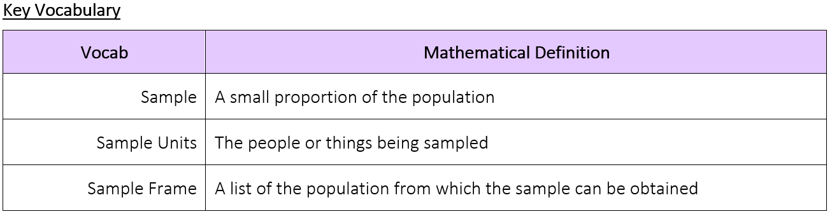
What is Data and how do we collect it?
How do we identify a sample, sample units and sample frame?

Slide 3
What is Data and how do we collect it?
The Knowledge Phase
A Sample is a small proportion of the population
Samples can be collected in a variety of way (we will look into this further later in the unit)
A sample contains information about part of the population as opposed to a census which contains information about all of the population
The purpose of a sample is to provide information which can be used to infer information about the population in a more convenient way
A sample:
✓ is quick
✓ is cheap
✓ is more convenient
x can be biased
x can be influenced by outliers
x does not take every member of the population into account
How do we identify a sample, sample units and sample frame?

Slide 4
What is Data and how do we collect it?
The Sample Units are the people or things being samples
The Sample Frame is a list of the population from which a sample can be obtained.
An employee or student register
An electoral roll
An inventory list
**AMAZING FACT YOU SHOULD KNOW**
A statistically large sample is any sample that is ≥30
How do we identify a sample, sample units and sample frame?

Slide 5
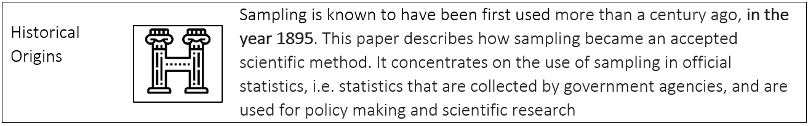
What is Data and how do we collect it?
How do we identify a sample, sample units and sample frame?

Slide 6
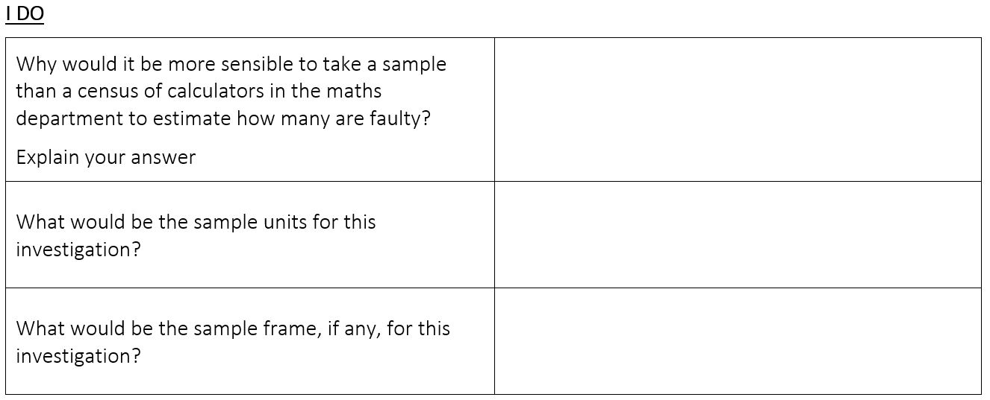
What is Data and how do we collect it?
It would be much quicker
The calculators in the maths department
A stock take list of the calculators
How do we identify a sample, sample units and sample frame?

Slide 7
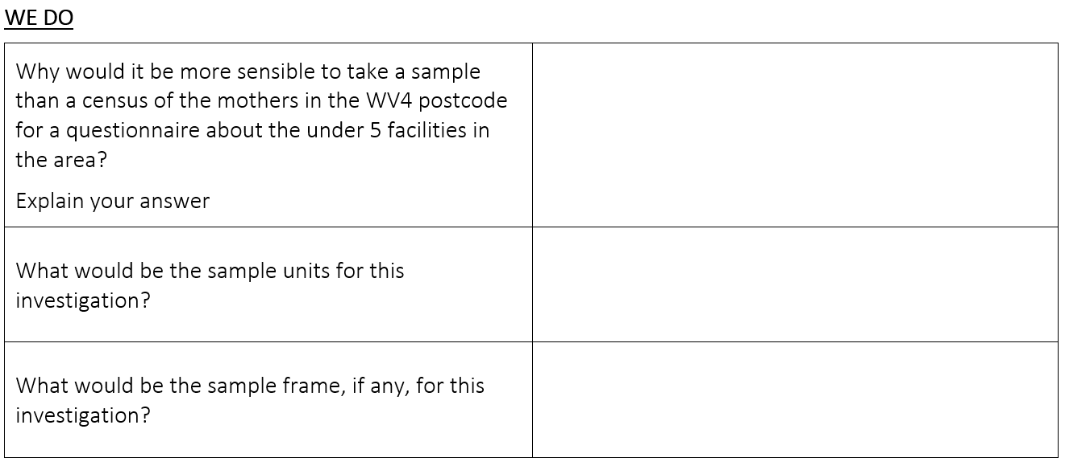
What is Data and how do we collect it?
Sample
It would take too long to speak to every mother
Mother in the WV4 postcode
Hospital records / health visitor records of mothers with children under 5
How do we identify a sample, sample units and sample frame?

Slide 8
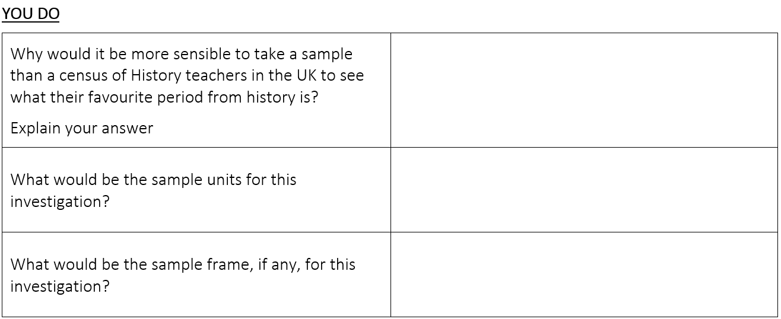
What is Data and how do we collect it?
Sample
It would take too long to speak to every History teacher
History teachers in the UK
School records of employees in the UK
How do we identify a sample, sample units and sample frame?

Slide 9

What is Data and how do we collect it?
Checking the burning time of a new candle being produced by a small family run business
MWB ACTIVITY
Sample
How do we identify a sample, sample units and sample frame?

Slide 10
What is Data and how do we collect it?
  Asking teachers in the UK their opinion on homework
MWB ACTIVITY
Census
How do we identify a sample, sample units and sample frame?

Slide 11
What is Data and how do we collect it?
  Testing tins of baked beans for taste, colour and consistency
MWB ACTIVITY
Sample
How do we identify a sample, sample units and sample frame?

Slide 12
What is Data and how do we collect it?
  Inspecting the fittings on a newly constructed set of scaffolding
MWB ACTIVITY
Census
How do we identify a sample, sample units and sample frame?

Slide 13
What is Data and how do we collect it?
  Examining boxes of cereal for foreign objects before leaving the factory
MWB ACTIVITY
Sample
How do we identify a sample, sample units and sample frame?

Slide 14

What is Data and how do we collect it?
Practise Questions
How do we identify a sample, sample units and sample frame?

