Slide 1




What is Data and how do we collect it?
Cleaning Data
How and why do we ‘clean’ data?

Slide 2
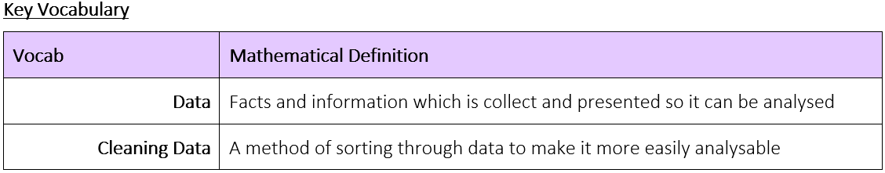
What is Data and how do we collect it?
How and why do we ‘clean’ data?

Slide 3




What is Data and how do we collect it?
The Knowledge Phase
When you have some data the first thing you need to do is to check it out and get rid of any obviously wrong or false data
This is called “Cleaning the Data”
WTLF:
Pointy Pete
Pete has a problem with the decimal point.
He puts decimals where there shouldn't be one
He moves the point around
Sometimes he does this on purpose but most of the time this is an accident
Silly Samantha
Samantha thinks she's funny
She like to write 'funny' answers to questions
She usually does this on purpose to try and make everyone's life more awkward
Obvious Olive
Olive is a little clumsy
She makes lots of obvious errors
Sometimes she does this on purpose but most of the time its just an accident
Devious Dave
Dave is a bit of a trickster
He messes with the data ON PURPOSE
He does it in ways that are not clear to see straight away
How and why do we ‘clean’ data?

Slide 4
What is Data and how do we collect it?
I DO
Which one of these pieces of data appear to have been inputted by Pointy Pete? "How long is your foot in cm?" 3.06 29.5 30.2 28.7 31.4 29.4 29.9 304
Which one of these pieces of data appear to have been inputted by Obvious Olive? "What gender to you identify yourself as?" Male Female 24 Female Girl None Boy Male
Which one of these pieces of data appear to have been inputted by Silly Samantha? "Where were you born?" America Walsall West Brom England Newquay The Moon Tipton Wales
Which one of these pieces of data appear to have been inputted by Devious Dave? "What is your favourite subject?" Maths English Spanish Biology History P.E Psychology Computing
3.06
304
24
The Moon
Can’t Tell
How and why do we ‘clean’ data?

Slide 5
What is Data and how do we collect it?
We DO
Which one of these pieces of data appear to have been inputted by Pointy Pete? "How many minutes does it take to complete the puzzle? 3.24 3.95 3.07 0.36 3.24 347 3.45 37.5
Which one of these pieces of data appear to have been inputted by Obvious Olive? "What is your favourite flavour ice cream?" Chocolate Strawberry Chocolate Vanilla Yes Vanilla Chocolate Raspberry Ripple
Which one of these pieces of data appear to have been inputted by Silly Samantha? "How long does it take you to get to work?" 1hour 45min 30mins 0.5hour 100hours 1.5hour 30mins 30mins
Which one of these pieces of data appear to have been inputted by Devious Dave? "How many hours do you spend on social media per day?" 3 5 8 4 6 1 8 6
347
37.5
Yes
100hours
Can’t Tell
How and why do we ‘clean’ data?

Slide 6
What is Data and how do we collect it?
You DO
Which one of these pieces of data appear to have been inputted by Pointy Pete? "How many hours of TV do you watch per day?" 2.5 4.5 2 0.5 45 2.5 3.5 0.5
Which one of these pieces of data appear to have been inputted by Obvious Olive? "What is the highest score you have got in a maths test?" 56% 12/18 47% Never 82% 26/28 14/17 94%
Which one of these pieces of data appear to have been inputted by Silly Samantha? "How many packets of crisps do you eat per week?" 7 5 3 4 50 6 5 2
Which one of these pieces of data appear to have been inputted by Devious Dave? "Which spice girl was your favourite?" Baby Scary Posh Baby Ginger Baby Sporty Baby
45
Never
50
Can’t Tell
How and why do we ‘clean’ data?

Slide 7

What is Data and how do we collect it?
Practise Questions
How and why do we ‘clean’ data?

Slide 8

What is Data and how do we collect it?
MWB ACTIVITY
How and why do we ‘clean’ data?

