Slide 1




What is Data and how do we collect it?
Capture / Recapture
How can we use the capture/recapture method for estimating population sizes?

Slide 2
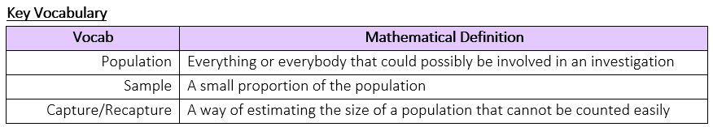
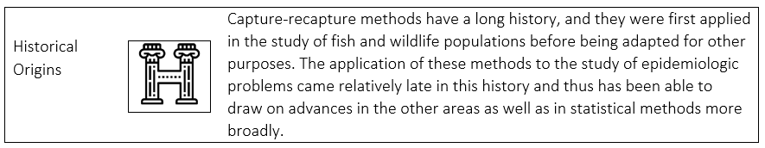
What is Data and how do we collect it?
How can we use the capture/recapture method for estimating population sizes?

Slide 3
What is Data and how do we collect it?
The Knowledge Phase
Some population are easy to count such as the number of students in a school, the number of products produced at a factory on a particular day, the members at a tennis club etc.
However, other population can be trickier such as the number of squirrels on the Isle of Wight, the number of deer at a national park etc.
The capture/recapture method is a way of estimating the size of a population that cannot be counted easily.
How can we use the capture/recapture method for estimating population sizes?

Slide 4
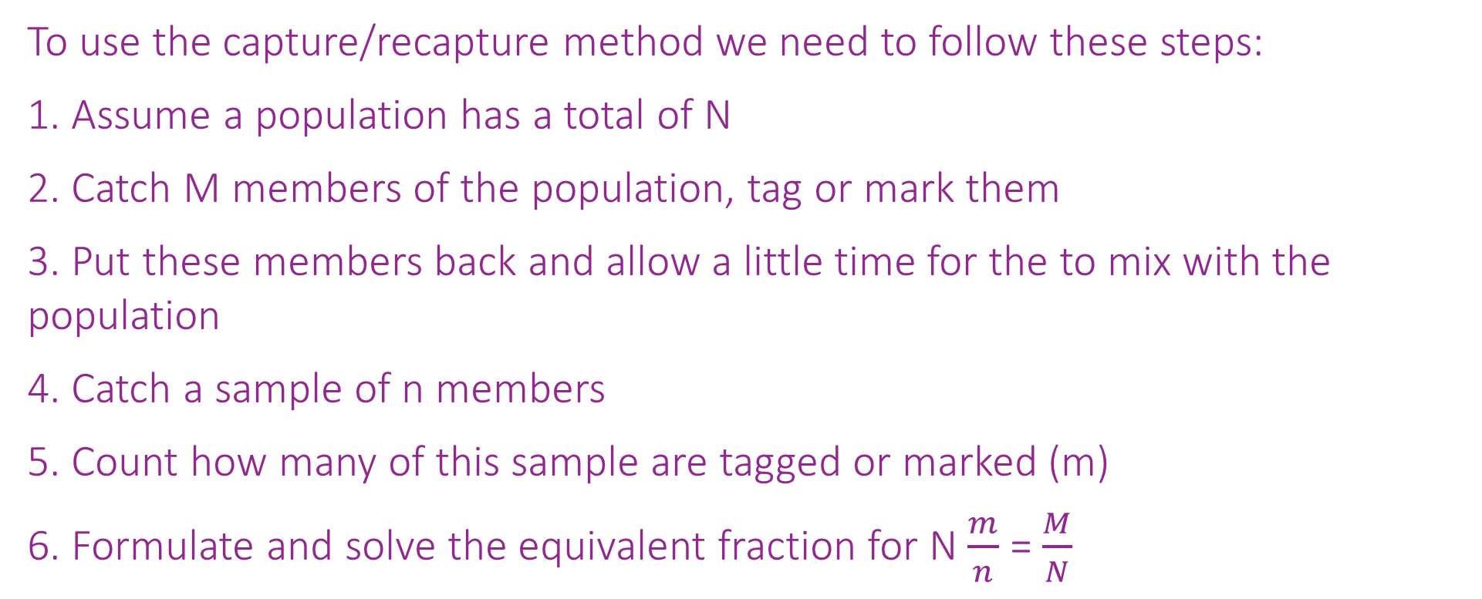
What is Data and how do we collect it?
To use the capture/recapture method we need to follow these steps:
1. Assume a population has a total of N
2. Catch M members of the population, tag or mark them
3. Put these members back and allow a little time for the to mix with the population
4. Catch a sample of n members
5. Count how many of this sample are tagged or marked (m)
6. Formulate and solve the equivalent fraction for N $\frac{m}{n}$ = $\frac{M}{N}$
How can we use the capture/recapture method for estimating population sizes?

Slide 5
What is Data and how do we collect it?
What must we always assume for this method to be an accurate estimate?
The initial sample must have enough time to mix with the rest of the population
The initial sample must not have too much time so that the population will have changed drastically
The markings placed on the initial sample must have not come off the sample or transferred onto the rest of the population
How can we use the capture/recapture method for estimating population sizes?

Slide 6
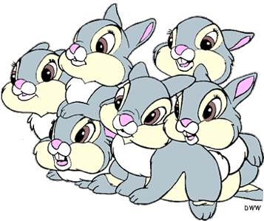
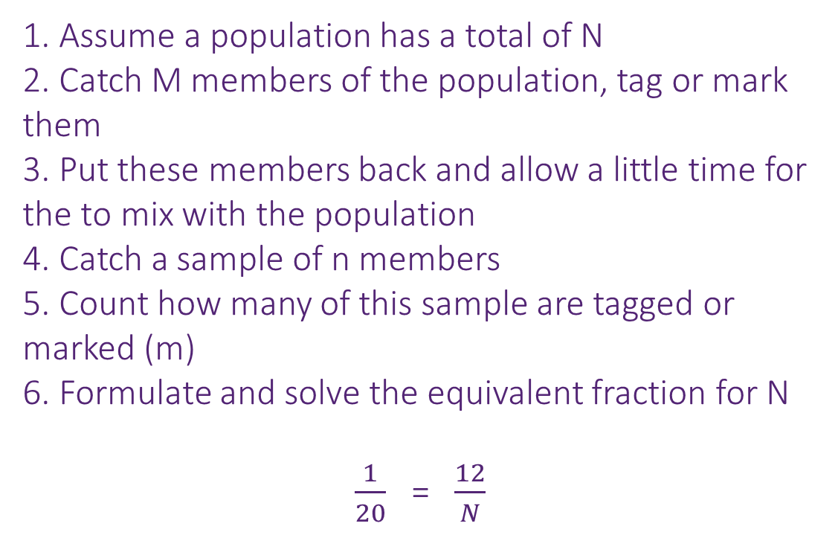
What is Data and how do we collect it?
I DO
In a wildlife park, 12 rabbits are caught, marked and released.
A week later 20 rabbits are caught and
1 is found to be marked.
Estimate the number of rabbits in the park
What assumptions have we made for this estimate to be accurate?
1. Assume a population has a total of N
2. Catch M members of the population, tag or mark them
3. Put these members back and allow a little time for the to mix with the population
4. Catch a sample of n members
5. Count how many of this sample are tagged or marked (m)
6. Formulate and solve the equivalent fraction for N
$\frac{1}{20}$ = $\frac{12}{N}$
The initial 12 rabbits have had enough time to mix with the rest of the population
No rabbits have been born or died in the week between taking the samples
The marks on the rabbits have not come off between the taking the samples
x12
x12
20 x 12 = 240
How can we use the capture/recapture method for estimating population sizes?

Slide 7

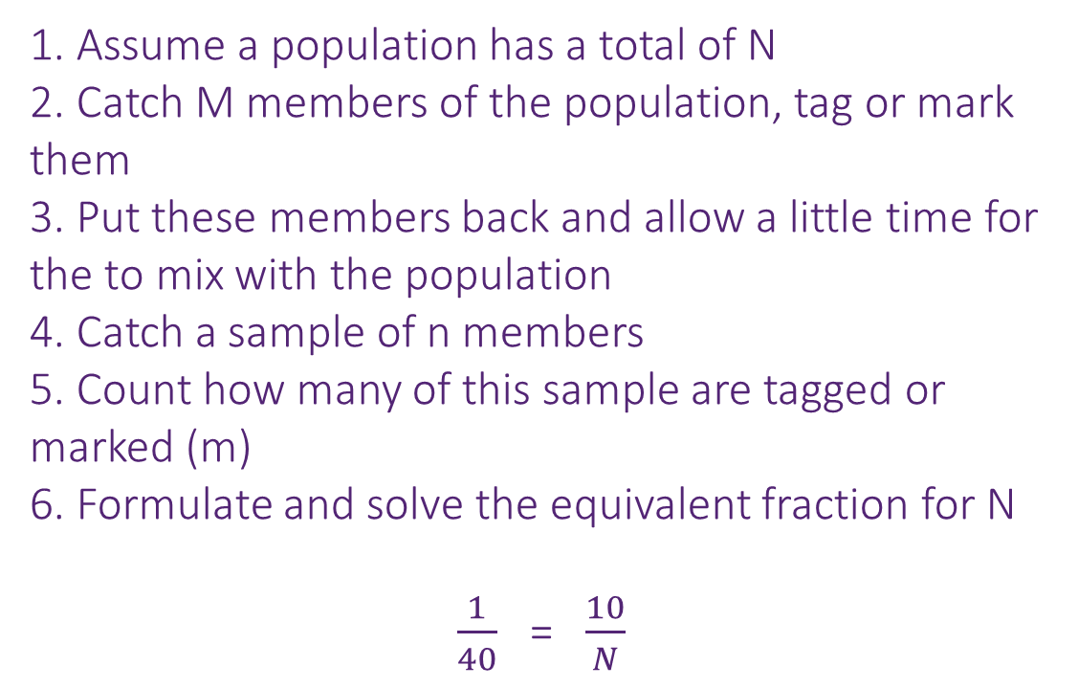
What is Data and how do we collect it?
WE DO
In a lake, 10 fish are caught, marked and released.
A week later 40 fish are caught and
1 is found to be marked.
Estimate the number of fish in the lake.
What assumptions have we made for this estimate to be accurate?
1. Assume a population has a total of N
2. Catch M members of the population, tag or mark them
3. Put these members back and allow a little time for the to mix with the population
4. Catch a sample of n members
5. Count how many of this sample are tagged or marked (m)
6. Formulate and solve the equivalent fraction for N
$\frac{1}{40}$ = $\frac{10}{N}$
The initial 10 fish have had enough time to mix with the rest of the population
No fish have been born or died in the week between taking the samples
The marks on the fish have not come off between the taking the samples
x10
x10
40 x 10 = 400
How can we use the capture/recapture method for estimating population sizes?

Slide 8

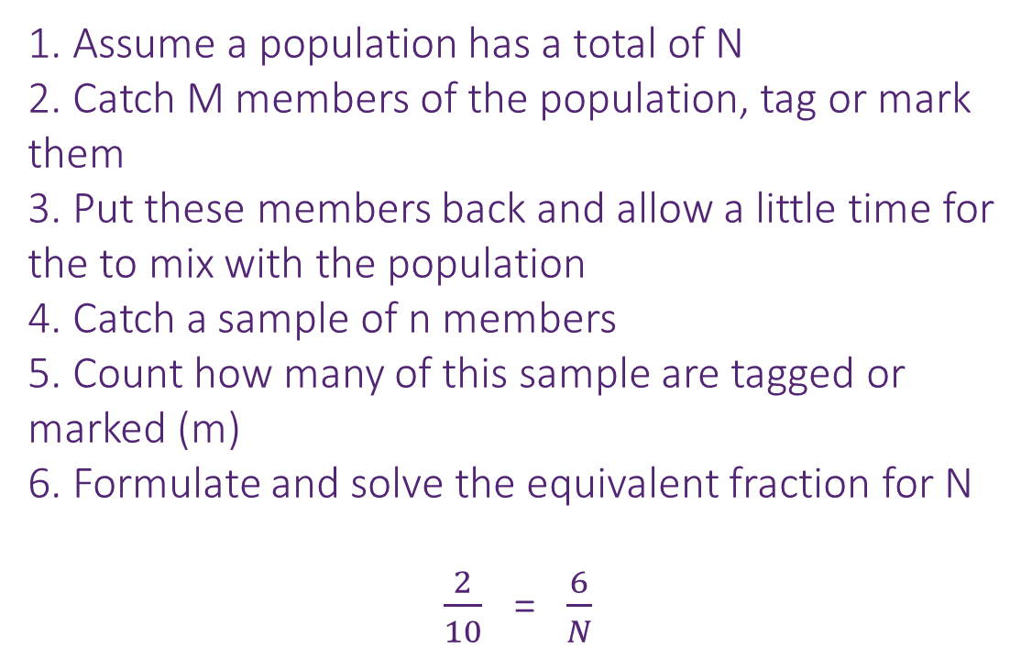
What is Data and how do we collect it?
YOU DO
In a safari, 6 wildcats are caught marked and released.
A week later 10 wildcats are caught and
2 are found to be marked.
Estimated the number of wildcats in the park.
What assumptions have we made for this estimate to be accurate?
1. Assume a population has a total of N
2. Catch M members of the population, tag or mark them
3. Put these members back and allow a little time for the to mix with the population
4. Catch a sample of n members
5. Count how many of this sample are tagged or marked (m)
6. Formulate and solve the equivalent fraction for N
$\frac{2}{10}$ = $\frac{6}{N}$
The initial 6 wildcats have had enough time to mix with the rest of the population
No wildcats have been born or died in the week between taking the samples
The marks on the wildcats have not come off between the taking the samples
x3
x3
10 x 3 = 30
How can we use the capture/recapture method for estimating population sizes?

Slide 9


What is Data and how do we collect it?
In a wildlife park, 9 deer are caught, marked and released.
A week later 10 deer are caught and 1 is found to be marked.
Estimate the number of deer in the park
MWB ACTIVITY
90
How can we use the capture/recapture method for estimating population sizes?

Slide 10
What is Data and how do we collect it?
In a pond, 15 fish are caught, marked and released.
A week later 30 fish are caught and 3 are found to be marked.
Estimate the number of fish in the pond
MWB ACTIVITY
150
How can we use the capture/recapture method for estimating population sizes?

Slide 11

What is Data and how do we collect it?
In a nature reserve, 120 badgers are caught, marked and released.
A week later 60 badgers are caught and 8 are found to be marked.
Estimate the number of badgers in the reserve
MWB ACTIVITY
900
How can we use the capture/recapture method for estimating population sizes?

Slide 12
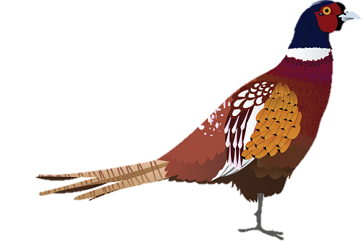
What is Data and how do we collect it?
In a wildlife park, 27 pheasants are caught, marked and released.
A week later 50 pheasants are caught and 3 are found to be marked.
Estimate the number of pheasants in the park
MWB ACTIVITY
450
How can we use the capture/recapture method for estimating population sizes?

Slide 13
What is Data and how do we collect it?
In a wildlife park, 31 rabbits are caught, marked and released.
A week later 30 rabbits are caught and 1 is found to be marked.
Estimate the number of rabbits in the park
MWB ACTIVITY
930
How can we use the capture/recapture method for estimating population sizes?

Slide 14

What is Data and how do we collect it?
Practise Questions
How can we use the capture/recapture method for estimating population sizes?

Slide 15
What is Data and how do we collect it?
CHALLENGE
30
On a farm, some rabbits are caught, marked and released.
2 days later, 15 rabbits are caught and 3 are found to be marked.
It is estimated that there were 150 rabbits on the farm
How many were caught and marked for the original sample?
In a hedgerow, 8 badgers are caught, marked and released.
The next week, 10 badgers are caught and the ones which are marked are counted
It is estimated that there are 20 badgers in the hedgerow
How many were found to be marked in the second sample?
4
In a national park, 12 tigers are caught, tagged and released.
A week later, a second sample of tigers are caught and 8 are found to be tagged
It is estimated that 75 tigers are in the park
How many tigers were checked in the second sample?
50
How can we use the capture/recapture method for estimating population sizes?

