Slide 1




What is Data and how do we collect it?
Systematic Sampling
How do we calculate and explain how to take a systematic sample?

Slide 2
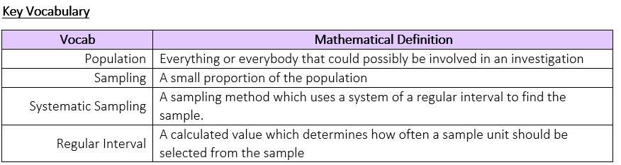
What is Data and how do we collect it?
How do we calculate and explain how to take a systematic sample?

Slide 3
What is Data and how do we collect it?
The Knowledge Phase
A Systematic Sample is a sampling method which uses a system of a regular interval to find the sample.
After selecting a random starting point, we then calculate what is known as the ‘regular interval’ which determines how often we select a sample unit form the population.
This ‘regular interval’ is not random and must be calculated using the population size (or an estimate of it) and the sample size you are intending to create
When Taking a Systematic sample we must first be able to calculate the interval:
Population
Sample Size
How do we calculate and explain how to take a systematic sample?

Slide 4
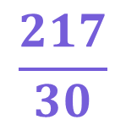
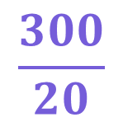
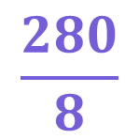
What is Data and how do we collect it?
I DO
A street in Halesowen has 280 houses.
What would the regular interval be for a
sample of 8 houses?
WE DO
A factory produces approximately 300 bolts per hour.
What would the regular interval be for a
sample of 20 bolts per hour?
YOU DO
A shop has approximately 217 customer per day
What would the regular interval be for a
sample of 30 customers?
$$\frac{280}{8}$$
= 35
Every 35th value
$$\frac{300}{20}$$
= 15
Every 15th value
$$\frac{217}{30}$$
= 7.23
Every 7th value
How do we calculate and explain how to take a systematic sample?

Slide 5

What is Data and how do we collect it?
How do we calculate and explain how to take a systematic sample?

Slide 6
Answer Sheet
Statistical Treasure-hunt:
Systematic Sampling Regular Intervals
Name:
__________________

Slide 7
49
Statistical
Treasure-hunt:
Systematic Sampling Regular Intervals
91
Statistical
Treasure-hunt:
Systematic Sampling Regular Intervals
Previous Answer
Previous Answer
A factory conveyor has 950 sweets travelling along it each day
The company director has asked staff to take a systematic sample to make sure that all products are to an acceptable standard
What would the regular interval be for a sample of 25 sweets?
Every ……^{th} sweet
A shop in town has 910 products in stock
The shop wants to take a systematic sample to check the quality of the products in the store.
What would the regular interval be for a sample of 10 products?
Every ……^{th} product
?
?
To the next clue
To the next clue

Slide 8
38
Statistical
Treasure-hunt:
Systematic Sampling Regular Intervals
90
Statistical
Treasure-hunt:
Systematic Sampling Regular Intervals
Previous Answer
Previous Answer
A school has 900 pupils in it at the start of the year
The head teacher wants to take a systematic sample of pupils to see what their opinions are of the school canteen
What would the regular interval be for a sample of 10 pupils?
Every ……^{th} pupil
A plantation has 1200 trees under 5 years old.
The agriculturalist wants to take a systematic sample to check the trees are growing as they should
What would the regular interval be for a sample of 25 trees?
Every ……^{th} tree
?
?
To the next clue
To the next clue

Slide 9
48
Statistical
Treasure-hunt:
Systematic Sampling Regular Intervals
97
Statistical
Treasure-hunt:
Systematic Sampling Regular Intervals
Previous Answer
Previous Answer
There are 970 houses in a village
The village school wants to take a systematic sample of estimate the number of pupils who will be attending next year.
What would the regular interval be for a sample of 10 houses?
Every ……^{th} house
A local clothing store has 910 dresses in stock
The shop wants to take a systematic sample to check the quality of the dresses in the store.
What would the regular interval be for a sample of 20 dresses?
Every ……^{th} dress
?
?
To the next clue
To the next clue

Slide 10
46
Statistical
Treasure-hunt:
Systematic Sampling Regular Intervals
95
Statistical
Treasure-hunt:
Systematic Sampling Regular Intervals
Previous Answer
Previous Answer
The Mathematics department at a university has 900 pupils in it at the start of the year
The Head Maths lecturer wants to take a systematic sample of students to see what their opinions are of the university facilities
What would the regular interval be for a sample of 25 students?
Every ……^{th} students
In a warehouse a conveyor belts runs 950 boxes each day
The warehouse manager has asked staff to take a systematic sample to make sure that all boxes are packed to an acceptable standard
What would the regular interval be for a sample of 10 boxes?
Every ……^{th} box
?
?
To the next clue
To the next clue

Slide 11
36
Statistical
Treasure-hunt:
Systematic Sampling Regular Intervals
96
Statistical
Treasure-hunt:
Systematic Sampling Regular Intervals
Previous Answer
Previous Answer
The local garden centre has rows upon rows of 960 bedding plants
The manager wants to take a systematic sample to check the plants are suitable for sale
What would the regular interval be for a sample of 10 plants?
Every ……^{th} plants
There are 970 new houses being built on a disused quarry
The site manager wants to take a systematic sample to make sure the houses are being built to a good standard
What would the regular interval be for a sample of 20 houses?
Every ……^{th} house
?
?
To the next clue
To the next clue

Slide 12
91
38
49
90
Answer Sheet
96
48
Statistical Treasure-hunt:
Systematic Sampling Regular Intervals
Name:
__ANSWERS__
36
97
95
46

Slide 13

What is Data and how do we collect it?
Practise Questions
How do we calculate and explain how to take a systematic sample?

Slide 14
What is Data and how do we collect it?
The Knowledge Phase
In the exam, your instructions for how to take a random sample must be clear
A) Calculate the 'regular interval'
1) Number the subjects from 1 to n
2) Choose a random number using a random number generator
3) Choose the corresponding subject from the population as a starting point
B) Using the 'regular interval' calculate the subjects needed for your sample
How do we calculate and explain how to take a systematic sample?

Slide 15
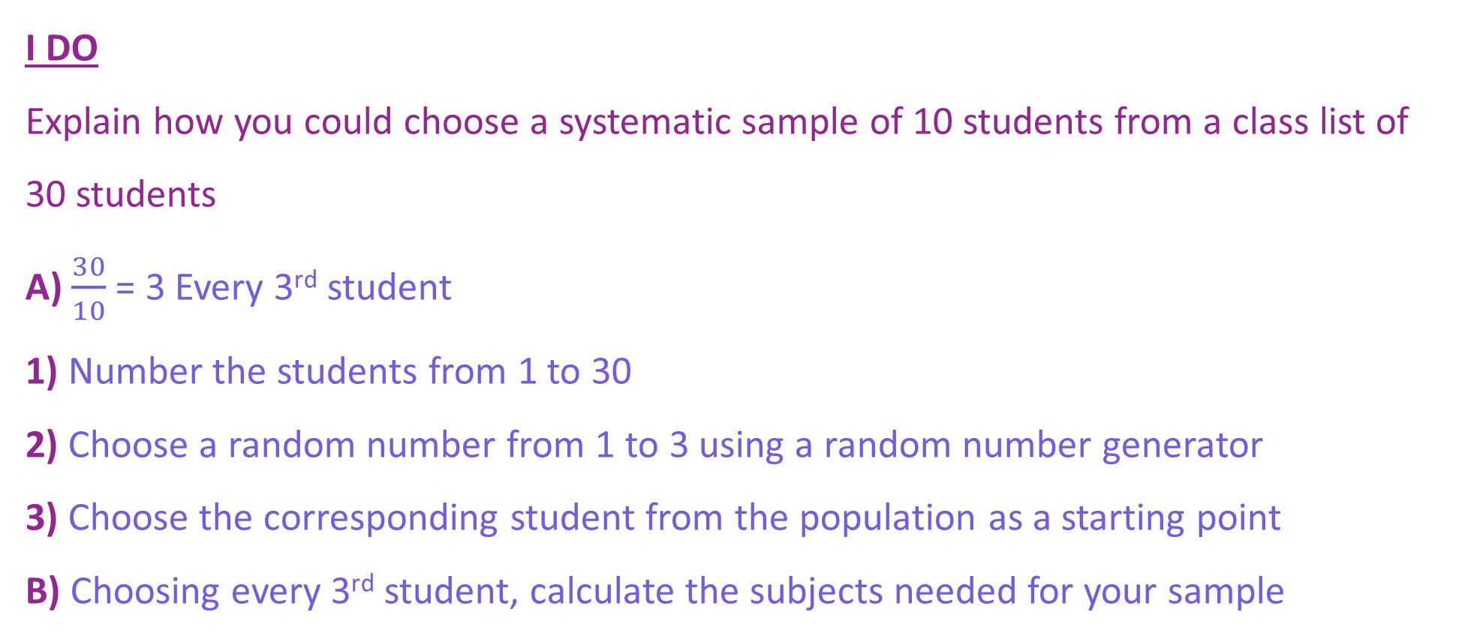
What is Data and how do we collect it?
I DO
Explain how you could choose a systematic sample of 10 students from a class list of 30 students
A) $\frac{30}{10}$ = 3 Every 3rd student
1) Number the students from 1 to 30
2) Choose a random number from 1 to 3 using a random number generator
3) Choose the corresponding student from the population as a starting point
B) Choosing every 3rd student, calculate the subjects needed for your sample
How do we calculate and explain how to take a systematic sample?

Slide 16
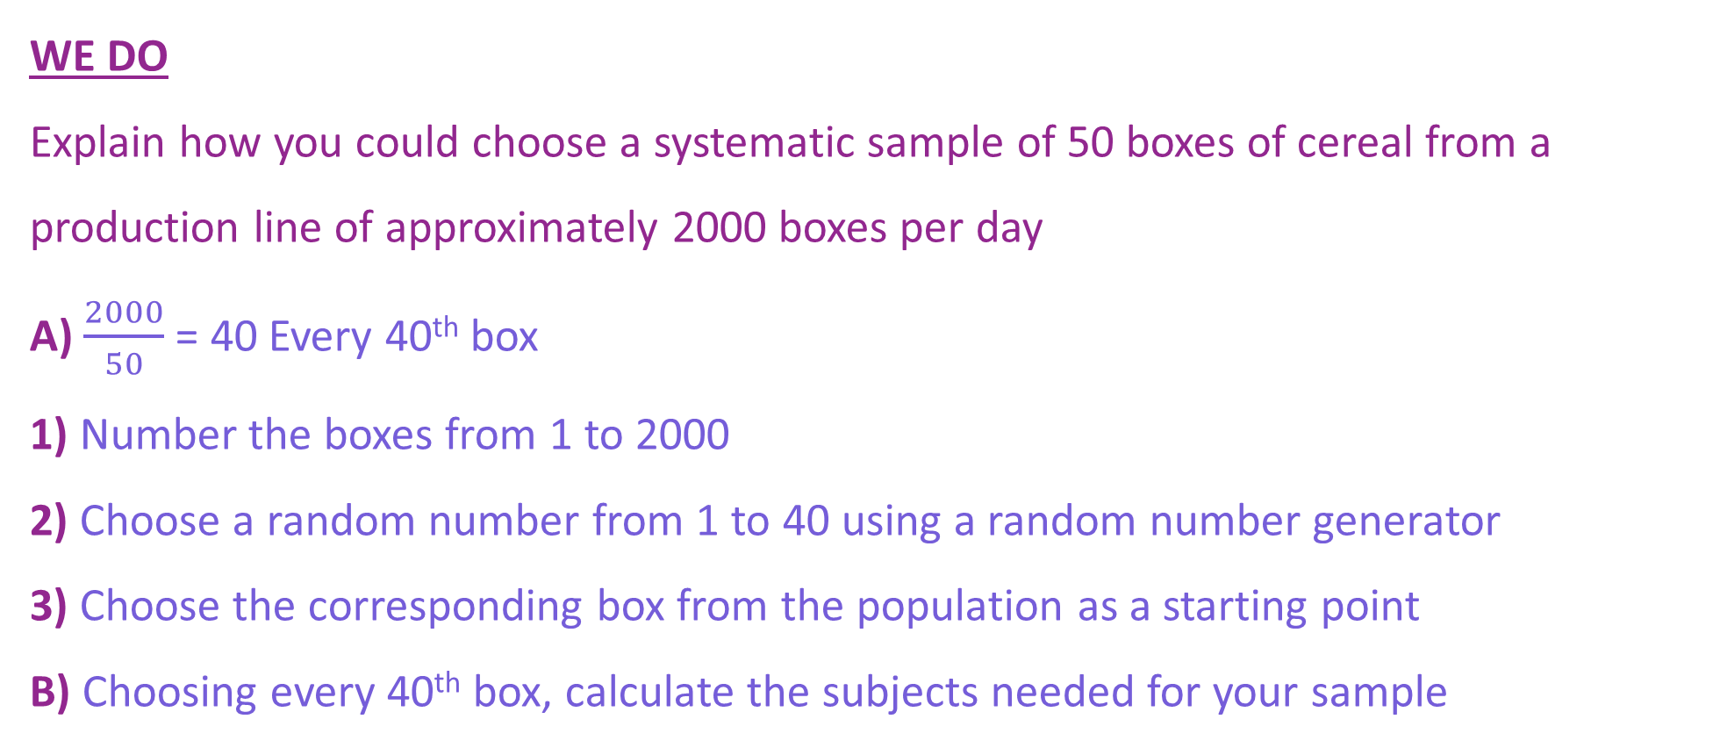
What is Data and how do we collect it?
WE DO
Explain how you could choose a systematic sample of 50 boxes of cereal from a production line of approximately 2000 boxes per day
A) $\frac{2000}{50}$ = 40 Every 40th box
1) Number the boxes from 1 to 2000
2) Choose a random number from 1 to 40 using a random number generator
3) Choose the corresponding box from the population as a starting point
B) Choosing every 40th box, calculate the subjects needed for your sample
How do we calculate and explain how to take a systematic sample?

Slide 17
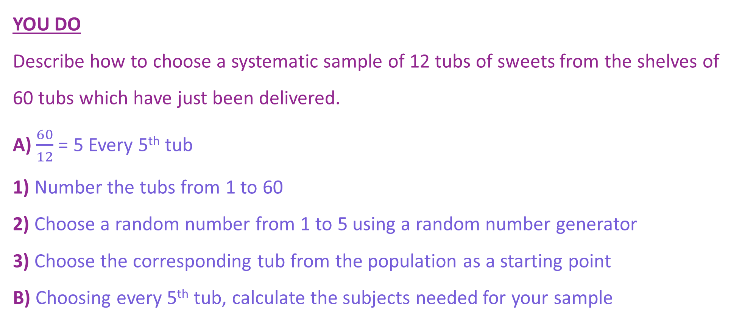
What is Data and how do we collect it?
YOU DO
Describe how to choose a systematic sample of 12 tubs of sweets from the shelves of 60 tubs which have just been delivered.
A) $\frac{60}{12}$ = 5 Every 5th tub
1) Number the tubs from 1 to 60
2) Choose a random number from 1 to 5 using a random number generator
3) Choose the corresponding tub from the population as a starting point
B) Choosing every 5th tub, calculate the subjects needed for your sample
How do we calculate and explain how to take a systematic sample?

Slide 18
What is Data and how do we collect it?
Practise Questions
How do we calculate and explain how to take a systematic sample?

Slide 19

What is Data and how do we collect it?
Q
MWB ACTIVITY
A
How do we calculate and explain how to take a systematic sample?

