Slide 1
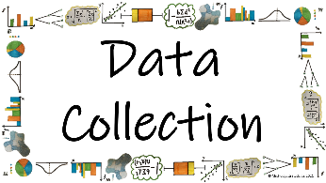



What is Data and how do we collect it?
Primary and Secondary Data
*How can we identify if data is Primary or Secondary?

Slide 2
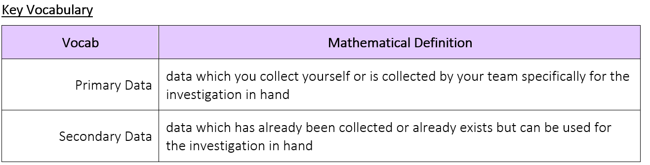
What is Data and how do we collect it?
*How can we identify if data is Primary or Secondary?

Slide 3
What is Data and how do we collect it?
The Knowledge Phase
Primary Data – data which you collect yourself or is collected by your team specifically for the investigation in hand
Examples:
_____________________________________________________________
_____________________________________________________________
_____________________________________________________________
Advantages Disadvantages
✓ The collection method is known x Time consuming
✓ The accuracy is known x Expensive
✓ The questions can be tailored to the investigation
You ask the people in your class to complete a questionnaire
You count the number of cars in the car park
Your team measure the jump distance of the athletes
*How can we identify if data is Primary or Secondary?

Slide 4
What is Data and how do we collect it?
Secondary Data – data which has already been collected or already exists but can be used for the investigation in hand
Examples:
_____________________________________________________________
_____________________________________________________________
_____________________________________________________________
Advantages Disadvantages
✓ Cheap x May be out of date
✓ Quicker than Primary x May have mistakes
✓ Can be more accurate if from a reliable source x May not answer the investigation properly
You ask your friend for their results from their experiment
You collect the information from the internet
Your team finds the football results from the last 20 years
*How can we identify if data is Primary or Secondary?

Slide 5


What is Data and how do we collect it?
Did you know? | You may have come across the words primary and secondary in terms of the schools that you went to You may have come across the terms primary and secondary sources in History or English
Cross-Curricular Link | You may use primary and secondary data when collecting information in Science or Geography
*How can we identify if data is Primary or Secondary?

Slide 6
What is Data and how do we collect it?
I DO
If I were to collect the annual household income of a sample of 100 houses from the online version of the 2020 UK Census. What sort of data would this be?
SECONDARY data
WE DO
What sort of data is being collected by Sam who is measuring the amount of rain collected in a bottle outside the classroom every 30 minutes?
PRIMARY data
YOU DO
Scott is researching opinions on the uniform at his school. He asks a sample of pupils whether they believe the uniform should be changes. Will his data be Primary or Secondary?
PRIMARY data
*How can we identify if data is Primary or Secondary?

Slide 7

What is Data and how do we collect it?
Is this an example of Primary or Secondary data?
Richard wants to know his friends’ favourite colour.
He asks his 10 friends their favourite colour.
MWB ACTIVITY
PRIMARY
*How can we identify if data is Primary or Secondary?

Slide 8
What is Data and how do we collect it?
Is this an example of Primary or Secondary data?
Laura wants to know how many cars travel down her street between 9am and 10am.
She stands outside her house and records how many cars drive down her street.
MWB ACTIVITY
PRIMARY
*How can we identify if data is Primary or Secondary?

Slide 9
What is Data and how do we collect it?
Is this an example of Primary or Secondary data?
Hollie wants to know how many people live in her village.
She looks it up on the internet.
MWB ACTIVITY
SECONDARY
*How can we identify if data is Primary or Secondary?

Slide 10
What is Data and how do we collect it?
Is this an example of Primary or Secondary data?
Joseph wants to find out if students like school dinners in his school
He carries out a survey
MWB ACTIVITY
PRIMARY
*How can we identify if data is Primary or Secondary?

Slide 11
What is Data and how do we collect it?
Is this an example of Primary or Secondary data?
Kyle collects information from the internet the weather in April over the last 10 years.
MWB ACTIVITY
SECONDARY
*How can we identify if data is Primary or Secondary?

Slide 12
What is Data and how do we collect it?
Is this an example of Primary or Secondary data?
Erin wants to find out information about the life expectancy of penguins
She watches a documentary on penguins to find out
MWB ACTIVITY
SECONDARY
*How can we identify if data is Primary or Secondary?

Slide 13
What is Data and how do we collect it?
Is this an example of Primary or Secondary data?
Rosie wants to find out the mass of an orange
She weighs 5 oranges
MWB ACTIVITY
PRIMARY
*How can we identify if data is Primary or Secondary?

Slide 14
What is Data and how do we collect it?
Is this an example of Primary or Secondary data?
Neil wants to find out information about how often people visit the cinema and how much money they spend while they’re there
Neil asks people to fill out a questionnaire
MWB ACTIVITY
PRIMARY
*How can we identify if data is Primary or Secondary?

Slide 15


What is Data and how do we collect it?
Practise Questions
Exam Questions
*How can we identify if data is Primary or Secondary?

Slide 16

What is Data and how do we collect it?
 | Create flash cards with lots of different examples of primary and secondary data to test yourself with. Try using GetRevising.co.uk
*How can we identify if data is Primary or Secondary?

