Slide 1
Hypothesis testing for proportion
Hypothesis testing for two population proportion
Can be used for non-numerical data
More Accurate than the sign test
Hypothesis Test for the mean (t)
The proportion compared to
a given value
The proportions of two samples
Hypothesis Test for the mean (z)
One Sample Sign Test
One Sample Wilcoxon Test
OR
What are you comparing?
NO
YES (using CLT)
Goodness of fit
ANOVA
Is n > 30?
YES
The population average compared to a given value
NO
Is σ known?
Goodness of Fit
… proportion
What are you comparing?
Analysis of variance
What are you comparing?
Wilcoxon Rank Sum Test
Hypothesis Testing for …
… the mean
The mean to a given value
Paired t test
The population difference of two samples
Non-parametric test
Distribution free test
Population averages
Pairs of data
The mean of two samples
The population average of two samples
… an association
… a correlation
Is σ known?
NO
YES
Paired Sample Sign Test
Paired Sample Wilcoxon Test
What are you comparing?
Testing for PMCC
OR
Testing for PMCC
Hypothesis Test for 2 population mean (t)
Hypothesis Test for 2 population mean (z)
Can be used for non-numerical data
More Accurate than the sign test
Data in a contingency table
Bivariate data
Chi Squared test
Testing for SRCC

Slide 2
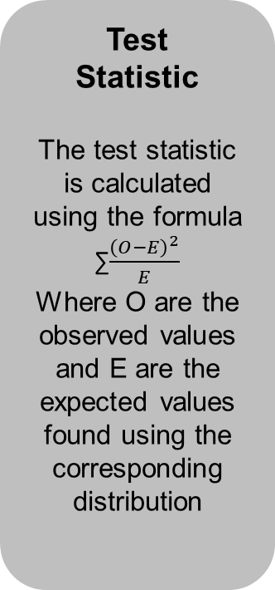
Goodness of fit
RETURN
Critical Region
Test
Statistic
Critical Region
The critical value is found from the χ² tables
The critical region is anything above this critical value
Test
Statistic
The test statistic is calculated using the formula
∑$\frac{{\left(O−E\right)}^{2}}{E}$
Where O are the observed values and E are the expected values found using the corresponding distribution
Compare and Conclude
Hypotheses
H0: The _______ distribution is a suitable model for the data
H1: The _______ distribution is NOT a suitable model for the data
Tailed
Always upper one tailed
Significance level
5% significance level unless otherwise stated in the question
Compare and Conclude
If the test statistic is below the critical value (in the belly) then we accept H0
If the test statistic is above the critical value (in the tail) then we reject H0
Hypotheses
Tailed
Significance Level

Slide 3
Testing for the PMCC
RETURN
Critical Region
The positive critical value is found from the Critical Values of the Product Moment Correlation Coefficient tables
The critical region is anything above this critical value
For a negative correlation we use the negative of the critical value and the critical region is anything below this critical value
Test
Statistic
The test statistic is calculated value for the PMCC
Critical Region
Tailed
Test
Statistic
Compare and Conclude
Hypotheses
H0: ρ = 0
H1: ρ ≠ 0
ρ > 0
ρ < 0
Tailed
Dependant on H1
ρ ≠ 0 is 2 tailed
ρ > 0 is 1 tailed
ρ < 0 is 1 tailed
Significance level
5% significance level unless otherwise stated in the question
Compare and Conclude
For a positive correlation, if the test statistic is above the critical value we reject H0
For a negative correlation, if the test statistic is below the critical value we reject H0
Hypotheses
Significance Level

Slide 4
ANOVA
RETURN
Hypotheses
Test
Statistic
Critical Region
Compare and Conclude
Hypotheses
H0: µ = µ _{ij}
H1: at least two of the means differ
Tailed
Always upper one tailed
Significance level
5% significance level unless otherwise stated in the question
Test
Statistic
The test statistic is calculated using the ANOVA table
One Factor ANOVA
Two Factor ANOVA
Critical Region
The critical value is found from the F tables
The critical region is anything above this critical value
Compare and Conclude
If the test statistic is below the critical value (in the belly) then we accept H0
If the test statistic is above the critical value (in the tail) then we reject H0
Tailed
Significance Level

Slide 5








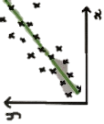

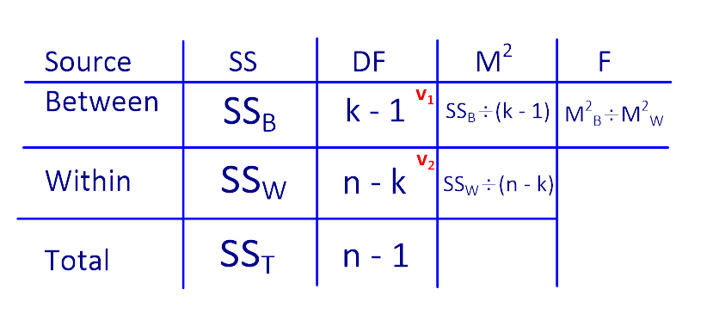
RETURN

Slide 6
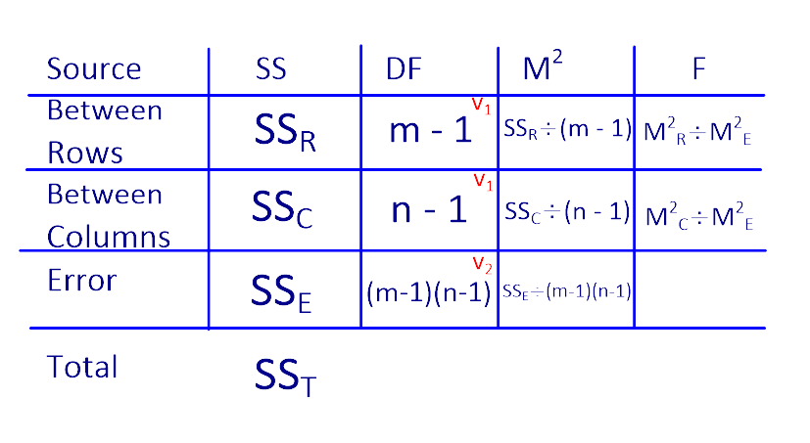
RETURN

Slide 7
Testing for the SRCC
RETURN
Tailed
Compare and Conclude
Hypotheses
H0: variables x and y are independent (no association)
H1: variables x and y are NOT independent (an association / positive association / negative association)
Tailed
Dependant on H1
No association is 2 tailed
Positive association is 1 tailed
Negative association is 1 tailed
Significance level
5% significance level unless otherwise stated in the question
Test
Statistic
Critical Region
Compare and Conclude
For a positive correlation, if the test statistic is above the critical value we reject H0
For a negative correlation, if the test statistic is below the critical value we reject H0
Hypotheses
Significance Level
Test
Statistic
The test statistic is calculated value for the SRCC
Critical Region
The positive critical value is found from the Critical Values of the Spearmans Rank Correlation Coefficient tables
The critical region is anything above this critical value
For a negative correlation we use the negative of the critical value and the critical region is anything below this critical value

Slide 8
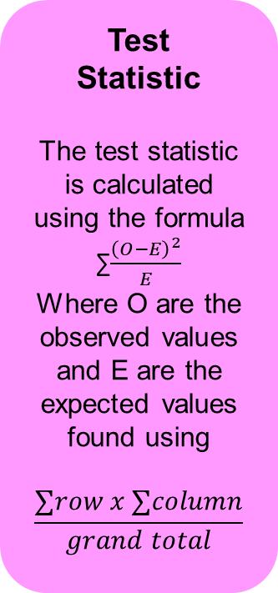
Chi Squared Test
RETURN
Test
Statistic
Critical Region
Test
Statistic
The test statistic is calculated using the formula
∑$\frac{{\left(O−E\right)}^{2}}{E}$
Where O are the observed values and E are the expected values found using
$$\frac{∑row x ∑column}{grand total}$$
Critical Region
The critical value is found from the χ² tables
The critical region is anything above this critical value
Compare and Conclude
Hypotheses
H0: variables x and y are independent
H1: variables x and y are NOT independent
Tailed
Always upper one tailed
Significance level
5% significance level unless otherwise stated in the question
Compare and Conclude
If the test statistic is below the critical value (in the belly) then we accept H0
If the test statistic is above the critical value (in the tail) then we reject H0
Hypotheses
Tailed
Significance Level

Slide 9
One Sample Sign Test
RETURN
Critical Region
Hypotheses
Tailed
Test
Statistic
Critical Region
If H0 is true then P(η > value) = P(η < value) = 0.5
Hence we can use B( n , 0.5 )
The critical region is anything ≤ X where P(X) ≤ α
Compare and Conclude
Hypotheses
H0: η = value
H1: η ≠ value
OR
η > value
OR
η < value
Tailed
H1: η ≠ value
2 tailed
H1: η > value
OR
H1: η < value
1 tailed
Significance level
5% significance level ( α )
unless otherwise stated in the question
Compare and Conclude
If the test statistic is below the critical value then we accept H0
If the test statistic is above the critical value then we reject H0
Significance Level
Test
Statistic
Calculate the difference between each data value and the value in H0
Assign a + or – sign to each value
Count the number of + and – signs
The Test Statistic is the number of + signs for a > H1 and the number of – signs for a < H1

Slide 10
One Sample Wilcoxon Test
RETURN
Test
Statistic
Critical Region
Hypotheses
H0: η = value
H1: η ≠ value
OR
η > value
OR
η < value
Tailed
H1: η ≠ value
2 tailed
H1: η > value
OR
H1: η < value
1 tailed
Significance level
5% significance level ( α )
unless otherwise stated in the question
Test
Statistic
Calculate the difference between each data value and the value in H0 (sign is important)
Rank the differences from closest to furthest from 0
Add up the Positive and negative ranks (T⁺ and T⁻)
The Test Statistic is the smallest rank total
Compare and Conclude
If the test statistic is below the critical value then we accept H0
If the test statistic is above the critical value then we reject H0
Hypotheses
Tailed
Significance Level
Critical Region
Table 10 in the formula booklet
You need to know the tail, n and α
The critical region is anything ≤ X
Compare and Conclude

Slide 11
Paired Sample Sign Test
RETURN
Hypotheses
Tailed
Significance Level
Test
Statistic
Compare and Conclude
Hypotheses
H0: η_{d} = 0
H1: η_{d} ≠ 0
OR
η_{d} > 0
OR
η_{d} < 0
Tailed
H1: η_{d} ≠ 0
2 tailed
H1: η_{d} > 0
OR
H1: η_{d} < 0
1 tailed
Significance level
5% significance level ( α )
unless otherwise stated in the question
Test
Statistic
Calculate the difference between each pair of data(the order of subtraction is important using H1)
Assign a + or – sign to each difference
Count the number of + and – signs
The Test Statistic is the number of + signs for a > H1 and the number of – signs for a < H1
Critical Region
Compare and Conclude
If the test statistic is below the critical value (in the belly) then we accept H0
If the test statistic is above the critical value (in the tail) then we reject H0
Critical Region
If H0 is true then P(η > value) = P(η < value) = 0.5
Hence we can use B( n , 0.5 )
The critical region is anything ≤ X where P(X) ≤ α

Slide 12
Paired Wilcoxon Signed Rank Test
RETURN
Hypotheses
Tailed
Test
Statistic
Critical Region
Compare and Conclude
Hypotheses
H0: η_{d} = 0
H1: η_{d} ≠ 0
OR
η_{d} > 0
OR
η_{d} < 0
Tailed
H1: η_{d} ≠ 0
2 tailed
H1: η_{d} > 0
OR
H1: η_{d} < 0
1 tailed
Significance Level
Critical Region
Table 10 in the formula booklet
You need to know the tail, n and α
The critical region is anything ≤ X
Compare and Conclude
If the test statistic is below the critical value then we accept H0
If the test statistic is above the critical value then we reject H0
Significance level
5% significance level ( α )
unless otherwise stated in the question
Test
Statistic
Calculate the difference between each pair of data (the order of subtraction depends on H1)
Rank the differences from closest to furthest from 0
Add up the Positive and negative ranks (T⁺ and T⁻)
The Test Statistic is the smallest rank total

Slide 13
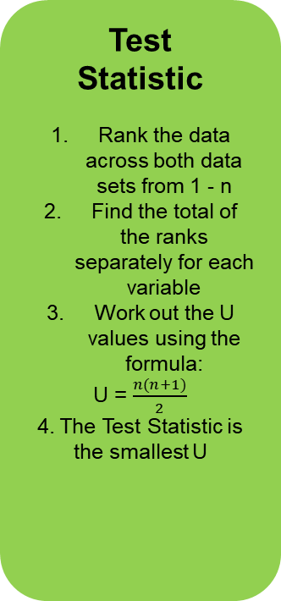
Wilcoxon Rank Sum Test
(Mann-Whitney U)
RETURN
Critical Region
Table 11 in the formula booklet
You need to know the tail, n, m and α
The critical region is anything ≤ X
Test
Statistic
Critical Region
Hypotheses
H0: η_{A} = η_{B}
H1: η_{A} ≠ η_{B}
OR
η_{A} > η_{B}
OR
η_{A} < η_{B}
Tailed
H1: η_{A} ≠ η_{B}
2 tailed
H1: η_{A} > η_{B}
OR
H1: η_{A} < η_{B}
1 tailed
Significance level
5% significance level ( α )
unless otherwise stated in the question
Test
Statistic
Rank the data across both data sets from 1 - n
Find the total of the ranks separately for each variable
Work out the U values using the formula:
U = $\frac{n(n+1)}{2}$
4. The Test Statistic is the smallest U
Compare and Conclude
If the test statistic is below the critical value then we accept H0
If the test statistic is above the critical value then we reject H0
Hypotheses
Tailed
Significance Level
Compare and Conclude

Slide 14
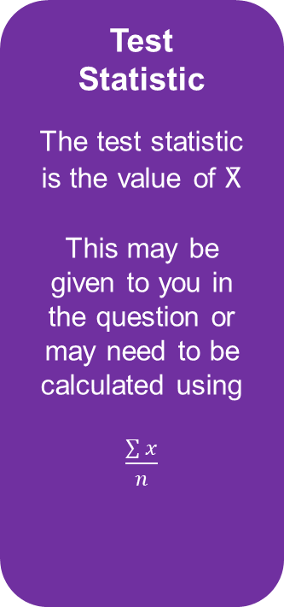
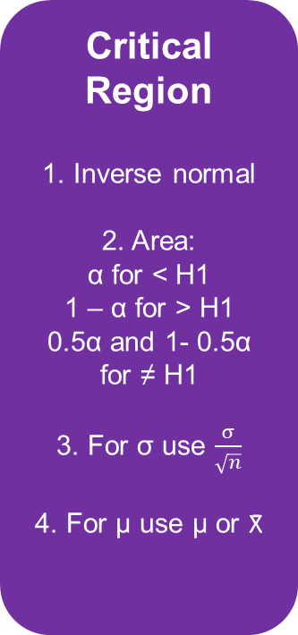
Hypothesis Test for the Mean (z)
RETURN
RETURN
Critical Region
1. Inverse normal
2. Area:
α for < H1
1 – α for > H1
0.5α and 1- 0.5α for ≠ H1
3. For σ use $\frac{σ}{\sqrt{n}}$
4. For μ use μ or X̄
Test
Statistic
The test statistic is the value of X̄
This may be given to you in the question or may need to be calculated using
$\frac{\sum{x}}{n}$
Critical Region
Test
Statistic
Compare and Conclude
Hypotheses
H0: μ = value
H1: μ ≠ value
OR
μ > value
OR
μ < value
Tailed
H1: μ ≠ value
2 tailed
H1: μ > value
OR
H1: μ < value
1 tailed
Significance level
5% significance level ( α )
unless otherwise stated in the question
Compare and Conclude
If the test statistic is below the lower critical value (in the tail)
or above the upper critical value (in the tail) then we reject H0
If the test statistic is between the critical values (in the belly) then we accept H0
Hypotheses
Tailed
Significance Level

Slide 15
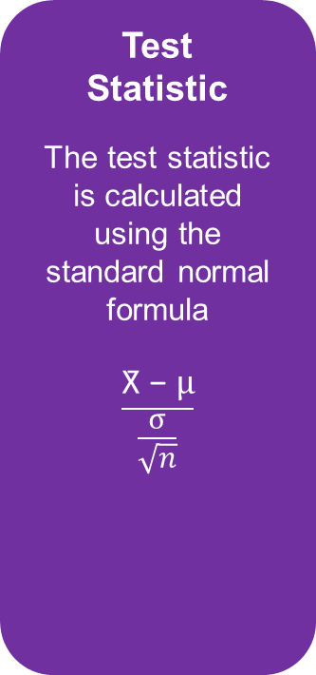
Hypothesis Test for the Mean (t)
RETURN
RETURN
Hypotheses
Tailed
Significance Level
Test
Statistic
Critical Region
Compare and Conclude
Hypotheses
H0: μ = value
H1: μ ≠ value
OR
μ > value
OR
μ < value
Tailed
H1: μ ≠ value
2 tailed
H1: μ > value
OR
H1: μ < value
1 tailed
Significance level
5% significance level ( α )
unless otherwise stated in the question
Test
Statistic
The test statistic is calculated using the standard normal formula
$$\frac{\text{X}\text{̄ }\text{− }μ}{\frac{σ}{\sqrt{n}}}$$
Critical Region
Table 5 in the formula booklet
You will need
v = n – 1
and
p = 1 – α
The critical region is anything ≤ x
Compare and Conclude
If the test statistic is below the lower critical value (in the tail)
or above the upper critical value (in the tail) then we reject H0
If the test statistic is between the critical values (in the belly) then we accept H0

Slide 16

Hypothesis Test for 2 population Means (z)
RETURN
RETURN
Critical Region
Test
Statistic
Critical Region
Table 4 in the formula booklet
You will need α for a < H1
You will need 1 – α for a > H1
You will need 0.5α and 1-0.5α for a ≠ H1
Hypotheses
Tailed
Significance Level
Test
Statistic
$$\frac{\overline{(X} − \overline{Y}) −(μ_{X}− μ_{Y}) }{\sqrt{\frac{{σx}^{2}}{nx}+ \frac{{σy}^{2}}{ny}}}$$
This can be found in the formula booklet on page 6
Compare and Conclude
Hypotheses
H0: μ_{A} = μ_{B}
H1: μ_{A} ≠ μ_{B}
OR
μ_{A} > μ_{B}
OR
μ_{A} < μ_{B}
Tailed
H1: μ_{A} ≠ μ_{B}
2 tailed
H1: μ_{A} > μ_{B}
OR
H1: μ_{A} < μ_{B}
1 tailed
Significance level
5% significance level ( α )
unless otherwise stated in the question
Compare and Conclude
If the test statistic is below the lower critical value (in the tail)
or above the upper critical value (in the tail) then we reject H0
If the test statistic is between the critical values (in the belly) then we accept H0

Slide 17

Hypothesis Test for 2 population Means (t)
RETURN
RETURN
Test
Statistic
Critical Region
Hypotheses
Tailed
Significance Level
Test
Statistic
$$\frac{\overline{(X} − \overline{Y}) −(μ_{X}− μ_{Y}) }{\sqrt{{Sp}^{2}\left(\frac{1}{nx}+ \frac{1}{ny}\right)}}$$
$${Sp}^{2}= \frac{\left(n_{x} −1\right){sx}^{2}+\left(n_{y} −1\right){sy}^{2}}{nx+ny −2}$$
These can be found in the formula booklet on page 6
Critical Region
Table 5 in the formula booklet
You will need
v = n – 1
and
p = 1 – α
The critical region is anything ≤ x
Compare and Conclude
Hypotheses
H0: μ_{A} = μ_{B}
H1: μ_{A} ≠ μ_{B}
OR
μ_{A} > μ_{B}
OR
μ_{A} < μ_{B}
Tailed
H1: μ_{A} ≠ μ_{B}
2 tailed
H1: μ_{A} > μ_{B}
OR
H1: μ_{A} < μ_{B}
1 tailed
Significance level
5% significance level ( α )
unless otherwise stated in the question
Compare and Conclude
If the test statistic is below the lower critical value (in the tail)
or above the upper critical value (in the tail) then we reject H0
If the test statistic is between the critical values (in the belly) then we accept H0

Slide 18
Paired t Test
RETURN
RETURN
Test
Statistic
Hypotheses
Tailed
Significance Level
Test
Statistic
What goes here?
Critical Region
Compare and Conclude
Hypotheses
H0: μ_{d} = 0
H1: μ_{d} ≠ 0
OR
μ_{d} > 0
OR
μ_{d} < 0
Tailed
H1: μ_{d} ≠ 0
2 tailed
H1: μ_{d} > 0
OR
H1: μ_{d} < 0
1 tailed
Significance level
5% significance level ( α )
unless otherwise stated in the question
Critical Region
Table 5 in the formula booklet
You will need
v = n – 1
and
p = 1 – α
The critical region is anything ≤ x
Compare and Conclude
If the test statistic is below the lower critical value (in the tail)
or above the upper critical value (in the tail) then we reject H0
If the test statistic is between the critical values (in the belly) then we accept H0

Slide 19
Hypothesis Test for Proportion
RETURN
RETURN
Test
Statistic
Critical Region
Hypotheses
Tailed
Significance Level
Test
Statistic
What goes here?
Critical Region
Table 5 in the formula booklet
You will need
v = n – 1
and
p = 1 – α
The critical region is anything ≤ x
Compare and Conclude
Hypotheses
H0: μ_{d} = 0
H1: μ_{d} ≠ 0
OR
μ_{d} > 0
OR
μ_{d} < 0
Tailed
H1: μ_{d} ≠ 0
2 tailed
H1: μ_{d} > 0
OR
H1: μ_{d} < 0
1 tailed
Significance level
5% significance level ( α )
unless otherwise stated in the question
Compare and Conclude
If the test statistic is below the lower critical value (in the tail)
or above the upper critical value (in the tail) then we reject H0
If the test statistic is between the critical values (in the belly) then we accept H0

Slide 20
Hypothesis Test for two Population Proportions
RETURN
RETURN
Test
Statistic
Critical Region
Hypotheses
Tailed
Significance Level
Test
Statistic
What goes here?
Critical Region
Table 5 in the formula booklet
You will need
v = n – 1
and
p = 1 – α
The critical region is anything ≤ x
Compare and Conclude
Hypotheses
H0: μ_{d} = 0
H1: μ_{d} ≠ 0
OR
μ_{d} > 0
OR
μ_{d} < 0
Tailed
H1: μ_{d} ≠ 0
2 tailed
H1: μ_{d} > 0
OR
H1: μ_{d} < 0
1 tailed
Significance level
5% significance level ( α )
unless otherwise stated in the question
Compare and Conclude
If the test statistic is below the lower critical value (in the tail)
or above the upper critical value (in the tail) then we reject H0
If the test statistic is between the critical values (in the belly) then we accept H0

